Slide 1
Introduction to Linux
David E. Douglas
University Professor—Information Systems
Walton College of Business
ddouglas@walton.uark.edu

Slide 2
Reading assignments
Mainframe SOA
Cloud, SOA, Integration
Sanity Check, Take Heart, Tainted Ones
Carico—most cost effective platform
Ageless Mainframes Support Multiple Antares Missions
Insurance, CICS/DB2, mainframe hosting
Examining the Usefulness of zIIP and zAAP
z Integrated Information Processor
z Application Assist Processor

Slide 3
Linux and Open Source
Linux-Who & When
Linus Torvalds, graduate Student; Helsinki, Finland
Free Software Foundation- Who, What, When
Larry Stallman, 1985, source code free
Open Source Initiative-Who, What, When
Jon Hall and others, 1998; used Open instead of Free
GNU General Public License
copyleft—requires derived works to be open
Linus Torvalds used this License for Linux

Slide 4
Using LINUX: A Beginner’s Guide
By David Douglas and Peggy L. Lane

Slide 5
What does an
Operating System do?

Slide 6
The major operating system services provide mechanisms for…
Execution of a program,
Input and output operations performed by programs,
Communication between processes,
Error detection and reporting, and
Manipulation of all types of files.

Slide 7
Features of the Linux OS
Multiuser capability
Portability
Multitasking
Ability to use multiple processors
Multiple modes of operation

Slide 8
Multiuser Capability
Linux handles multiple requests by a number of users.
Many companies run Linux as their main OS for their business for this reason.

Slide 9
Portability
Portability means Linux can run on numerous hardware systems.
Can run on either CISC or RISC processors:
CISC – Complex instruction set computer
RISC – Reduced instruction set computer (reduced number of instructions because the hardware performs tasks not in the instruction set)

Slide 10
Multitasking
When an OS handles multiple jobs at seemingly the same time.
Linux uses preemptive multitasking
The OS has the ability to take control of the system from an application
Other method is cooperative multitasking – the application takes control of the system resource.
Which one can crash the whole system if the application crashes???

Slide 11
Ability to Use Multiple Processors
Linux can accommodate up to 32 processors.
Also uses multithreading
Allows for a program to be split across several processors
with each processor working on a different piece of the program at the same time.

Slide 12
Multiple Modes of Operation
Graphical User Interface (GUI)
Text – commands are used to navigate the Linux system and write shell scripts.
Access text mode in the Linux OS via a shell (must follow its syntax or rules):
sh: the original shell(Bourne Shell by Steven Bourne)
bash: default shell (usually) ba = Bourne again shell
csh: C-shell that uses a C-like syntax.
ksh: Publicly licensed Korn shell by David Korn.

Slide 13
Layered View
Users
AUI – Application user’s interface
(LINUX shell, commands, and application programs)
API – Application Programmer’s Interface
language libraries and system call interface
Operating system kernel – core of the OS
Computer hardware

Slide 14
October, 1991
Posted on a newsgroup:
“I’m doing a (free) operating system (just a hobby, won’t be big and professional like GNU) for 386 (486) clones.”
Linus Torvalds, 21 year old student at the University of Helsinki, Finland

Slide 15
A few things to remember
LINUX was designed to be a command line user interface.
Everything in LINUX is a file.
Even devices (hard drives, floppy drives, etc.)
LINUX is case sensitive.
The file name “resume” is NOT the same file name as “Resume” or “RESUME”.
Linux commands are all lower case and environment variables are all upper case

Slide 16
LINUX System File Structure
Root directory (/)
At the top of the file system hierarchy.
Denoted by /
Can be thought of as the master cabinet that contains all drawers - folders, and files.

Slide 17
LINUX System File Structure
/bin (binary)
contains executables for every user
/boot
contains the kernel image, system map, bootstrap, etc.
/dev
contains special files that represent hardware devices
/etc
contains configuration files
/home
contains users’ home directories

Slide 18
LINUX System File Structure
/lib
contains libraries
/media
/mnt
contains mount points for other file systems
/opt
used to install add-on software packages
/proc
virtual file system (in memory) contains kernel & process info
/root
home directory for root user.
Protected from normal users.
/sbin
contains system admin executables (super user bin)

Slide 19
LINUX System File Structure
/srv
Services
/subdomain
/sys
/tmp
temporary storage space
/usr
UNIX System Resources - contains all nonessential programs and libraries, which can be either NFS mount or read only.
Contains numerous subdirectories. One of which is bin.
/var
contains log & spool files, temp storage space (other than /tmp)

Slide 20
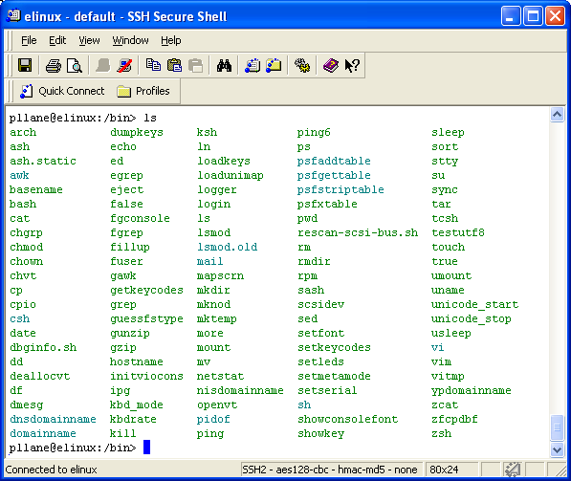
The /bin folder

Slide 21
/bin
Contains general-purpose commands such as:
cat – concatenates or displays files
chmod – changes security mode of a file or directory
date – displays the system date.
echo – displays a message
kill – ends a process
mail – read mail or send mail to users
more – browse or page through a text file one page at a time (use spacebar to advance by page)
ps – shows processes on a system

Slide 22
/bin
mkdir – create one or more directories under a parent directory.
cp – copies files from one directory to another
mv – moves files from one directory to another
pwd – displays your current path
ls – List contents of a directory.
-l option lists file in long format
-r option lists in reverse alphabetical order.
rm – removes a file
-r option deletes a specified directory and its contents.
rmdir – removes a directory (must be empty)

Slide 23
What is my “default” directory?
/home/userid
All of your files should be placed in or under this directory.
Looks like this: userid@elinux:~>
To get to your “home” no matter where you are, type:
cd ~ (and press the enter key) – be sure to leave a space between cd and ~!

Slide 24
A detailed Command Reference Guide
http://www.perpetualpc.net/srtd_commands_rev.html

Slide 25
Other Commands
cal – displays calendar
passwd – allows you to change your password.
cd .. – goes “up” a level in the structure
cd / - goes to the root directory (if access is granted)
echo $HOME – displays your home directory
tree – lists the structure (folders and files)

Slide 26
Editors
There are many editors for the Linux environment—some are listed below
vi (visual editor) is the most popular editor
emacs
pico
joe
jpico; the simple editor used for this class

Slide 27
Tree Command
pllane@elinux:~> tree
.
|-- china
| |-- clothing
| | |-- clothing
| | `-- clothinginIndia
| |-- food
| | `-- foodinIndia
| `-- sports
| `-- sportsinChina
`-- india
|-- food
| `-- foodinIndia
`-- sports
7 directories, 5 files
pllane@elinux:~>

