Slide 1
Web pages in Linux
David Douglas
Sam M. Walton College of Business, University of Arkansas

Slide 2
HTML Basics
<html>
<head>
<title>this appears on the browser title bar</title>
</head>
….other relevant header information goes here…
<body>
… the main part of the Web page goes here …
</body>
</html>

Slide 3
HTML Tags
Character Level
Italic, bold, big, small, etc.
Block Level
A for Anchor tags
DIV for division or section
Table Level
Table, head, row, data

Slide 4
Where to create web pages in Linux?
public_html directory

Slide 5
Simple Web Page jpico HTML1.htm
<html>
<head>
<title>Example HTML Document</title>
</head>

Slide 6
<body>
<h1>Level-1 Heading</h1>
<p>The elements of an HTML document and the resulting Web page are the same as those found in any written document. For example, a paragraph like this one is a common design element.
</p>

Slide 7
<h2>Level-2 heading</h2>
<p>There are ordered lists: </p>
<ol>
<li>This </li>
<li>That </li>
<li>Another thing </li>
</ol>

Slide 8
<h3>Level-3 heading</h3>
<p>There are unordered (bulleted) lists:</p>
<ul>
<li>This </li>
<li>That </li>
<li>Another thing </li>
</ul>
</body>
</html

Slide 9
How to view the web page
Save the web page
Open Internet Explorer
Type:
http://130.184.26.149:1080/~uoas3xx/HTML1.htm
Note: uoas3xx is your account id
To view the code in Internet Explorer, click on View; Source

Slide 10
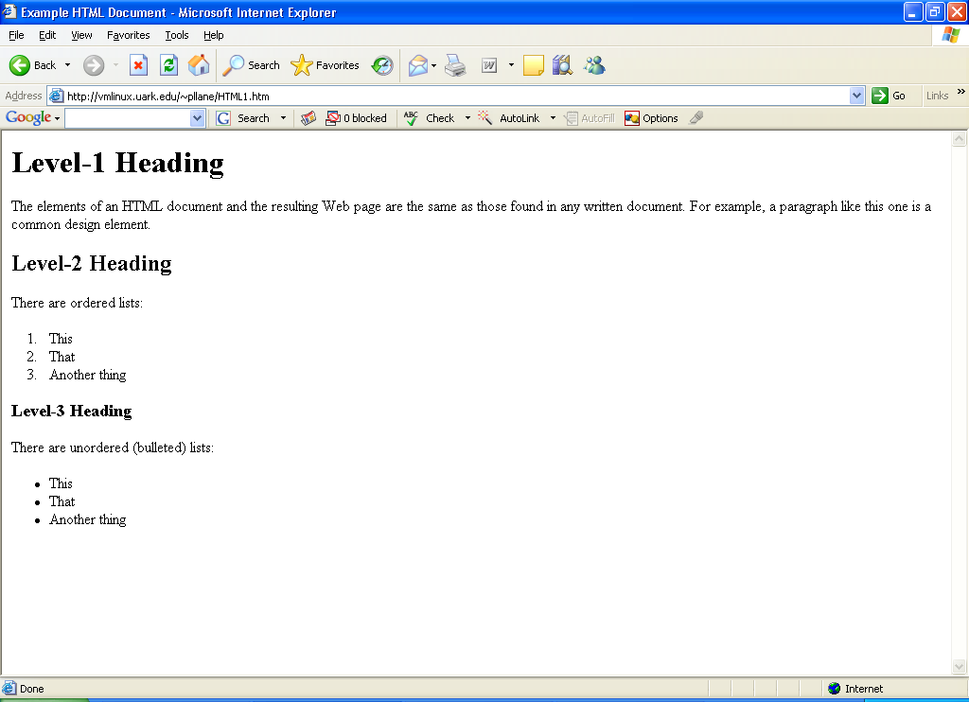
HTML1.htm

Slide 11
HTML2.htm
View HTML2.htm
Why is the text in red?
Why is the heading centered?
Why is there a line under the heading?
Why is the text centered?
What does <BR> do?
Why is there a line at the end?

Slide 12
HTML3.htm Intra-page linking
<a href="#MB">Margaret E. Bruner</A>
<h2><a name="MB"> Margaret E. Bruner</A></H2>

Slide 13
Links
Returns the view to poetry selections(HTML3.htm)
<a href="HTML3.htm">Poetry Selections</a><br>
Allows a viewer to send an e-mail.
Please send your favorite poem and author to me at
<a href=mailto:ddouglas@walton.uark.edu>ddouglas@walton.uark.edu</a>

Slide 14
Task for you
Include a link in HTML3.htm to return to frost.htm
Be sure to refresh the web page!

Slide 15
Tables
Basic HTML tags:
TABLE
TH – header
TR – row
TD – data
Task: Add a new part of 3482-AB; 82mm Socket for 55.00 to Table1

Slide 16
Table2
Adds a discount in column 4 that spans all rows.
Uses DIV
Right aligns the list prices.

Slide 17
Table3
Uses color and fonts
<BODY BGCOLOR="#66CCFF">
BGCOLOR="#FF66FF“
Task – make the tips icon appear in the upper right hand corner of Table3.

Slide 18
Table4
Introduces formatting with style sheets

Slide 19
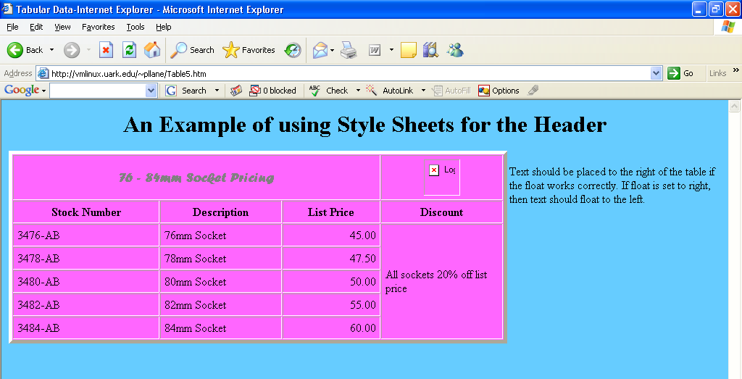
Table5
The table is floated left so that text is on the right.

Slide 20
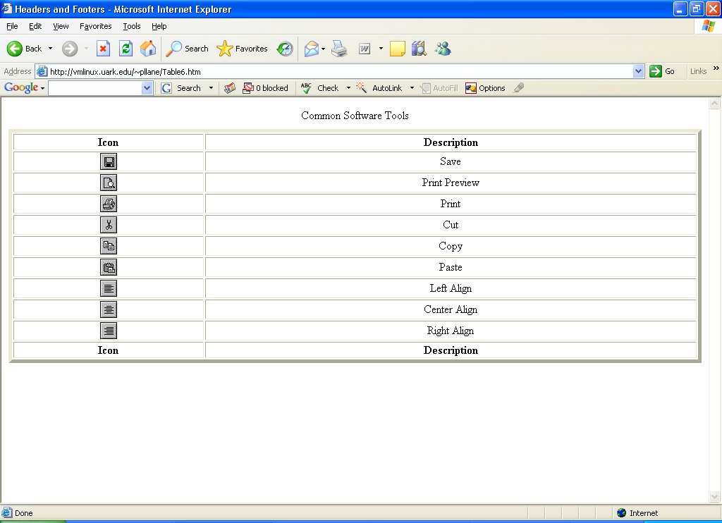
Table6 displays .jpg files

Slide 21
PHP - Introduction
PHP commands between the <?php or <? opening tag and the ?> closing tag
All statements in PHP end with ;
Type jpico helloworld.php

Slide 22
type and save and view
<html>
<head>
<title> Hello World Example </title>
</head>
<body>
<?
Echo "Hello, world!";
?>
<br>
<?
Echo "Hi Everybody!";
?>
</body>
</html>

Slide 23
Task: Add a link
copy the helloworld.php file to helloworld2.php.
To helloworld2.php, add a statement to link to poetry.htm with the link as shown below before the ending </body> line.

