Slide 1
Microsoft Enterprise Consortium
Data Mining in SQL Server 2008
Hosted by the University of Arkansas

Slide 2
What is Data Mining?
Knowledge Discovery
A part of the umbrella of tasks, tools, techniques etc. within business Intelligence (BI)
It involves using large datasets to discover previously unknown knowledge and patterns.
This knowledge discovered is not trivial and can be usefully applied.
Hosted by the University of Arkansas

Slide 3
Data Mining Tasks
Description
Estimation
Classification
Prediction
Association Analysis
Clustering
Hosted by the University of Arkansas

Slide 4
Description
Descriptive statistics are used to better understand and profile areas of interest.
Well known statistical tools and methods are used for this task.
Frequency charts and other graphical output, measures of central tendency and variation.
Hosted by the University of Arkansas

Slide 5
Data Mining Tasks with a Target or Dependent Variable
Estimation
Interval level dependent target variable
Example- Estimating family income based on a number of attributes.
Classification
Categorical (symbolic) target variable
Example- a model to place families into the three income brackets of Low, Medium or High
Difference lies in the data type of the target variable.
Hosted by the University of Arkansas

Slide 6
Prediction
An estimation data mining task or classification task used to predict future outcomes.
Estimation and classification- Predictive Models.
Hosted by the University of Arkansas

Slide 7
Data Mining Algorithms for Directed/Supervised Data Mining Tasks
Linear Regression
Common data mining algorithms for estimation
data mining tasks.
Data mining algorithms used for classification
tasks
Logistic regression
Decision trees
Neural networks
Memory based reasoning (k-nearest neighbor)
Naïve Bayes
Hosted by the University of Arkansas

Slide 8
Data Mining Tasks without a Target or Dependent Variable
Association Analysis
Affinity Analysis- Used for Market Basket Analysis
Clustering
Attempts to put records into groups based on the
record’s attributes.
Those within a cluster are very similar to each other
and are not similar with those in another cluster.
Note: Since these data mining tasks do not have a target variable, their corresponding models cannot be used for prediction.
Hosted by the University of Arkansas

Slide 9
Data mining overview summary
Data mining tasks | Target Variable | Typical Data Mining Algorithm(s)
Description | No | Statistics, including descriptive, & visualization
Estimation | Yes Interval Numeric | Linear Regression
Classification | Yes Categorical | Logistic Regression, Decision Trees, Neural Networks, Memory Based Reasoning, Naïve Bayes
Prediction | Yes | Estimation and Classification models for prediction
Association Analysis | No | Affinity Analysis (Market Basket Analysis)
Clustering | No | k-means, Kohonen Self Organizing Maps (SOM)
Hosted by the University of Arkansas

Slide 10
Data Mining Example using SQL 2008 BI Development Studio from REMOTE
Microsoft’s Business Intelligence Suite
Building the data warehouse
Creating and Analyzing cubes
data mining.
Classification tasks use a table of 3333 telecommunications records.
Includes Column, churn, which represents whether a customer left the telecommunications company or not.
The idea is to build and select the best model so it can be used for predictive purposes with new customers.
Hosted by the University of Arkansas

Slide 11
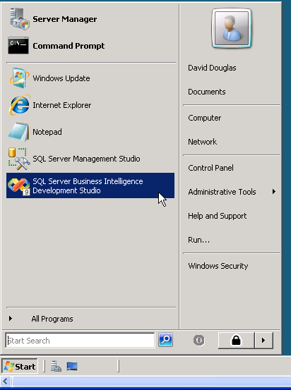
Click either the SQL Server Business Intelligence Development Studio icon the Desktop. (or) Click Start and then click SQL Server Business Intelligence Development Studio as shown.
Starting SQL Server Business Intelligence Development Studio
Hosted by the University of Arkansas

Slide 12
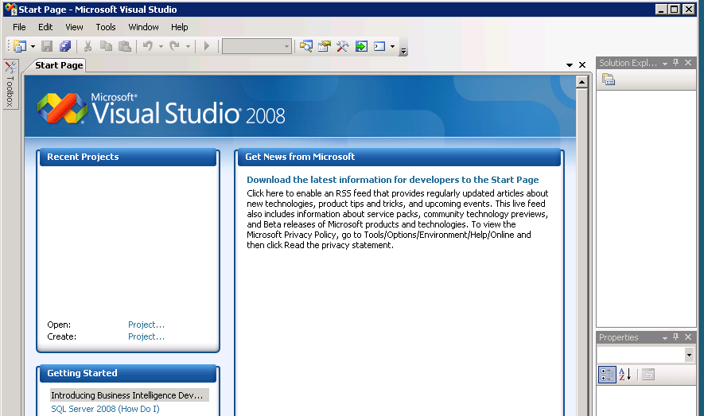
Uses Microsoft Visual Studio (VS) as the Integrated Development Environment (IDE).
The top will include the menu and tool bar with the Start Page tab active.
Along the left of the Start page are three windows: Recent Projects, if any; Getting Started and Visual Studio Headlines.
Hosted by the University of Arkansas

Slide 13
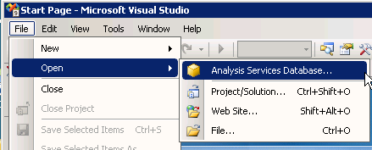
To Connect to Analysis Services Database
Used to create BI objects.
To connect to/access the database,
click File -> Open -> Analysis Services Database
Hosted by the University of Arkansas

Slide 14
The Connect To Database screen opens as shown. Enter the Server name, ENT-ASRS.waltoncollege.uark.edu and press the Enter key.
Use the drop down list box to select your database (account ID with AS attached at the end)
This is where Analysis Services will save Analysis Services objects.
Click the OK button.
Hosted by the University of Arkansas

Slide 15
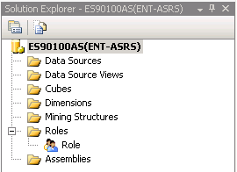
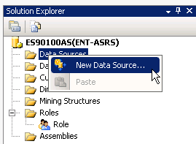
Click View on the menu and then click Solution Explorer.
The name of your project should be visible with a number of other entries as shown.
To create a data source, right-click Data Source in the Solution Explorer and click New Data Source.
Hosted by the University of Arkansas

Slide 16
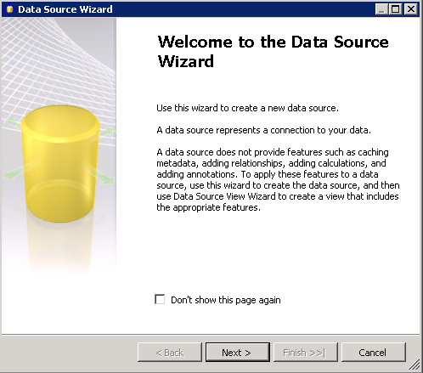
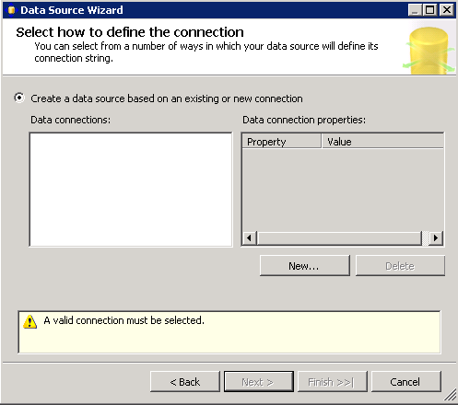
Click the New… button to create a new connection
The Data Source Wizard opens to its Welcome page. Click Next .
The Data Source Wizard then allows the creation of a connection by clicking the New button.
Hosted by the University of Arkansas

Slide 17
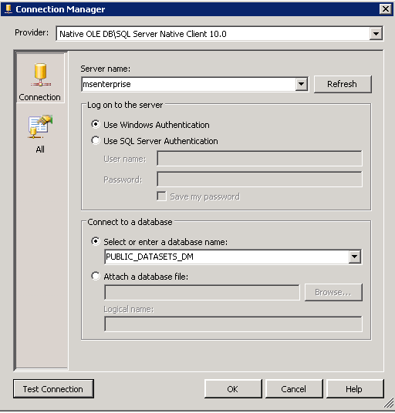
Accept the default Provider: Native OLEDB\SQL Native Client 10.0.
Enter the Server name MSENTERPRISE.
Leave the default security as Windows Authentication.
Use the drop down list box to select a database that has the table for data mining.
Click the Test Connection button to ensure a connection exists to the database. Click the OK button.
Click the drop down list box to select a database
Click to test connection
Hosted by the University of Arkansas

Slide 18
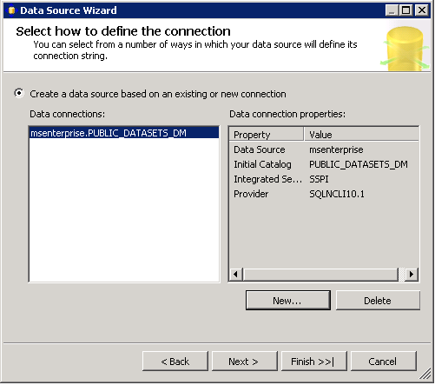
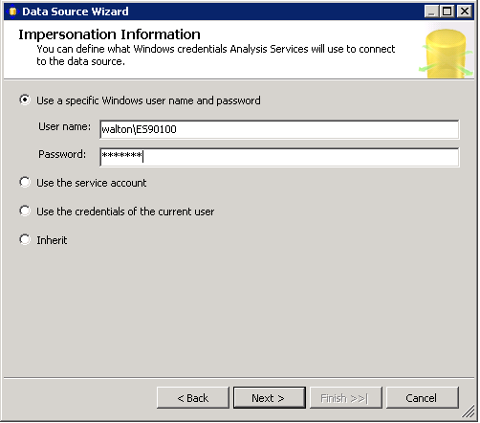
Note the Data connection properties and then click the Next button.
Select Use a specific user name and password in the Impersonation Information page.
Enter your credentials (user name and password provided to you by the University of Arkansas).
Click the Next button.
Hosted by the University of Arkansas

Slide 19
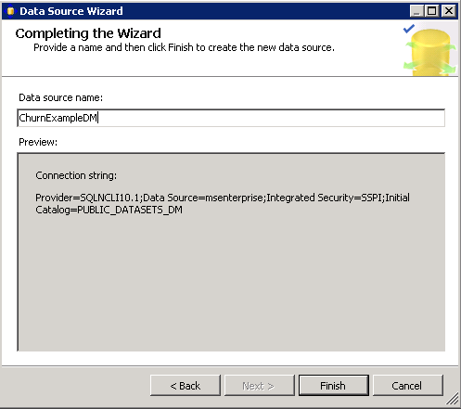
Click Finish after you provide a name to your Data Source.
Hosted by the University of Arkansas

Slide 20
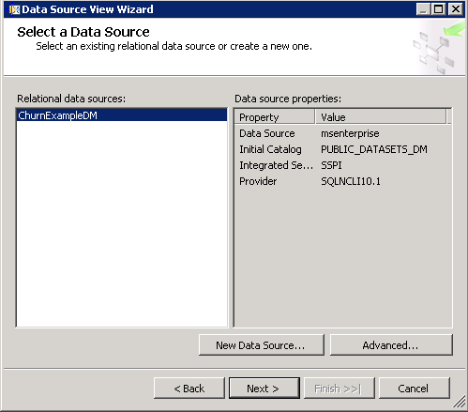
Data Source View
An abstract client view of the data that allows changes without affecting the original tables(A database view).
Right-click Data Source Views in the Solution Explorer and click New Data Source View to open the Data Source View Wizard.
Click the Next button on the Welcome page.
Hosted by the University of Arkansas

Slide 21
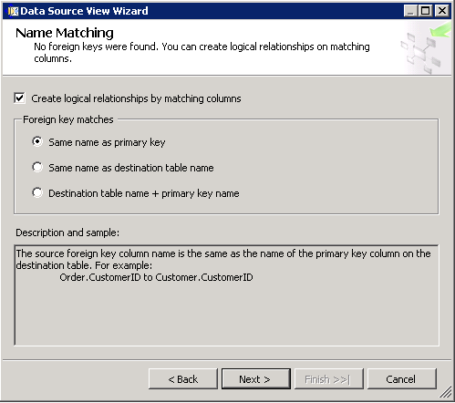
Ensure the Create logical relationships by matching columns is checked.
The Foreign key matches has the Same name as primary key selected.
Click the Next button.
Hosted by the University of Arkansas

Slide 22
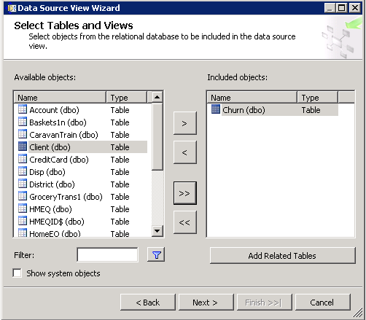
In the Available objects of the Select Tables and Views dialog, click desired data sources.
Click the > to move them to the list of Included objects.
The Churn(dbo) table is selected and moved to the Included objects list.
Click the Next button.
Hosted by the University of Arkansas

Slide 23
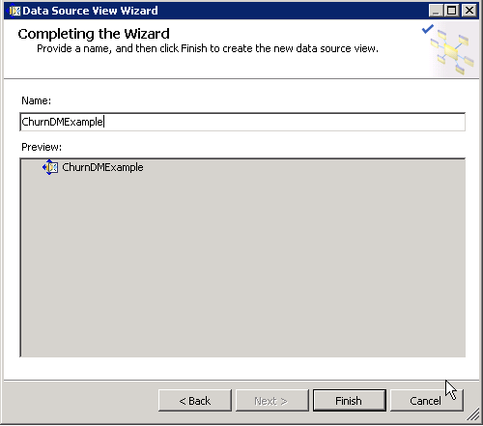
The last page of the Wizard requires a Name.
Enter ChurnExampleDM in the Data Source name (Will be used as a data source view name in this example)
Click Finish.
Hosted by the University of Arkansas

Slide 24
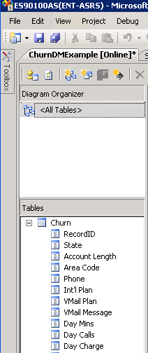
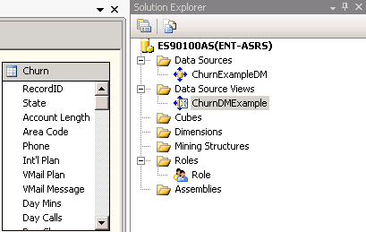
In the Solution Explorer, a data source (ChurnExampleDM) and a data source view (ChurnDMExample) are shown.
In the left edge, the Data Source View tab is highlighted and the Diagram Organizer and Tables are listed.
Hosted by the University of Arkansas

Slide 25
Data Mining Process
It consists of two parts.
Creating the mining structures.
Creating the mining models.
Data mining structure
Defines the domain of a data mining problem.
Data mining model
Involves the algorithm to run against the data.
This will use a decision tree analysis.
Hosted by the University of Arkansas

Slide 26
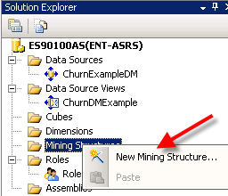
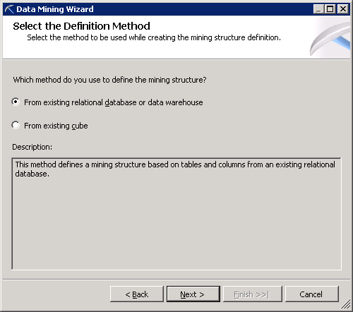
Create a Mining Structure
Right-click Mining Structures in the Solution Explorer window.
Select Create New Mining Structure to open the Data Mining Wizard.
Click the Next button on the Welcome page to get to the Select the Definition Method.
Accept the option From existing relational database or data warehouse and click the Next button.
Hosted by the University of Arkansas

Slide 27
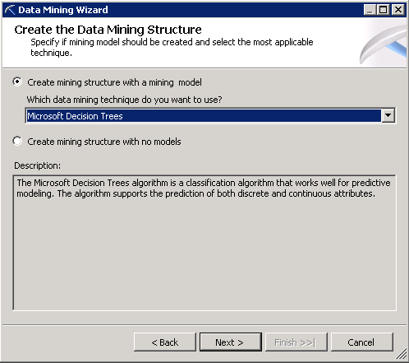
The default data
mining technique is
Microsoft Decision
Trees.
Click the Next button.
The Select Data
Source View page
displays the most
recently created
Data Source View.
Other Data Source
Views can be located
via the Browse
button.
Click the Next button.
Hosted by the University of Arkansas

Slide 28
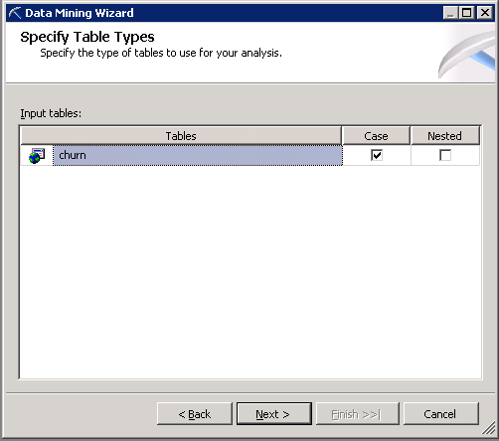
The Specify Table Types page defaults to the churn table.
Case Format
Each record represents one customer record.
Nested format
Allows directly using multiple tables in a relational database.
For this example, Case is the correct format so click the Next button.
Hosted by the University of Arkansas

Slide 29
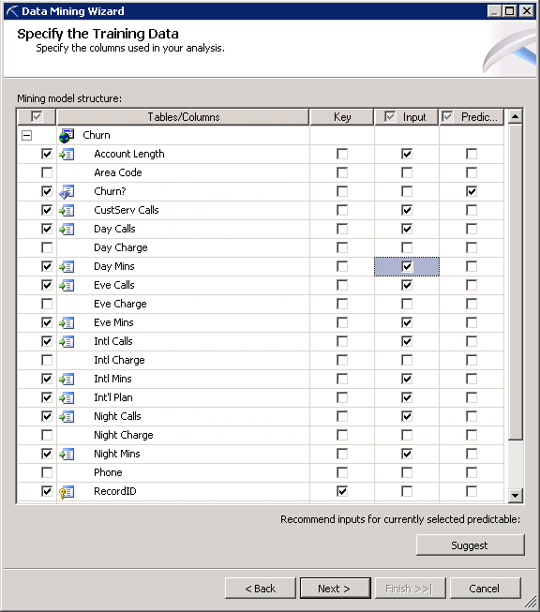
Churn? has values representing whether the customer left the company (true) or not (false).
The RecordID will be
specified as the key.
The variable Churn? is selected as a predictable variable.
The Suggest button suggests variables to be included as input variables
Click the Next button.
Note: From exploratory data analysis, it was determined that State, Area Code and Phone contained bad data. Columns related to Charge were perfectly correlated to the corresponding Mins (Minutes) column so the Charge columns will not be used in the analysis.
Hosted by the University of Arkansas

Slide 30
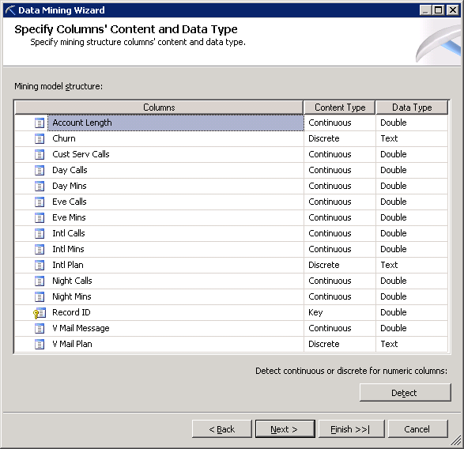
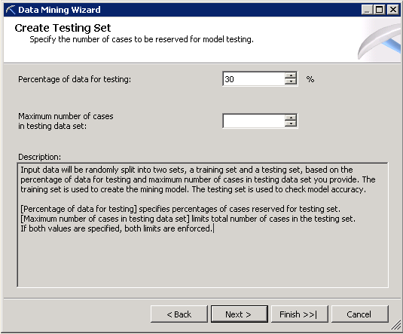
Churn? is discrete and needs a model to predict true or false.
Click the Next button to partition the data into a training set and a test set.
Test set provides information on the stability and the generalization of the model.
Accept the default 30% random test value with a training set of 70% of the records.
Hosted by the University of Arkansas
30

Slide 31
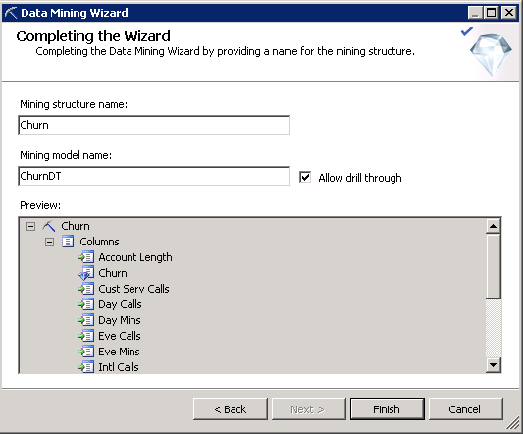
The user can provide a name for the mining structure and a name for the mining model.
In this example, Churn is used for the name of the mining structure and ChurnDT is used for this particular Decision Tree model.
Click the Finish button.
Hosted by the University of Arkansas

Slide 32
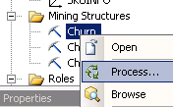
Processing the Project
From the Solution Explorer, right-click the Mining Structure entry and click Process.
To save all changes before processing, click the Yes button.
Click the Run button on the Process Mining structure.
The system confirms that Process Succeeded or lists errors if there is a problem.
Click the Close button after the Process completes, then Close to exit the Process Mining Structure dialog.
Hosted by the University of Arkansas

Slide 33
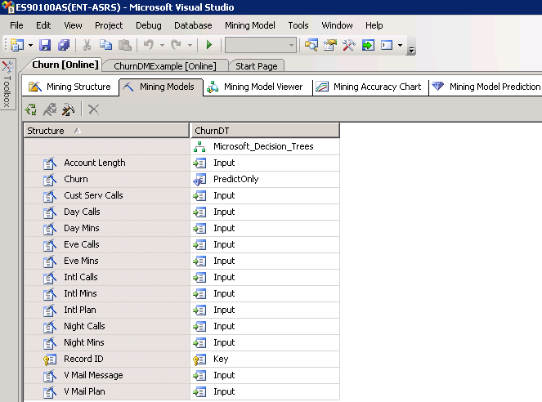
Mining Models tab provides a summary of the model. (ChurnDMExample)
The green circular icon processes one or more data mining models.
If this decision tree model has not been run, then click this icon.
Hosted by the University of Arkansas

Slide 34
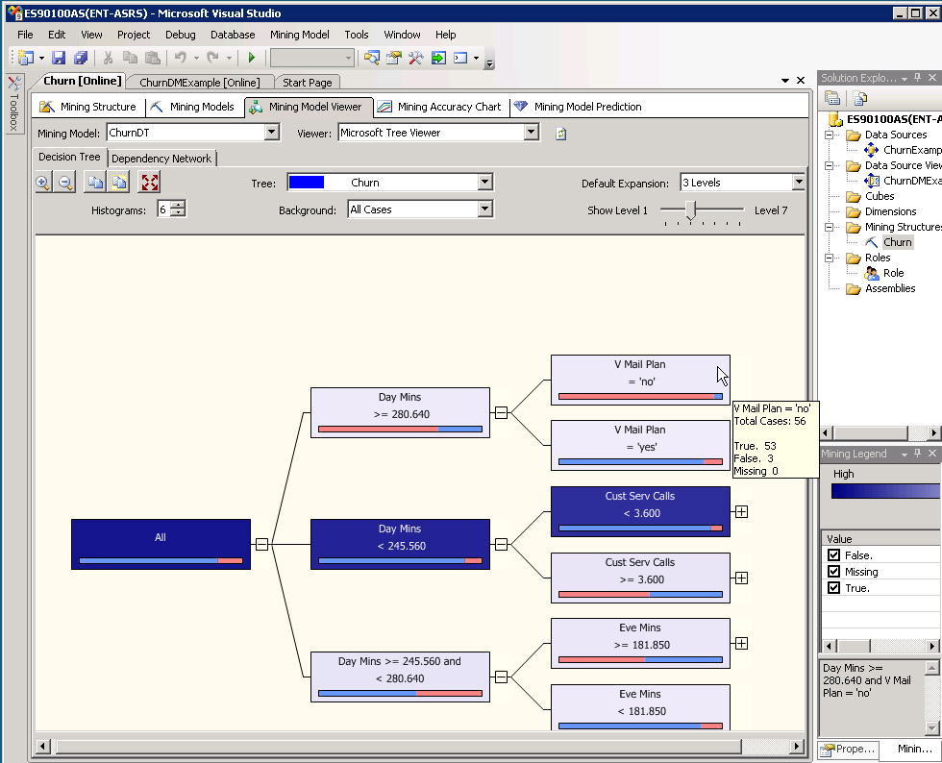
Click the Mining Model Viewer tab and Microsoft Tree Viewer from the Viewer drop down list box.
The tree viewer provides options for viewing the tree. (Default number of levels to display)
Moving the mouse over the bar on a tree node provides data about that node.
The nodes with Day Mins > than 280.64 and also have a Voice Mail Plan are highly likely to churn.
Hosted by the University of Arkansas

Slide 35
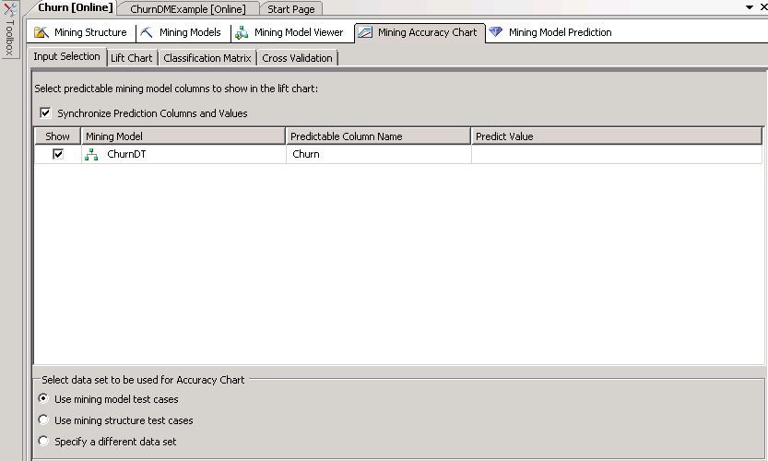
Click the Lift Chart tab and select Lift Chart from the Chart type drop down list box.
Hosted by the University of Arkansas

Slide 36
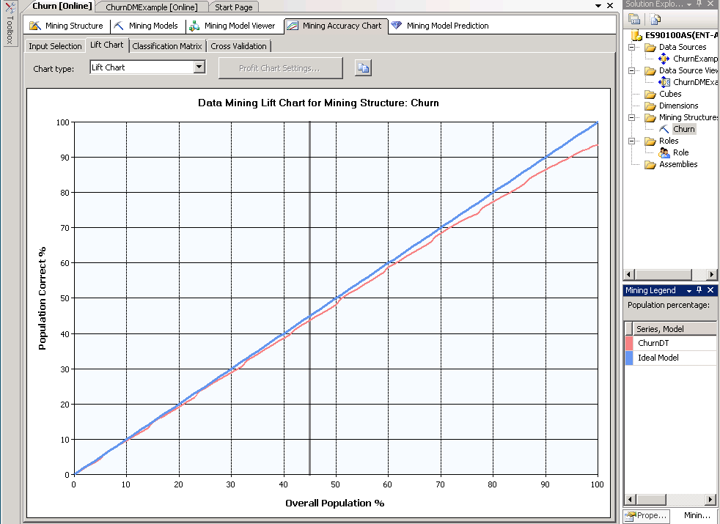
Blue diagonal line represents an ideal model.
Red line shows the results of the decision tree model.
More tradition lift chart - by selecting a Predict Value. (Mining Accuracy Tab main tab and Column Mapping sub tab)
Hosted by the University of Arkansas

Slide 37
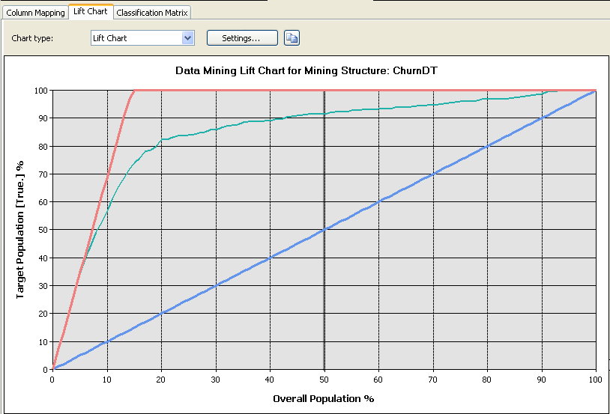
Click the Lift tab to get a lift chart based on a Predict Value of True as shown below.
The green line is an ideal model.
The red line is the decision tree.
The blue line would be the result with random guess.
Hosted by the University of Arkansas

Slide 38
Classification Matrix sub tab
To view a table of the model’s predicted values versus actual values.
Diagonal values circled in green represent where the model correctly predicted the actual values.
The off-diagonal values in red represent where the model missed predicting the actual values.
The 34 value is referred to as a False Positive.
The 30 value is referred to as a False Negative.
Hosted by the University of Arkansas

Slide 39
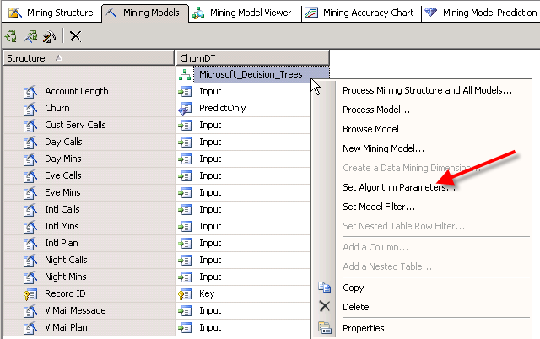
Mining Model Parameters
Data mining algorithms have parameters that can be set by the user to improve model development.
The user can change selected default parameters - by right-clicking the data mining model and selecting Set Algorithm Parameters.
Hosted by the University of Arkansas

Slide 40
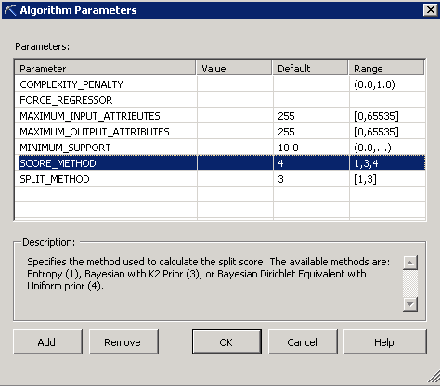
The Algorithm Parameters Window shows the parameters the user can set for decision trees.
The particular row shown indicates a Bayesian Dirichlet Equivalent with Uniform prior method as the default SCORE_METHOD.
Change the default setting to 1 to use the Entropy method.
Hosted by the University of Arkansas

Slide 41
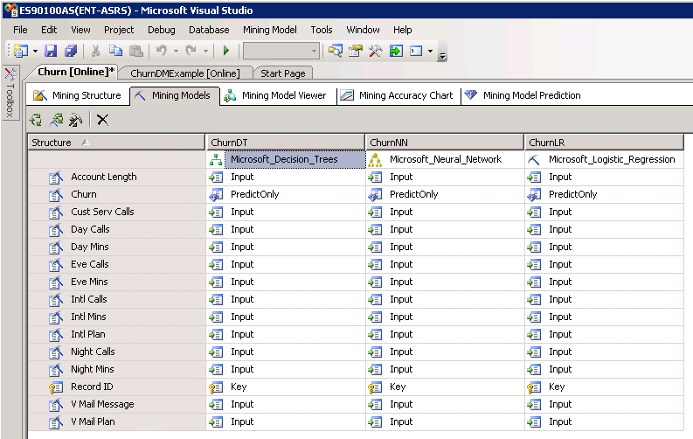
Adding Additional Supervised (Directed) Classification Models
Additional data mining algorithms for this classification task can be easily added and compared.
To add a model, click the Mining Models tab and then click the hammer/chisel icon (new model) where a name and the data mining algorithm you wish to run can be provided.
Click the green circle icon to run all the models.
Hosted by the University of Arkansas

Slide 42
A prompt will indicate that the models are out of date.
Click Yes to build and deploy the project with the new models.
Click the Run button on the next dialog.
Note: You may need to click Yes at times to keep the model up to date and deployed.
Hosted by the University of Arkansas

Slide 43
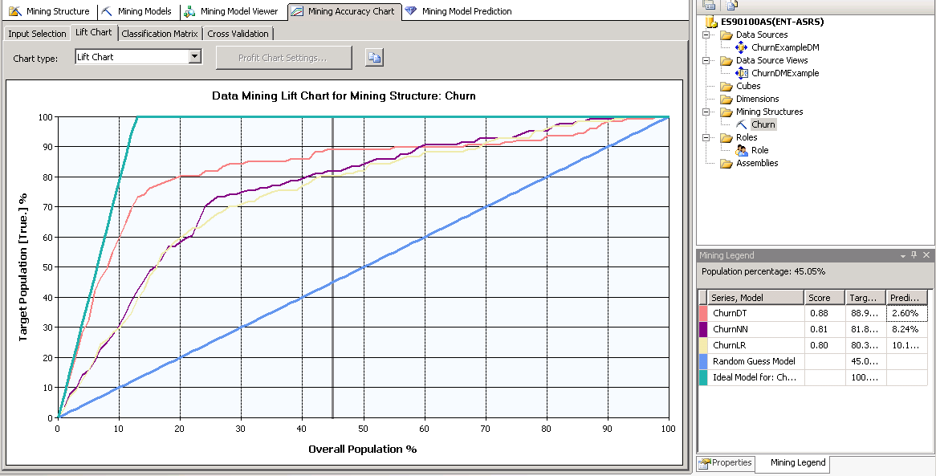
The easiest way to compare the classification models is by lift and percent accuracy.
Click the Mining Accuracy tab and note the lift chart for each model compared to an ideal model-prediction of True.
Each model has a score that represents the model’s accuracy.
Decision tree model is superior in terms of model accuracy for this data.
Hosted by the University of Arkansas

Slide 44
All three models have the Predict Value set to True.
This is enforced via checking the Synchronize Prediction Columns and Values.
Hosted by the University of Arkansas

Slide 45
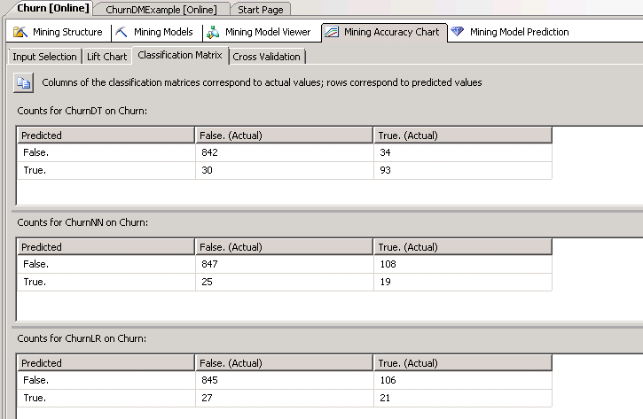
The usual resulting decisions of building these classification models is to select the best performing model.
This may be based on cost values instead of just misclassification rate.
Apply it to new data.
Hosted by the University of Arkansas

Slide 46
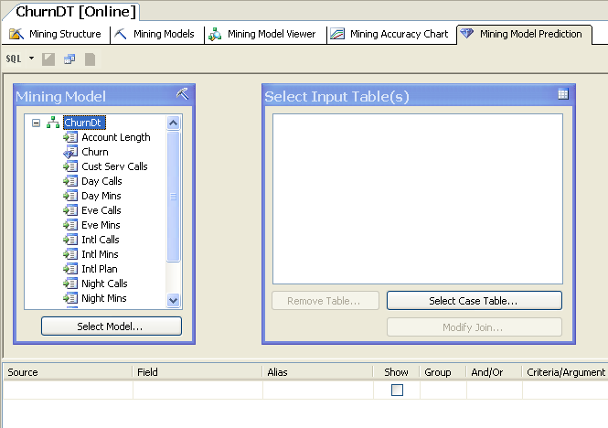
Mining Model Prediction tab
Clicking this tab opens the window as shown.
Allows the user to select a model and then the data that the model will be applied to.
Hosted by the University of Arkansas

Slide 47
Undirected (unsupervised) Data Mining
Clustering
Does not have a target variable.
The churn data has an obvious target variable churn.
Two approaches used in the data mining process.
Leave the churn variable in for clustering—lead to insights about the attributes of the cases and the variable churn.
Leave out the churn variable for clustering and then add the cluster number to each record (case) that can be used downstream for classification tasks.
Hosted by the University of Arkansas

Slide 48
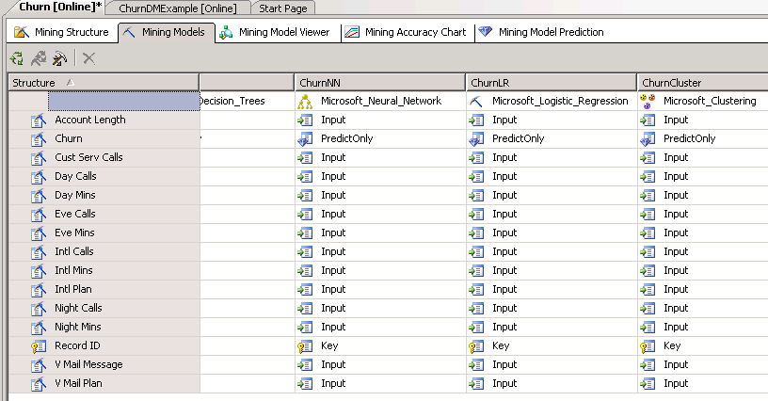
Illustration
Add a new mining model as shown below. (The churn variable is included as PredictOnly)
Can be run by leaving Churn? in the analysis to see what cluster(s) it is associated.
To make the classification model stronger:
Remove Churn? and run the clustering algorithm.
Add a cluster number to each record.
Run a classification model.

Slide 49
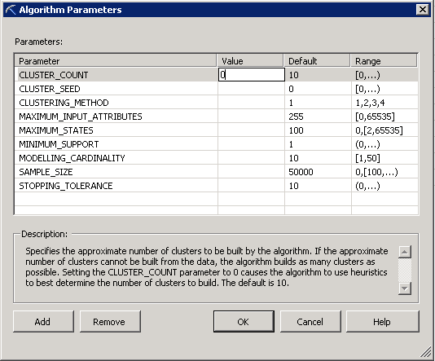
Right click the cluster model.
Select Set Algorithm Parameters.
Set the CLUSTER_COUNT value to zero in the Value column. Heuristics will be used to help determine the number of clusters—the default value is 10.
Hosted by the University of Arkansas

Slide 50
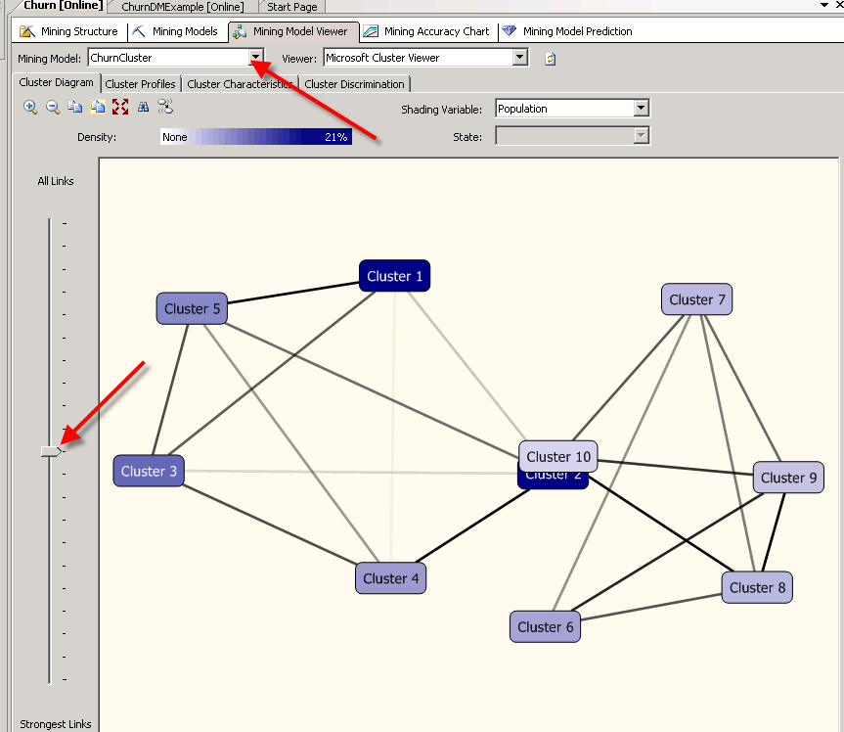
Run the model and view the results.
Major tab is Mining Model Viewer and the model selected
is ChurnCluster from the dropdown menu.
There are four sub tabs.
Cluster Diagram
Cluster Profiles
Cluster Characteristics
Cluster Discrimination.
Hosted by the University of Arkansas

Slide 51
Slider on the left is between including all links between clusters and only the strongest links.
Move the slider to the top and then to the bottom to see the links change.
Moving the mouse cursor over a cluster indicates how many records (cases) are in the cluster.
The challenge is to review the records (cases) in each cluster to determine which clusters, if any, may have important new and usable information.
Hosted by the University of Arkansas

Slide 52
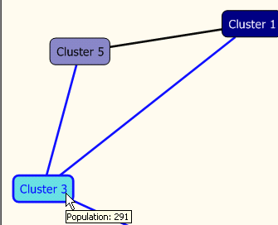
Note that 10 clusters have been produced and that the default names for the clusters are cluster 1, cluster 2 cluster 3.
Clicking Cluster 3 produces the following and contains 414 records.

Slide 53
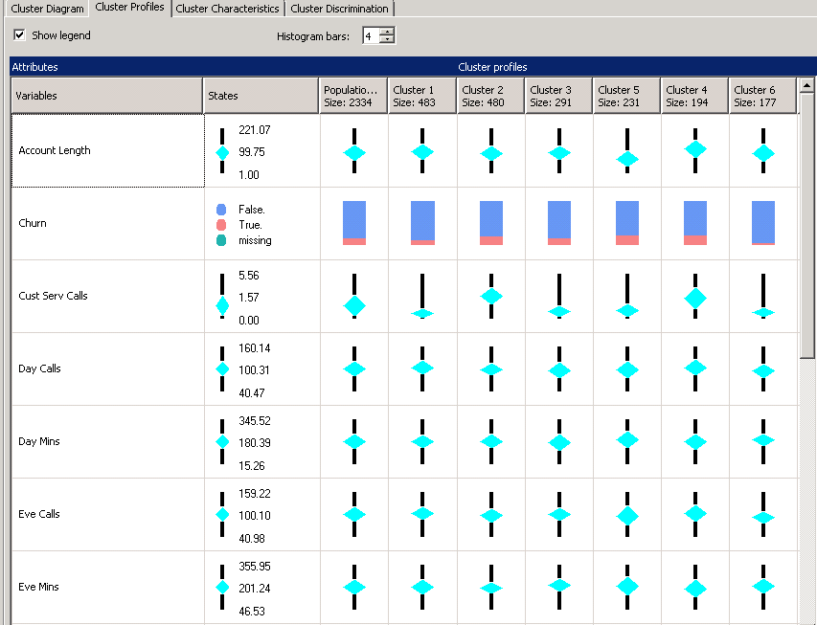
Click the Cluster Profile sub tab.
Determines differences in the clusters.
The entire population is presented before the first cluster.
Not possible to view all the clusters and corresponding attributes in one screen shot—seven attributes are shown.
Notice the different visuals for numeric values versus categorical values.
Hosted by the University of Arkansas

Slide 54
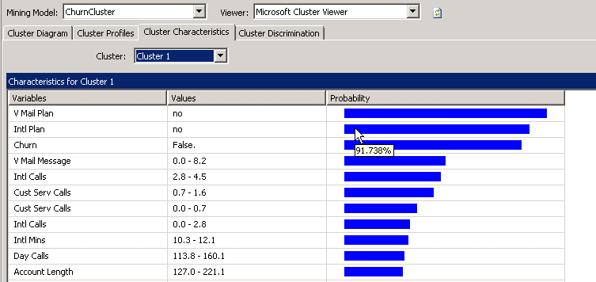
Click the Cluster Characteristics sub tab.
The Cluster: drop down list box allows the user to select a cluster for viewing the variables that occur most often.
Moving the mouse cursor over a bar provides the probability.
Note: Almost all of the customers have remained with the telecommunications company—that is they did not churn. Almost all of these customers also did not have either a voice mail plan or an international plan.
Hosted by the University of Arkansas

Slide 55
Click the Cluster Discrimination sub tab.
Displays the variables that favor cluster 1 and those that do not favor cluster 1.
Can select clusters from the Cluster 1: drop down list box. Compare to the default of Complement of Cluster to specified clusters via selection in the Cluster 2: drop down list box.
Note: Clustering is very exploratory so you may try different values for the number of customers and also remove the Churn variable and rerun the clustering.
Hosted by the University of Arkansas

Slide 56
Association Analysis
Association Analysis will use a different dataset to be more in line with the predominant use of Association Analysis which is for Market Basket Analysis.
A new data mining project may be built using the GroceryTrans1 table in the Public_Datasets_DM database.
The steps for creating and Data Source and a Data Source View are not repeated here.
Hosted by the University of Arkansas

Slide 57
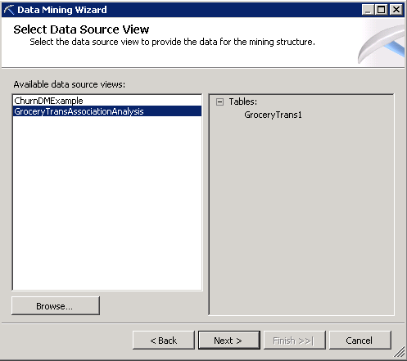
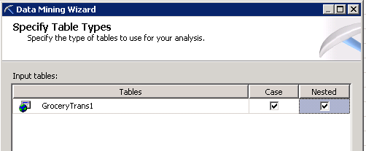
Right click Mining Structures in Solution Explorer and create a new mining structure.
GroceryTrans Association Analysis is the Data Source View to be used for creating the mining structure.
Select the GroceryTrans1 table and check both the Case and Nested check boxes.
Click the Next button.
Hosted by the University of Arkansas

Slide 58
The format of the data is in transactional format and appears as below.
RecordNbr | CUSTOMER | PRODUCT
1 | 0 | hering
2 | 0 | corned_b
3 | 0 | olives
4 | 0 | ham
5 | 0 | turkey
6 | 0 | bourbon
7 | 0 | ice_crea
8 | 1 | baguette
9 | 1 | soda
10 | 1 | hering
11 | 1 | cracker
12 | 1 | heineken
13 | 1 | olives
14 | 1 | corned_b
15 | 2 | avocado
16 | 2 | cracker

Slide 59
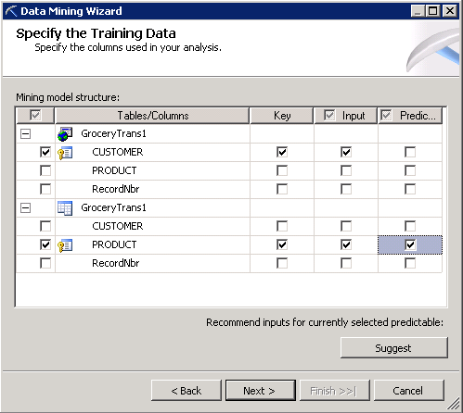
Since the customer is repeated, have the single table work both as a case and nested table.
The Customer will be the key value for the Case portion.
The Product will be the key for the nested portion.
Hosted by the University of Arkansas

Slide 60
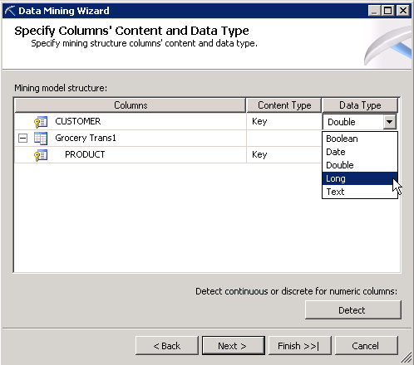
Click the Next button.
Set the Customer Key to Long.
Click the Next button.
Accept the default of a random test set of 30%.
Click the Next button.

Slide 61
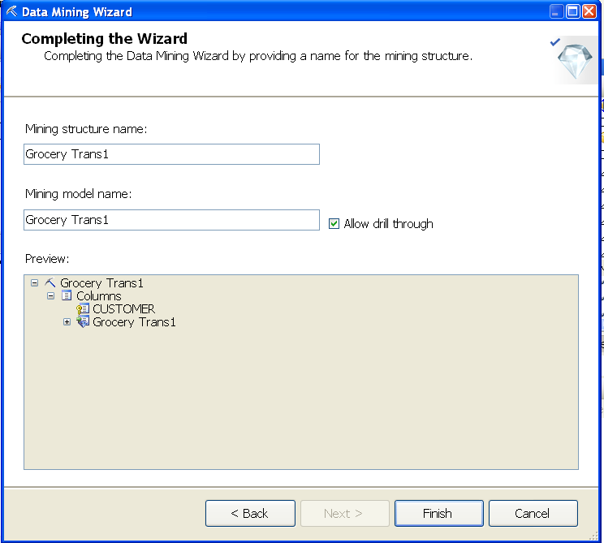
In the Complete the Data Mining Wizard, provide a Mining Structure name, a Mining Model name.
Ensure that the Allow drill through check box is checked.
Click the Finish button.
Hosted by the University of Arkansas

Slide 62
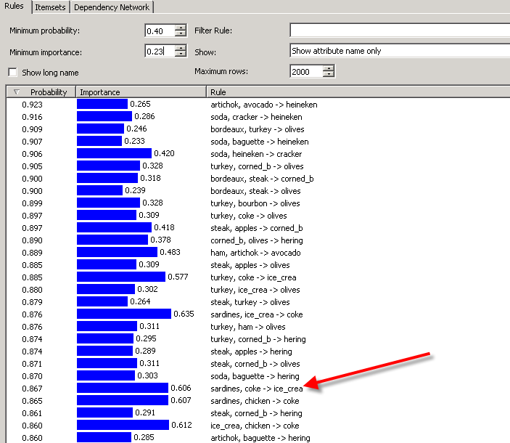
Run the model and review the results.
The Rules tab is the default tab with a default minimum probability of .40 displayed and initially sorted by probability.
Change the Minimum importance to .23.
Set the Show: dropdown to Show attribute names only.
Note: Sardines, coke-> ice_crea has a fairly high probability and also a fairly high level of Importance. If you have checked to allow drill downs when building the model, Drill down is possible to view customer baskets for this rule. Right click and select Drill Through.
Hosted by the University of Arkansas

Slide 63
Click the Itemsets tab.
You will probably want to set the Show: drop down box to Show attribute name only.
Change this to Show attribute name only.
The number of rows has been set to 2000.
The Itemset shows the Support for each of the products, a count of how many times the product occurred in the baskets.
Hosted by the University of Arkansas

Slide 64
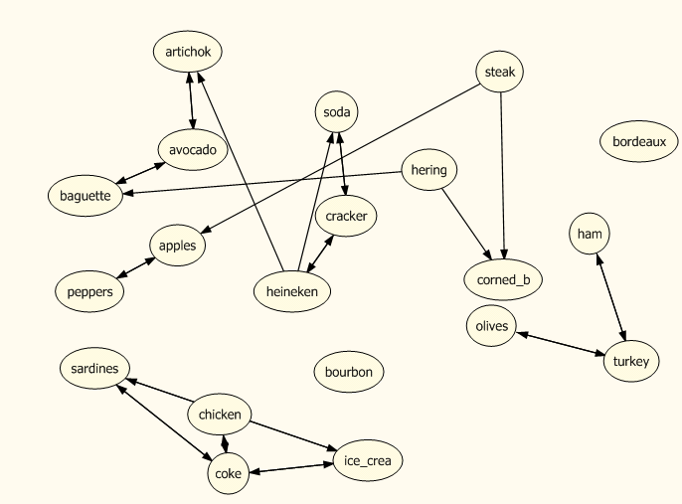
Click the Dependency Network sub tab.
The slider on the left allows one to investigate the strength of the links between the products. Move the slider to the top and then to the bottom.
Hosted by the University of Arkansas

Slide 65
Click on a node and the strength of the links are highlighted.
Steak has a strong link to apples and corned_b.
Note: The legend at the bottom of the screen indicates the selected product, the products it predicts and the products that predict it.

