Slide 1
Advanced SQL
Microsoft Enterprise Consortium
Type I Subquery
Microsoft Enterprise Consortium: http://enterprise.waltoncollege.uark.edu
Microsoft Faculty Connection/Faculty Resource Center http://www.facultyresourcecenter.com

Slide 2
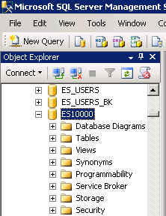
What you’ll need …
Log in to MEC for this lesson and into MSSMS (Microsoft SQL Server Management Studio).
Be sure to select your account ID under Database in the Object Explorer pane, similar to the example shown here.
You should know the SQL covered in the SQL Fundamental series.

Slide 3
Type I Subquery
A subquery typically appears in the WHERE clause or the HAVING clause but may also be in the FROM clause.
The Type I subquery is executed one time—before the outer query—and the output is a termporary data set used by the outer query.
Let’s take a look at a simple example …

Slide 4
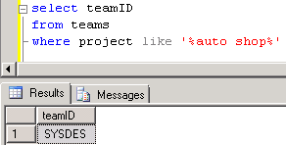
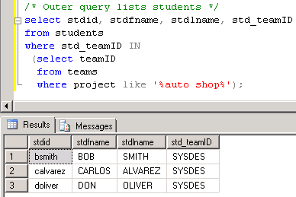
Type I Subquery - Example
List the students working on the auto shop database project.
/* S-T: List students working on the auto shop database project.
Subquery: Find the team ID for the team working on the auto shop project.
Outer query: List students assigned to that team ID. */
/* Subquery */
select teamID
from teams
where project like '%auto shop%‘
/* Outer query lists students */
select stdid, stdfname, stdlname, std_teamID
from students
where std_teamID IN
(select teamID
from teams
where project like '%auto shop%';

Slide 5
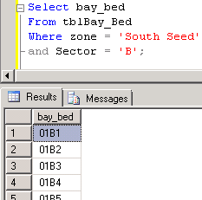
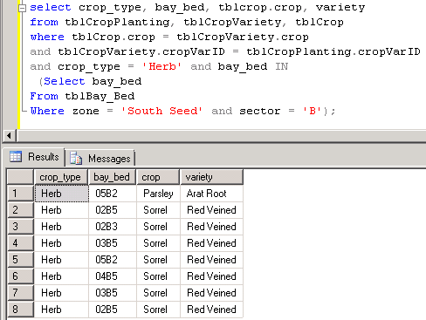
Type I Subquery – Another Example
List the herb crop/varieties planted in sector B of the South Seed zone.
/* Greenhouse: Show crops of type herb planted in sector B of the South Seed zone.
Subquery: List bay-beds for zone South Seed, sector B.
Outer query: List the crop_type, bay_bed, crop, and variety for the herb crop type.
*/
/* Subquery */
Select bay_bed
From tblBay_Bed
Where zone = 'South Seed‘ and sector = 'B';
/* Outer query */
select crop_type, bay_bed, tblcrop.crop, variety
from tblCropPlanting, tblCropVariety, tblCrop
where tblCrop.crop = tblCropVariety.crop
and tblCropVariety.cropVarID = tblCropPlanting.cropVarID
and crop_type = 'Herb'
and bay_bed IN
(Select bay_bed
From tblBay_Bed
Where zone = 'South Seed‘ and sector = 'B');

Slide 6
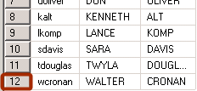
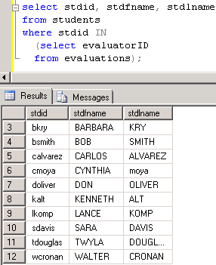
Type I Subquery – versus Distinct
/* Subquery versus DISTINCT
Show students who did evaluations about their teammates. Show the student's ID and name. */
select stdid, stdfname, stdlname
from students, evaluations
where students.stdid = evaluations.evaluatorID;
/* Remove duplicates */
select distinct stdid, stdfname, stdlname
from students, evaluations
where students.stdid = evaluations.evaluatorID;
/* Try this with a Type I subquery.
Subquery: List the evaluator IDs.
Outquery: List the students that have an ID in
the subquery list. */
select stdid, stdfname, stdlname
from students
where stdid IN
(select evaluatorID
from evaluations);

Slide 7
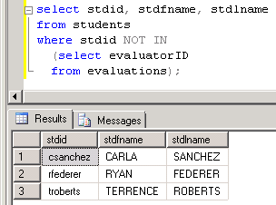
Type I Subquery for deleting records
If you want to delete records from a table based on criteria in another table, you must use a Type I subquery.
/* For instance, see which students didn’t do any evaluations. Note the use of NOT IN. */
select stdid, stdfname, stdlname
from students
where stdid NOT IN
(select evaluatorID
from evaluations);
/* If we wanted to delete these students, we would use the following statement. */
delete
from students
where stdid NOT IN
(select evaluatorID
from evaluations);
However, we can’t execute this delete statement because it conflicts with the evaluatee foreign key constraint.

Slide 8
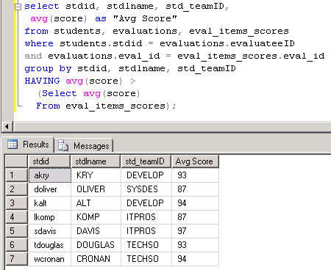
Type I Subquery in the HAVING clause
Find out who got an average evaluation score higher than the class average .
/* Subquery */
Select avg(score)
From eval_items_scores;
/* List students with an above average score. *;
select stdid, stdlname, std_teamID, avg(score)
from students, evaluations, eval_items_scores
where students.stdid = evaluations.evaluateeID
and evaluations.eval_id = eval_items_scores.eval_id
group by stdid, stdlname, std_teamID
HAVING avg(score) >
(Select avg(score)
From eval_items_scores);

Slide 9
What was covered …
Type I subquery in the WHERE clause.
The IN/NOT IN operator acts like a join between the outer query and the subquery.
The inner query doesn’t reference the outer query.
Do data is displayed directly from the subquery.
Deleting data using the Type I query.
A Type I subquery in the HAVING clause.

Slide 10
Resources
http://enterprise.waltoncollege.uark.edu/mec.asp
Microsoft Faculty Connection—Faculty Resource Center http://www.facultyresourcecenter.com/
Microsoft Transact-SQL Reference
http://msdn.microsoft.com/en-us/library/aa299742(v=SQL.80).aspx
AdventureWorks Sample Database
http://msdn.microsoft.com/en-us/library/ms124659%28v=sql.100%29.aspx

