Slide 1
SQL Fundamentals
Microsoft Enterprise Consortium
WHERE clause using IN and IS NULL
Microsoft Enterprise Consortium: http://enterprise.waltoncollege.uark.edu
Microsoft Faculty Connection/Faculty Resource Center http://www.facultyresourcecenter.com

Slide 2
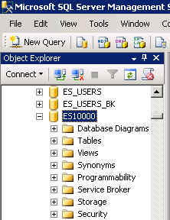
What you need …
Log in to MEC for this lesson and into MSSMS (Microsoft SQL Server Management Studio).
Be sure to select your account ID under Database in the Object Explorer pane, similar to the example shown here.
You need to be familiar with some of the concepts presented in earlier lessons in this SQL Fundamentals series.

Slide 3
An alternative to using the OR operator
In a previous lesson, we covered the use of the logical operators AND, OR and NOT. This lesson presents other operators you can use in the WHERE clause of a SELECT statement.
IN (…, …, … ) – An alternative to the OR operator.
IS NULL – Check for null values.

Slide 4
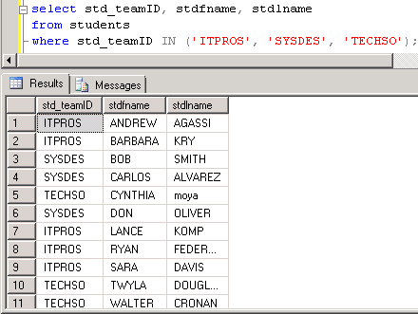
Using IN instead of OR
List students in these teams: ITPROS, SYSDES or TECHSO.
/* List students who are in these
teams: ITPROS, SYSDES or TECHSO. */
/* using OR */
select std_teamID, stdfname, stdlname
from students
where std_teamID = 'ITPROS'
OR std_teamID = 'SYSDES'
OR std_teamID = 'TECHSO';
/* using IN */
select std_teamID, stdfname, stdlname
from students
where std_teamID IN ('ITPROS', 'SYSDES', 'TECHSO');

Slide 5
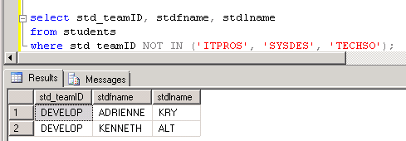
NOT IN
List students who are NOT in these teams: ITPROS, SYSDES or TECHSO.
/* List students who are NOT in these teams: ITPROS, SYSDES or TECHSO. */
select std_teamID, stdfname, stdlname
from students
where std_teamID NOT IN ('ITPROS', 'SYSDES', 'TECHSO');

Slide 6
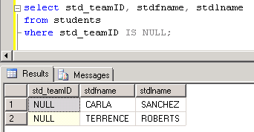
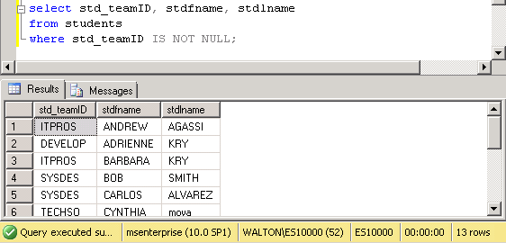
Working with NULL (no data)
List students who have not been assigned to a team. This is the case if the teamID field is null (no data).
/* List students who have not been assigned to a team. */
select std_teamID, stdfname, stdlname
from students
where std_teamID IS NULL;
/* List students who are assigned to a team. */
select std_teamID, stdfname, stdlname
from students
where std_teamID IS NOT NULL;

Slide 7
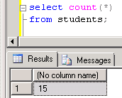
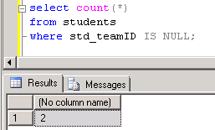
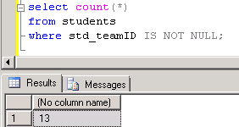
Working with NULL - continued
Count how many students there are, how many are not assigned to a team and how many are assigned to a team.
/* How many students are there? */
select count(*) from students;
/* How many students have not been assigned to a team. */
select count(*)
from students
where std_teamID IS NULL;
/* How many students have been
assigned to a team. */
select count(*)
from students
where std_teamID IS NOT NULL;

Slide 8
What was covered …
More operators to use in the WHERE clause.
IN ( … ) - an alternative to using OR.
NOT IN
IS NULL
IS NOT NULL

Slide 9
Resources
http://enterprise.waltoncollege.uark.edu/mec.asp
Microsoft Faculty Connection—Faculty Resource Center http://www.facultyresourcecenter.com/
Microsoft Transact-SQL Reference
http://msdn.microsoft.com/en-us/library/aa299742(v=SQL.80).aspx
AdventureWorks Sample Database
http://msdn.microsoft.com/en-us/library/ms124659%28v=sql.100%29.aspx

