Slide 1
Database Fundamentals
Microsoft Enterprise Consortium
Data Model: Physical Design – Part 1
Logical & Physical Model

Slide 2
What you should know …
The presentation assumes you already know relational data model terminology—entity, relationship, unary, etc. These terms are explained in other presentations.

Slide 3
Logical & physical models
A data model can be documentation of how an existing database is constructed or it can be the tool for designing a new database.
Depending on the level of abstraction or the level of detail, we may classify a data model as logical or physical.
A logical data model is a general depiction of the data—entities and relationships.
A physical data model shows enough detail to depict how the database is built.

Slide 4
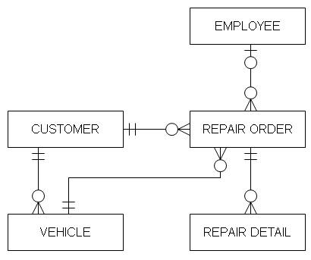
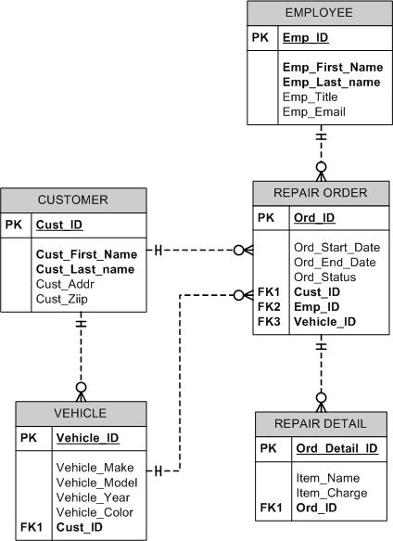
Examples: Logical & physical models
The examples shown here are for an auto repair shop.
The logical model is on the top.
It shows entities and relationships.
It might also show some attributes.
The physical model, as you can see here, shows a great deal more detail.
In future presentations we’ll find out what ‘PK’ and ‘FK’ represent and why some attributes are in bold text.
The physical model shown here was created in Microsoft Visio.

Slide 5
Physical model -> relational database
When we go from the model to the database, the terminology changes.
Entity … becomes … table
Attribute … becomes … column or field
Entity instance … becomes … a row in a table (also called a record).
Relationship … becomes … a column (or columns) that is in each table at both ends of the relationship.

Slide 6
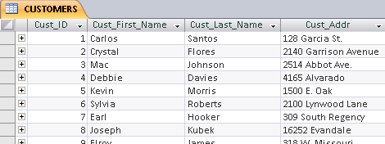
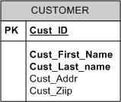
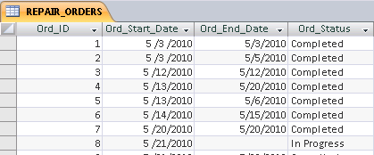
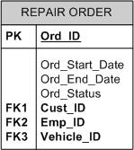
From model to database – An example
CUSTOMER and REPAIR ORDER entities in the data model will become CUSTOMERS and REPAIR ORDERS tables in the database. (It’s not necessary but it is customary to use singular terms in the model then make these plural in the database.)

Slide 7
Entity instance = row in a table
One of the principles of relational databases is that each row in a table is unique.
Primary key: A field (or combination of fields) that uniquely identify one row in the table.
Remember the identifier in the data model? That was one or more attributes used to uniquely identify an entity instance. The identifier in the model becomes the primary key in the database.
Many attributes or fields are not unique. For example, names, addresses, and phone numbers may not be unique for each customer, employee, or student.
So, we often create an identifier or primary key field to uniquely identify each instance of an entity—each row in a table.

Slide 8
What you’ve learned …
This presentation explained the difference between the logical and physical data model.
Terms change when you talk about the data model versus the database built from the data model.
A primary key is used to uniquely identify each record in a database table.

Slide 9
Resources
Microsoft Enterprise Consortium: http://enterprise.waltoncollege.uark.edu/mec.asp
Microsoft Faculty Connection—Faculty Resource Center http://www.facultyresourcecenter.com/

