Slide 1
Database Fundamentals
Microsoft Enterprise Consortium
Data Model: Physical Design – Part 2
Primary & Foreign Keys

Slide 2
What you should already know …
You should know relational data model terminology.
You should know the database terms that correspond to the data model terms.
For example: attribute = column/field
In the previous presentation, we started implementing a physical data model in a relational database.
This presentation begins with how to implement the relationship between two entities.

Slide 3
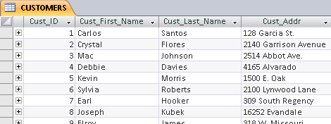
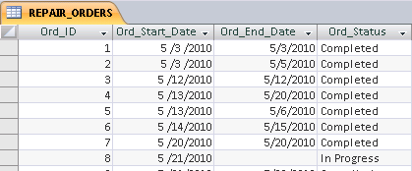
Database “relationships”
How do we put a “relationship” between the CUSTOMER and REPAIR ORDER tables in the database?
We put the primary key from one table into the related table.
Which primary key goes into the other table?
CUSTOMER
REPAIR ORDER

Slide 4
Foreign key
Foreign key: A foreign key is a field in one table that corresponds to a primary key field in another table.
We know which primary key to put in a related table because of the “one” side and the “many” side of the relationship.
The rule: In a one-to-many relationship the “many” side gets the foreign key.
One-to-many
CUSTOMER
REPAIR ORDER
The REPAIR ORDER table gets the foreign key column.

Slide 5
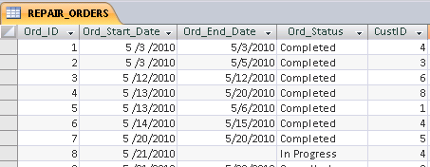
Foreign key: Building a relationship
The primary key field from CUSTOMER, which is CUST_ID, has a corresponding column in the related REPAIR ORDER table.
The foreign key field, called CUSTID column in the example shown here, holds data that links to related data in the CUSTOMER table.
CUSTOMER
REPAIR ORDER
For repair order #1 (Ord_ID), the #4 in the CustID field, tells us that this work was done for Debbie Davies.

Slide 6
Data redundancy
Using the foreign key field to link related data is an essential element of relational database.
It reduces data redundancy.
Each relational database table stores data about a particular entity (a person, place, thing, or event).
In the example below, there are 3 repair orders for Debbie Davies.
However, we don’t store her information (name, address, etc.) more than once. The foreign key value #4 links Debbie Davies’ information to each of her repair orders.

Slide 7
Foreign key field name
The foreign key field name can match the related primary key field name exactly. This is often done.
However, as shown in the example here, it is not required that the names match. In fact, in one situation, which you’ll see later, the names cannot match.
It is required that the foreign key column be defined so that it contains the same data as in the related primary key column. The foreign key column is the same data type and field size as the primary key column.

Slide 8
This presentation covered …
A relationship in the data model becomes the link between a primary key column in one table and its related foreign key column in another table.
Storing data in separate tables, such as data about customer stored in CUSTOMER and repair work data in REPAIR ORDER, reduces data redundancy.

Slide 9
Resources
Microsoft Enterprise Consortium: http://enterprise.waltoncollege.uark.edu/mec.asp
Microsoft Faculty Connection—Faculty Resource Center http://www.facultyresourcecenter.com/

