Slide 1
Database Fundamentals
Microsoft Enterprise Consortium
Physical Design - Part 4
Many-to-Many Relationships

Slide 2
What you should already know …
You should already know how to implement the following relationships when you build a database:
Binary, one-to-many
Unary, one-to-many
Binary, one-to-one

Slide 3
Many-to-many relationship
Now, we look at implementing a many-to-many relationship in a relational database.
In a many-to-many relationship, like the one between REPAIR ORDER and INVENTORY, neither side gets a foreign key.
In fact, you can’t build a many-to-many relationship in a relational database.
REPAIR ORDER
INVENTORY

Slide 4
Many-to-many: add associative entity
A many-to-many relationship must be decomposed into at least two one-to-many relationships.
You add an associative entity that links the two original entities.
a.k.a. (also known as) conjunction entity
a.k.a. intersection entity
REPAIR ORDER
REPAIR ORDER
INVENTORY
REPAIR DETAIL
INVENTORY

Slide 5
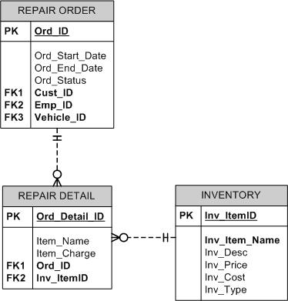
Many-to-many: Physical model
A many-to-many relationahip is appropriate in a logical data model
The physical data model should not contain many-to-many relationships.
They should be decomposed into one-to-many relationships.
REPAIR ORDER
INVENTORY

Slide 6
Associate entity -> Building the table
For the auto repair shop example, you’ll build a table called REPAIR DETAILS.
This table has a foreign key field from REPAIR ORDERS
It also has a foreign key field from INVENTORY.
A table can have many foreign keys or it can have none. It depends on its relationships with other tables.

Slide 7
What was covered …
How to implement a many-to-many relationship in a relational database.
What an associative entity is in the physical data model.

Slide 8
Resources
Microsoft Enterprise Consortium: http://enterprise.waltoncollege.uark.edu/mec.asp
Microsoft Faculty Connection—Faculty Resource Center http://www.facultyresourcecenter.com/

