Slide 1
Database Fundamentals
Microsoft Enterprise Consortium
Physical Design - Part 5
Multivalued Attribute

Slide 2
What you should know …
This presentation is the last in a set about “physical design”.
At this point, you should know how to implement the relationships listed below when you build a relational database.
Binary, one-to-many
Unary, one-to-many
Binary, one-to-one
Binary or unary, many-to-many
The steps for actually building tables is shown in other presentations that follow this Database Fundamentals presentation series.

Slide 3
Multivalued attribute
The entity shown here has a multivalued attribute. Which attribute is it?
Emp_phone
A multivalued attribute can have more than one value for a single entity instance.
In this example, Emp_phone is multivalued because it is possible for each employee to have more than one phone number that we need to keep in the database.
EMPLOYEE
Emp_ID
Emp_First_Name
Emp_Last_Name
{Emp_Phone}

Slide 4
Concatenated primary key
The entity on the left depicts a multivalued attribute.
The physical data model shown on the right illustrates how a multivalued attribute is transformed.
The primary key from the parent entity usually becomes part of the primary key in the child entity (Emp_ID in EMPLOYEE, in this case).
Remember, a primary key can consist of more than one field.
A concatenated primary key consists of two or more fields.
EMPLOYEE
Emp_ID
Emp_First_Name
Emp_Last_Name
{Emp_Phone}

Slide 5
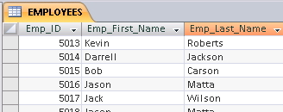
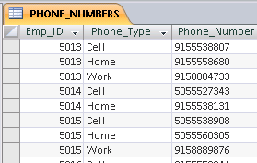
Multivalued attribute implementation
The examples below illustrate the transformation from
a logical entity
to a physical design
to the tables in the relational database.
EMPLOYEE
Emp_ID
Emp_First_Name
Emp_Last_Name
{Emp_Phone}

Slide 6
What was covered here …
We’ve seen how to implement a multivalued attribute when we move from the logical data model to the physical data model and then to the database.
The concept of parent and child entities was presented.
An example was given for a concatenated primary key.

Slide 7
Resources
Microsoft Enterprise Consortium: http://enterprise.waltoncollege.uark.edu/mec.asp
Microsoft Faculty Connection—Faculty Resource Center http://www.facultyresourcecenter.com/

