Slide 1
FRESHMAN BUSINESS CONNECTIONS
Business
Brief
WEEK 4

Slide 2





What you will learn in FBC this semester...
Starting Up
FBC
Career Readiness
Learn best practices, build your resiliency
Internships and career planning
Communication
All Things Walton
How college changes how you communicate
From course selection to majors/minors
2

Slide 3



What we will learn today...
The Prompt
Research
Writing
What is the prompt asking of you?
How to conduct research
Strategies for writing a successful brief

Slide 4
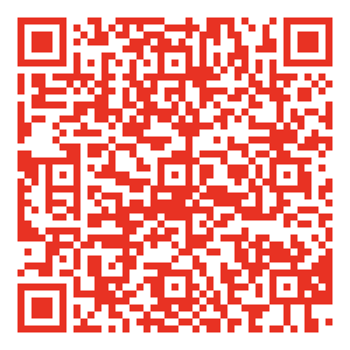
You can find the prompt and other resources online.
Scan this QR code to access the FBC materials or click here.
It’s a good idea to bookmark this page. You will be returning here often.

Slide 5
Students must pass 3 of the 5 categories:​
Criterion​ | Meets expectation (Pass)​
Purpose​ | Student mostly understands the document’s problem and prompt Student generally understands the assignment and its major aspects; critical thinking of its major concerns is mostly evident • Gives two recs (could give more that fall under the same rec category) • Recs mostly address the main problem of the prompt
Content & Organization of Ideas​ | Contents are logically organized; may possess a minor logical misstep/fallacy Student mostly synthesizes information into a coherent, plausible analysis • Mostly integrates, synthesizes, and analyzes at least three sources • Attempt to explain why sources are included and matter Document contains adequate factual support for recommendations, claims, or arguments
Audience: Professionalism, Style, & Tone​ | Student mostly addresses audience’s needs and expectations for the document • Mostly relates evidence back to audience • Gives a few tangible and specific actions for the recs Student uses a professional yet conversational tone; scant (three or less) instances of slang, jokes, or unnecessary jargon Student demonstrates an appropriate level of cultural/global sensibility and awareness Style is appropriate but not as engaging as could be; some wordiness or indirect language
Grammar & Punctuation​ | Document may contain some minor errors, but not enough to distract the average reader In short, the writer’s credibility would not be harmed because of these minor errors; the average reader would have no trouble understanding contents on the first read-through
Genre Conventions & Format​ | Document follows the format given in the assignment prompt • Miss less than three of the following: header, spacing, indentation, references page, formatted like the functional model, follows length requirement • Has in-text citations and reference page but not in the correct format
Click here to access the full rubric.

Slide 6

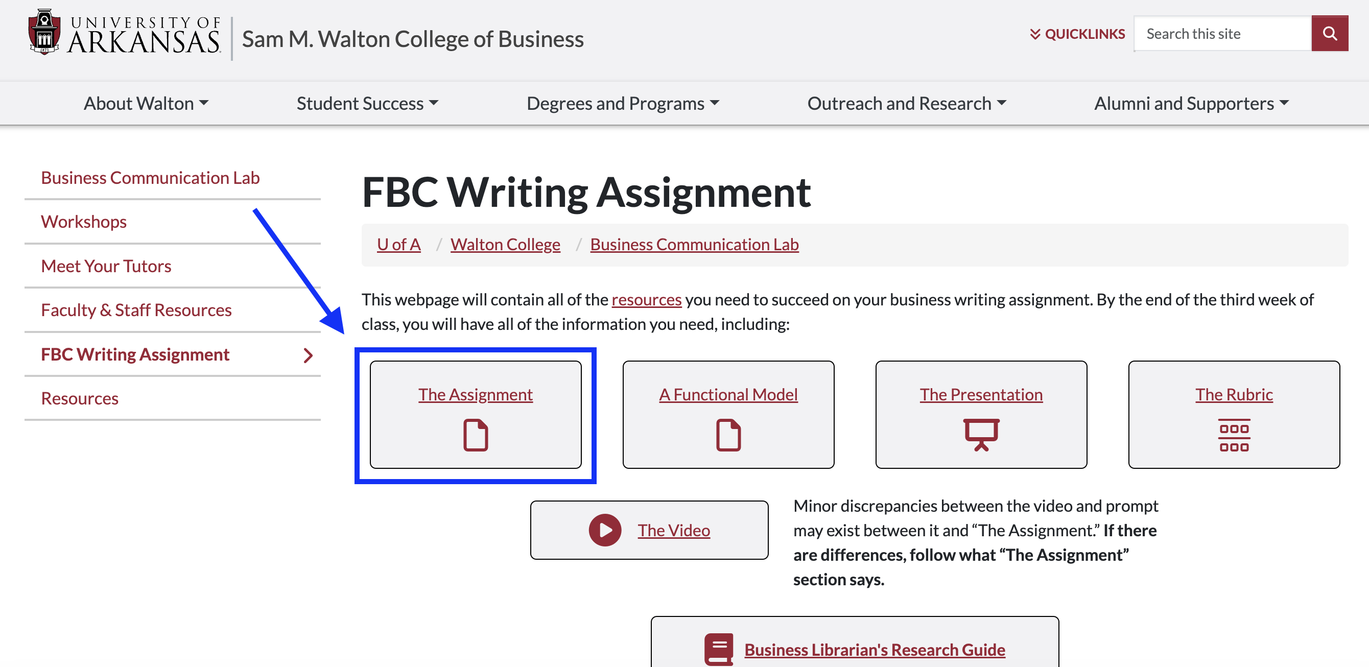
Understanding the Prompt
Notes:
Walk the students through the prompt here. Be sure you talk them through it at length.

Slide 7
Understanding the Prompt
Carefully read and annotate the prompt.
  What am I being asked to do?​
  Who is my audience?​
  What is my role?​
Note: Reread the prompt several times throughout your research and writing process to make sure you’re doing what the assignment asks of you.

Slide 8
Students must pass 3 of the 5 categories:​
Criterion​ | Meets expectation (Pass)​
Purpose​ | Student mostly understands the document’s problem and prompt Student generally understands the assignment and its major aspects; critical thinking of its major concerns is mostly evident • Gives two recs (could give more that fall under the same rec category) • Recs mostly address the main problem of the prompt
Content & Organization of Ideas​ | Contents are logically organized; may possess a minor logical misstep/fallacy Student mostly synthesizes information into a coherent, plausible analysis • Mostly integrates, synthesizes, and analyzes at least three sources • Attempt to explain why sources are included and matter Document contains adequate factual support for recommendations, claims, or arguments
Audience: Professionalism, Style, & Tone​ | Student mostly addresses audience’s needs and expectations for the document • Mostly relates evidence back to audience • Gives a few tangible and specific actions for the recs Student uses a professional yet conversational tone; scant (three or less) instances of slang, jokes, or unnecessary jargon Student demonstrates an appropriate level of cultural/global sensibility and awareness Style is appropriate but not as engaging as could be; some wordiness or indirect language
Grammar & Punctuation​ | Document may contain some minor errors, but not enough to distract the average reader In short, the writer’s credibility would not be harmed because of these minor errors; the average reader would have no trouble understanding contents on the first read-through
Genre Conventions & Format​ | Document follows the format given in the assignment prompt • Miss less than three of the following: header, spacing, indentation, references page, formatted like the functional model, follows length requirement • Has in-text citations and reference page but not in the correct format
Click here to access the full rubric.

Slide 9

Research Strategies
How do I do my "job"?​
  Analyze facts​
  Locate patterns​
  Rank importance​
  Provide recommendations

Slide 10
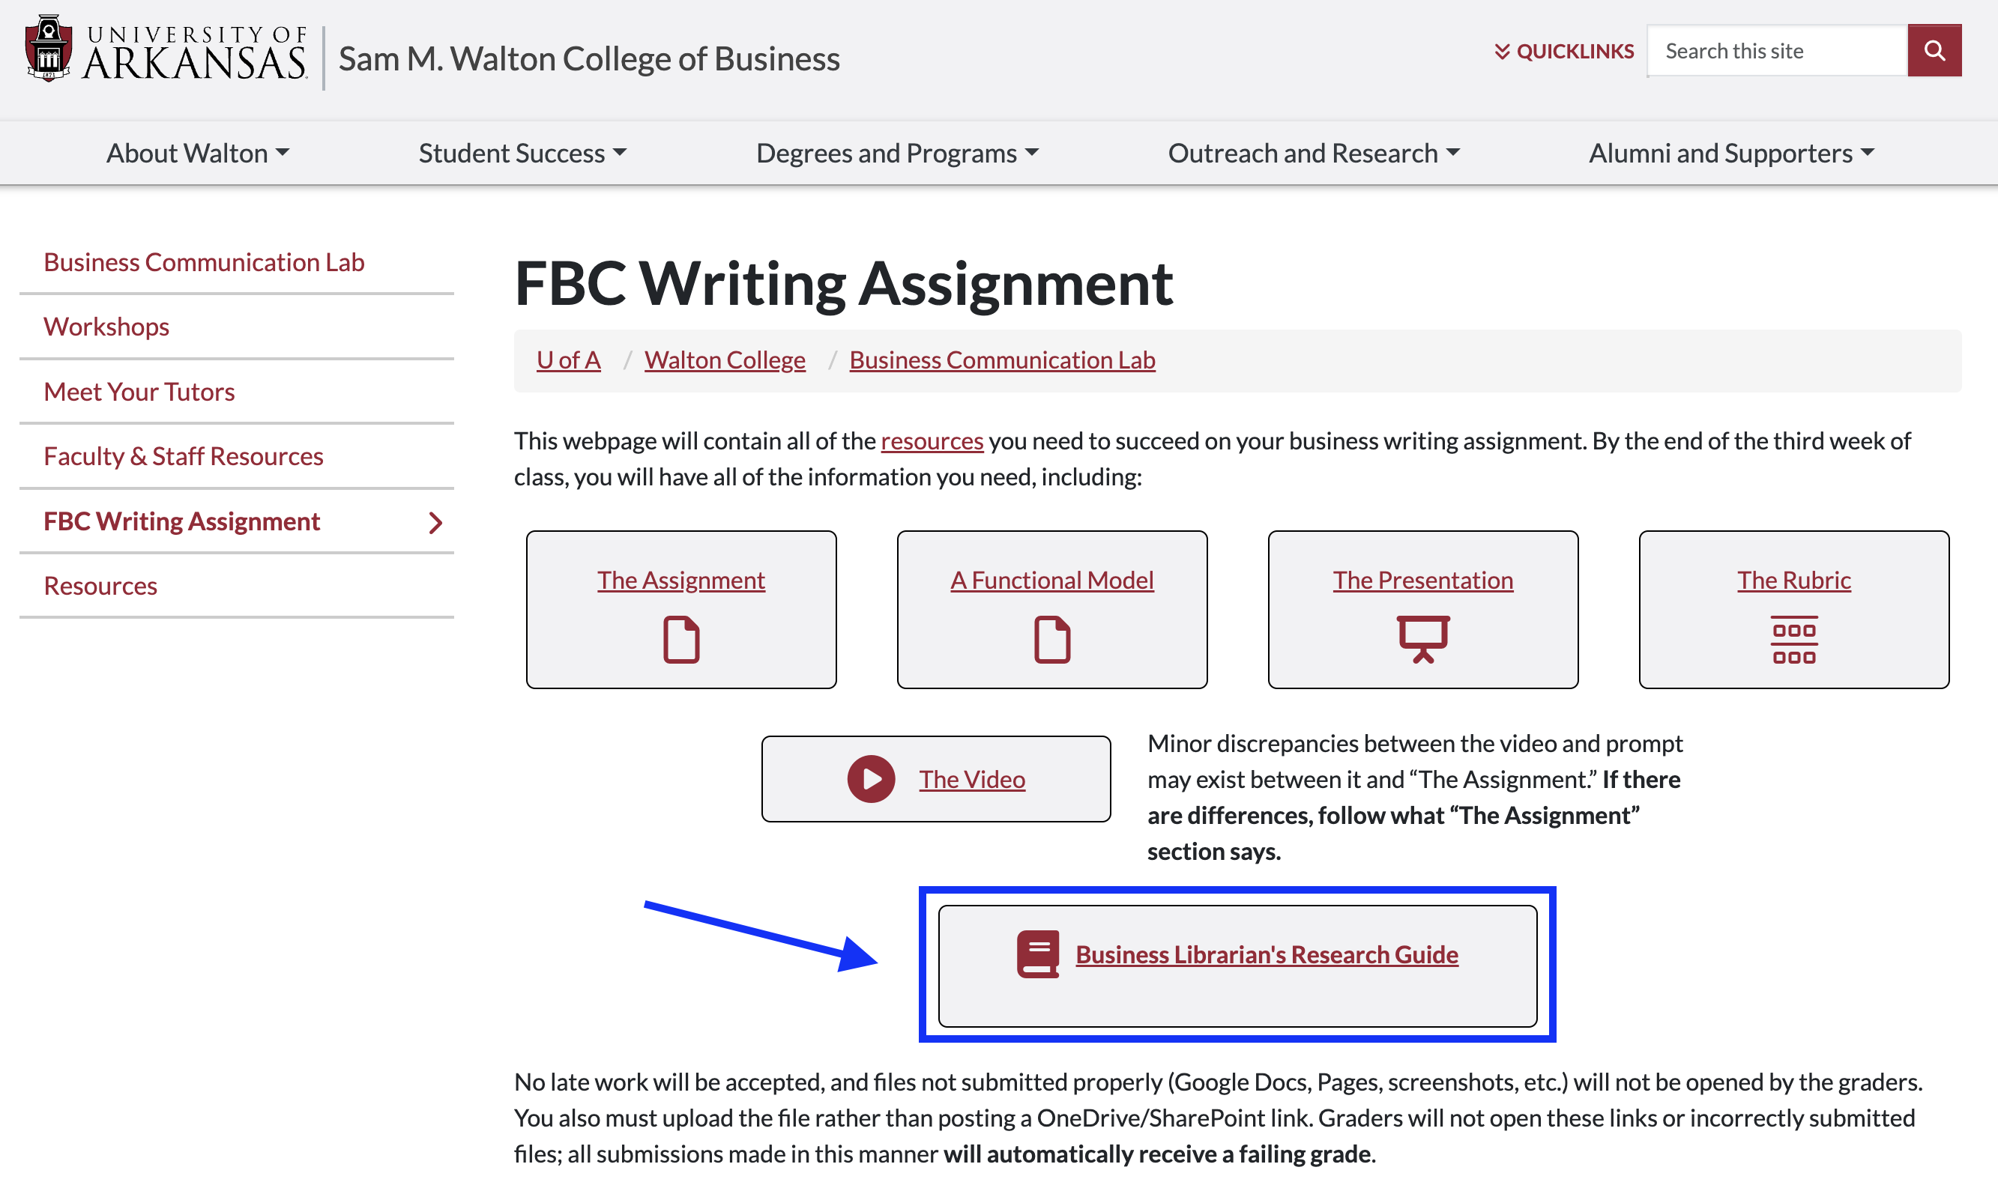
Business Librarian’s Research Guide

Slide 11
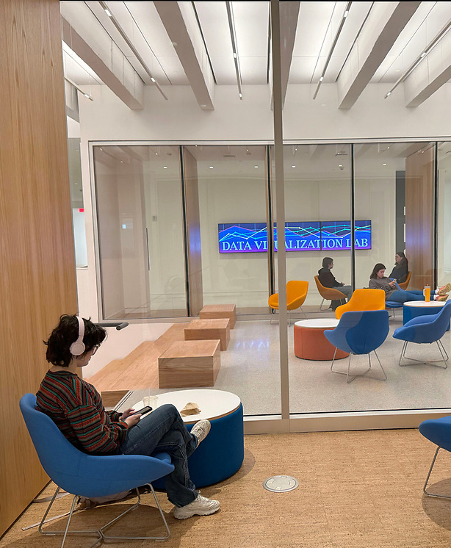
A message from your Business Librarian:​
Remember that the University Libraries are here to help!​
Check out this short clip that walks you through the sections of a peer reviewed article, so you can decide where to aim your focus. ​
Explore our Business Research site to find more guides on how to improve your research process!

Slide 12
Integrating Sources
Use at least four sources.
Use APA citations, both in-text and on a references page at the end of your brief.

Slide 13
Integrating Sources
The economist Paul Krugman critiques the common idea that the housing market and economy as a holistic entity was completely stable. The thrust of his 2009 article is to examine the flaws of the economists who professed the perfection of the economy prior to the Great Recession. For instance, Krugman (2009) asserts, "the economics profession went astray because economists, as a group, mistook beauty, clad in impressive-looking mathematics, for truth" (p.17). What Krugman's article articulates so well is how far removed from reality economists were allowed to become because they walled themselves off with ideology and statistics.
Paul Krugman writes about economics. "The economics profession went astray because economists, as a group, mistook beauty clad in impressive-looking mathematics, for truth." ​I think Krugman makes a good point. Another point Krugman makes is...
vs.

Slide 14
Integrating Sources
References:​
Briley, Liv. (2024). Personal finance education is lacking in American schools. The Daily Mississippian. _____https://thedmonline.com/personal-finance-education-is-lacking-in-american-schools/​
EDSCOOP Staff. (2023). University support services disjointed, poorly advertised, finds report. EDSCOOP. _____ _____ https://edscoop.com/university-student-support-services/​
Ezarick, Melissa. (2022). Where the Weaknesses Are in Student Financial Wellness. Inside Higher Ed. _____ _____ _____ https://www.insidehighered.com/news/2022/02/25/survey-college-students-need-help-financial-literacy

Slide 15
Integrating Sources
Using in-text citations​
Author is stated​: ​ ​ ​ Author is not stated: | As Adam Grant (2021) claims, "one of the hallmarks of an open mind is responding to confusion with curiosity and interest" (p.199).​ ​ With regards to expressing opinions, "it's our responsibility to ground them in logic and facts...and change our minds when better evidence emerges" (Grant, 2021, p.74).​
Paraphrased with author​: ​ ​ Paraphrased without author: | According to Grant (2021), it is important to think like a scientist to learn. ​ ​ When people admit that they are wrong, it isn't a reflection of their competence, rather it shows that they are honestly open to learning (Grant, 2021, p.73).​
Click here to access the BCL's APA citation resource & here for the official APA website​

Slide 16
Students must pass 3 of the 5 categories:​
Criterion​ | Meets expectation (Pass)​
Purpose​ | Student mostly understands the document’s problem and prompt Student generally understands the assignment and its major aspects; critical thinking of its major concerns is mostly evident • Gives two recs (could give more that fall under the same rec category) • Recs mostly address the main problem of the prompt
Content & Organization of Ideas​ | Contents are logically organized; may possess a minor logical misstep/fallacy Student mostly synthesizes information into a coherent, plausible analysis • Mostly integrates, synthesizes, and analyzes at least three sources • Attempt to explain why sources are included and matter Document contains adequate factual support for recommendations, claims, or arguments
Audience: Professionalism, Style, & Tone​ | Student mostly addresses audience’s needs and expectations for the document • Mostly relates evidence back to audience • Gives a few tangible and specific actions for the recs Student uses a professional yet conversational tone; scant (three or less) instances of slang, jokes, or unnecessary jargon Student demonstrates an appropriate level of cultural/global sensibility and awareness Style is appropriate but not as engaging as could be; some wordiness or indirect language
Grammar & Punctuation​ | Document may contain some minor errors, but not enough to distract the average reader In short, the writer’s credibility would not be harmed because of these minor errors; the average reader would have no trouble understanding contents on the first read-through
Genre Conventions & Format​ | Document follows the format given in the assignment prompt • Miss less than three of the following: header, spacing, indentation, references page, formatted like the functional model, follows length requirement • Has in-text citations and reference page but not in the correct format
Click here to access the full rubric.

Slide 17
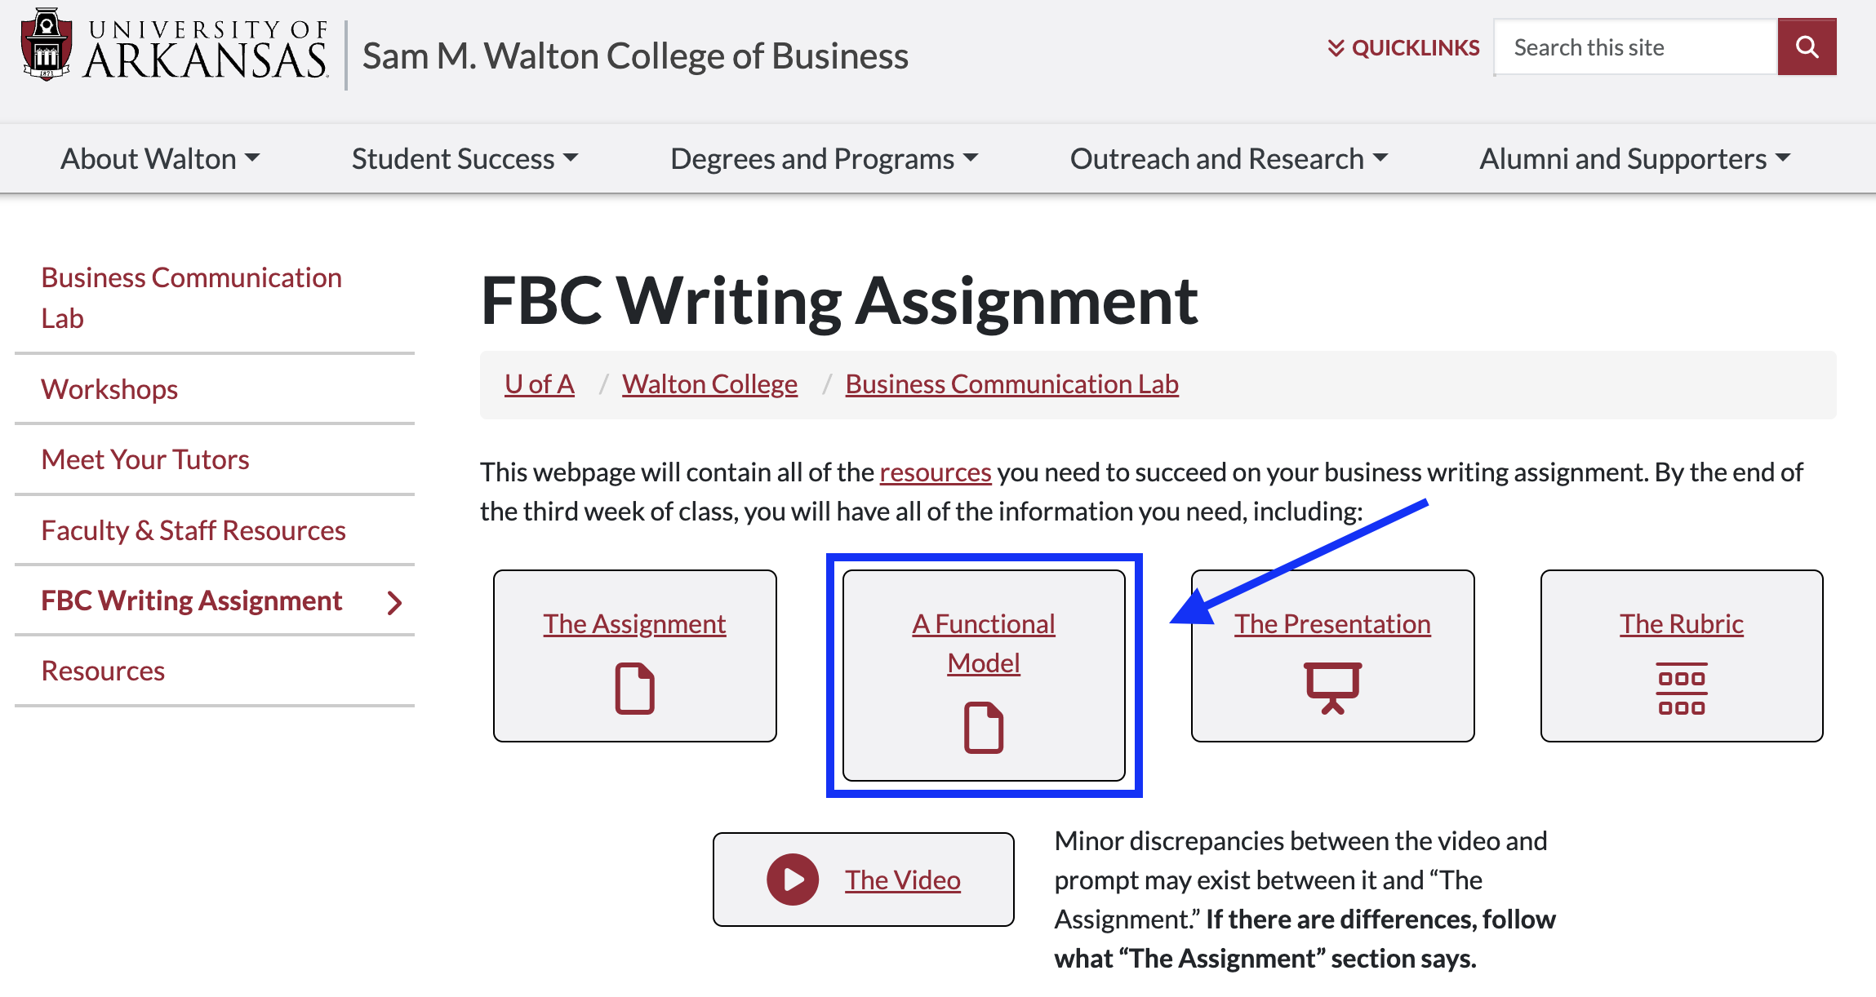
Writing a Successful Brief
Click here to access the functional model.

Slide 18
Your message should be:
Audience-driven
Goal-minded
Front-loaded
This is where understanding happens and where decisions can be made.

Slide 19
Business Writing
Academic Writing
Audience-driven​
Goal-minded​
Front-loaded
vs.
Build to your argument
Favors nuance over brevity

Slide 20
How will the audience respond?
Avoid colloquialisms, idioms, or clichés. ​
Use a simple sentence structure​.
Write with precision but in plain terms.

Slide 21
What tone should I adopt?​
I think your team is acting irresponsibly.
Your team would benefit from this strategy because...
I need you to follow my recommendations. ​
I recommend your team adopt X method.​ ​
​

Slide 22
Students must pass 3 of the 5 categories:​
Criterion​ | Meets expectation (Pass)​
Purpose​ | Student mostly understands the document’s problem and prompt Student generally understands the assignment and its major aspects; critical thinking of its major concerns is mostly evident • Gives two recs (could give more that fall under the same rec category) • Recs mostly address the main problem of the prompt
Content & Organization of Ideas​ | Contents are logically organized; may possess a minor logical misstep/fallacy Student mostly synthesizes information into a coherent, plausible analysis • Mostly integrates, synthesizes, and analyzes at least three sources • Attempt to explain why sources are included and matter Document contains adequate factual support for recommendations, claims, or arguments
Audience: Professionalism, Style, & Tone​ | Student mostly addresses audience’s needs and expectations for the document • Mostly relates evidence back to audience • Gives a few tangible and specific actions for the recs Student uses a professional yet conversational tone; scant (three or less) instances of slang, jokes, or unnecessary jargon Student demonstrates an appropriate level of cultural/global sensibility and awareness Style is appropriate but not as engaging as could be; some wordiness or indirect language
Grammar & Punctuation​ | Document may contain some minor errors, but not enough to distract the average reader In short, the writer’s credibility would not be harmed because of these minor errors; the average reader would have no trouble understanding contents on the first read-through
Genre Conventions & Format​ | Document follows the format given in the assignment prompt • Miss less than three of the following: header, spacing, indentation, references page, formatted like the functional model, follows length requirement • Has in-text citations and reference page but not in the correct format
Click here to access the full rubric.

Slide 23
Writing a Successful Brief
Click here to access the functional model.

Slide 24
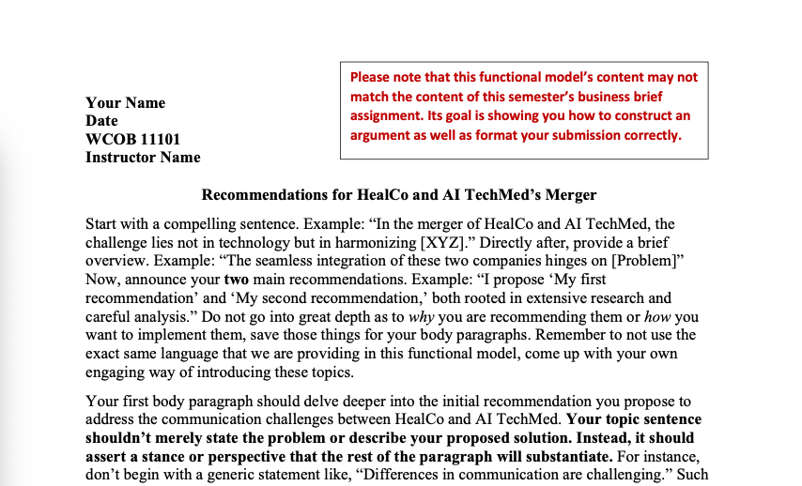
USE THE FUNCTIONAL MODEL
Note the header block and the title
Follow these tips to write a more compelling document
Use block formatting; don’t indent but use a line break.

Slide 25
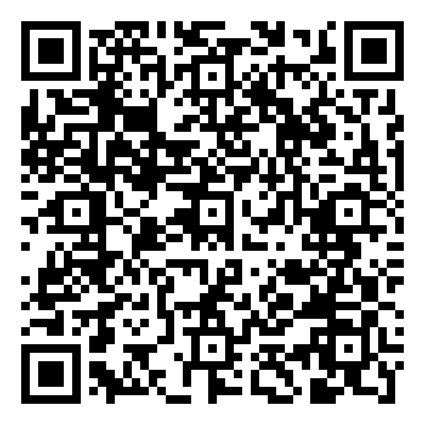
Use the functional model
Scan this QR code to access the functional model or click here.
It’s a good idea to bookmark this page. You will be returning here often.

Slide 26
Students must pass 3 of the 5 categories:​
Criterion​ | Meets expectation (Pass)​
Purpose​ | Student mostly understands the document’s problem and prompt Student generally understands the assignment and its major aspects; critical thinking of its major concerns is mostly evident • Gives two recs (could give more that fall under the same rec category) • Recs mostly address the main problem of the prompt
Content & Organization of Ideas​ | Contents are logically organized; may possess a minor logical misstep/fallacy Student mostly synthesizes information into a coherent, plausible analysis • Mostly integrates, synthesizes, and analyzes at least three sources • Attempt to explain why sources are included and matter Document contains adequate factual support for recommendations, claims, or arguments
Audience: Professionalism, Style, & Tone​ | Student mostly addresses audience’s needs and expectations for the document • Mostly relates evidence back to audience • Gives a few tangible and specific actions for the recs Student uses a professional yet conversational tone; scant (three or less) instances of slang, jokes, or unnecessary jargon Student demonstrates an appropriate level of cultural/global sensibility and awareness Style is appropriate but not as engaging as could be; some wordiness or indirect language
Grammar & Punctuation​ | Document may contain some minor errors, but not enough to distract the average reader In short, the writer’s credibility would not be harmed because of these minor errors; the average reader would have no trouble understanding contents on the first read-through
Genre Conventions & Format​ | Document follows the format given in the assignment prompt • Miss less than three of the following: header, spacing, indentation, references page, formatted like the functional model, follows length requirement • Has in-text citations and reference page but not in the correct format
Click here to access the full rubric.

Slide 27
How to submit your assignment
Login to your blackboard account​.
Open your FBC course​.
Click on "Links to Upload Assignments" and you should find a submission link for this assignment.
Note: You must submit as a doc, docx, or pdf only!​
No Pages or Google Docs.​
No OneDrive links.
Submit the actual file!
​

Slide 28








Sep. 26
Study abroad flier
Sep. 5
Oct. 10
Email
Career exploration, LinkedIn profile
Today
Fall
Break
Sep. 19
Oct. 17
Majors reflection
Oct. 3
Résumé, VMock
Business brief
First half upcoming due dates

Slide 29
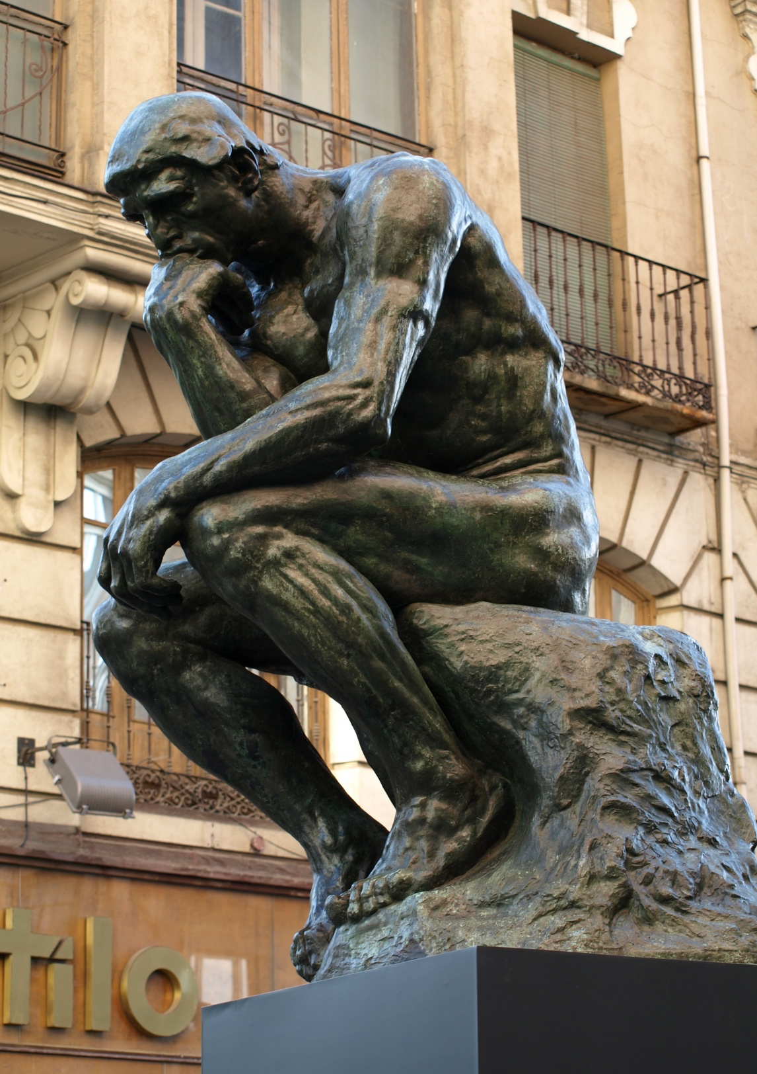
Questions?
Next week: Majors & Minors
Homework: N/A - Business Brief is due Oct. 3rd

