Slide 1

FBC 2016
Writing Proficiency Exercise
Presented by the Walton College of Business, Business Communication Center
walton.uark.edu/business-communication-center

Slide 2
THIS SLIDESHOW WILL COVER:
Assignment Overview
Citations
Submitting the Brief
walton.uark.edu/business-communication-center

Slide 3
Objectives of the FBC writing exercise:
Introduce new Walton students to business writing.
Reinforce critical thinking and synthesis of ideas and information.
Help Walton develop better strategies for teaching better business writing skills.
walton.uark.edu/business-communication-center

Slide 4
What You Need to Write: Business Brief
Length: 750 – 1000 words
Due Date: Oct. 12th
See a tutor by October 7th!
walton.uark.edu/business-communication-center

Slide 5
Remember Week 4?
a business brief is brief (it gets straight to the point)
concerns itself with the “big picture”
does not joke or wander off topic
synthesizes, rather than summarizes
makes a definite recommendation
  Supported by facts, data, and specific examples
walton.uark.edu/business-communication-center

Slide 6
Prompt:
Imagine that you work for a large international company. The board of directors is in the process of creating an official employee diversity policy. They have asked you to research current thinking about business diversity programs and to investigate the policies of other large companies. They ask that you write a business brief in which you address the question:
“If we create an official diversity policy, what kinds of programs or initiatives should we include to make it most effective?”
walton.uark.edu/business-communication-center

Slide 7
First Identify:
Your audience
“The board of directors”
Who you work for
“a large international company”
What your audience
is doing
“creating an official employee diversity policy”
What you need to do
“research current thinking about business diversity programs…investigate the policies of large companies”
What you need to answer
“what kinds of programs…should [you] include?”
walton.uark.edu/business-communication-center

Slide 8
This is NOT academic writing, so:
Don’t explain what a brief is.
Don’t explain why you’re writing the brief.
Don’t explain what “diversity” means.
  Your audience asked you to write the brief,
  so they know the context of it.
walton.uark.edu/business-communication-center

Slide 9
CRITICAL THINKING & SYNTHESIS
Analyze the facts!
Make a strong recommendation.
Do not repeat information verbatim.
This is not a compare and contrast essay.
Do not include irrelevant facts.
walton.uark.edu/business-communication-center

Slide 10
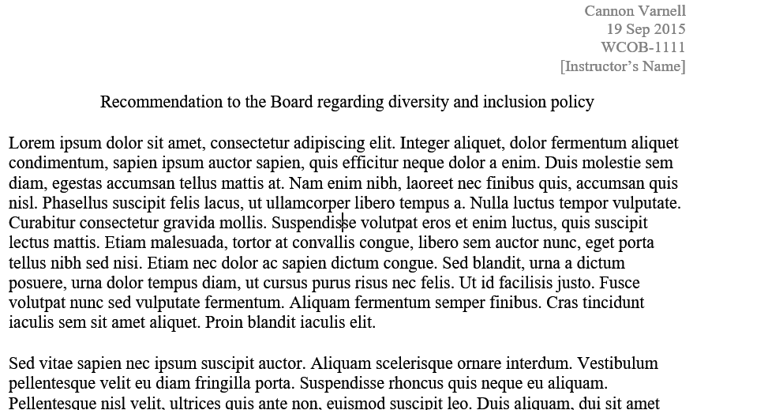
PHYSICAL FORMAT
Header like this:
750 – 1000 words
Allison Banks
12 Oct 2016
WCOB-1111
[Instructor’s Name]
No indent
Single-spaced
Empty line between paragraphs
walton.uark.edu/business-communication-center

Slide 11
Citations
You must cite any direct quotes, data, facts, or statistics that are not common knowledge.
You must use APA citation style.
You need a References page.
walton.uark.edu/business-communication-center

Slide 12
SUBMITTING YOUR BRIEF
walton.uark.edu/business-communication-center

Slide 13
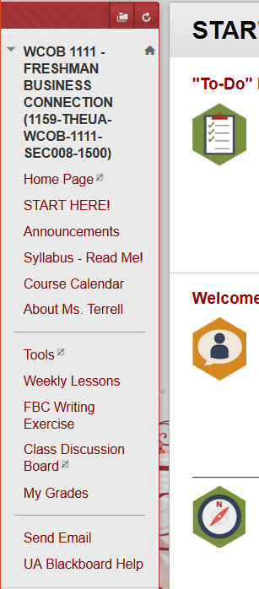
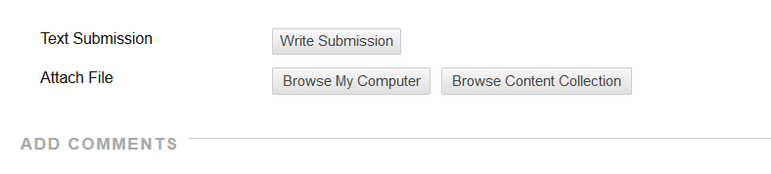
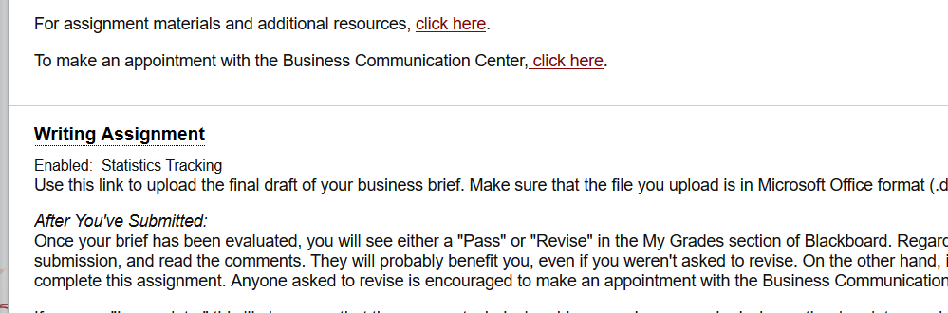
Submit via the Blackboard link.
Do NOT write or paste your brief here.
walton.uark.edu/business-communication-center

Slide 14
Your brief must be in
Microsoft Word format
Either .doc or .docx
Do NOT upload:
.PDF .txt .rtf .zip
.odt (OpenOffice)
.pages (Mac users)
a link to your Google Drive
walton.uark.edu/business-communication-center

Slide 15
Q & A
How do I make an appointment with the business communication center?
What if I have a question later?
Go to our website and create an account.
Email Allison Banks at axb082@uark.edu
***Take note that the people grading this assignment heavily suggest that you come meet with them before turning it in!***
walton.uark.edu/business-communication-center

