Slide 1
Advanced SQL
Microsoft Enterprise Consortium
The relational data set DIVISION problem
Microsoft Enterprise Consortium: http://enterprise.waltoncollege.uark.edu
Microsoft Faculty Connection/Faculty Resource Center http://www.facultyresourcecenter.com

Slide 2
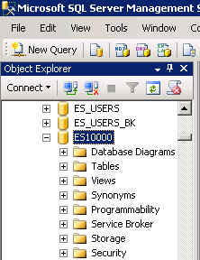
What you’ll need …
Log in to MEC for this lesson and into MSSMS (Microsoft SQL Server Management Studio).
Be sure to select your account ID under Database in the Object Explorer pane, similar to the example shown here.
You should know the SQL covered in the SQL Fundamental series.
If there is something besides the topics for this lesson that you’re not familiar with in this presentation, please review earlier lessons in the Advanced SQL presentations.

Slide 3
DIVISION problem
The “division” problem asks the question: “Which records in data set A correspond to every record in data set B?”
Example: Which students have attended all the workshops offered for skills needed in teams?
WkSp ID | Course Name
EL | Effective Leadership
CE | Communicating Effectively
AL | Active Listening
GO | Get Organized
ID | First Name | Last Name
1003 | Alice | Anderson
1004 | Bill | Bailey
1005 | Carl | Carson
1006 | Denise | Davis

Slide 4
Set Operators – No DIVISION
Remember the set operators such as UNION, INTERSECT, SUBTRACT? There isn’t a DIVISION operator but you can still answer the question: “Which records in data set A correspond to every record in data set B?”
Count the # of records in data set B then see if any record in data set A has that many links to B.
There are 4 workshops.
Let’s say that Alice has attended 2 workshops, Bill has attended 3, Carl has attended 1, Denise has attended 4.
Therefore, Denise has attended all the workshops.
ID | First Name | Last Name
1003 | Alice | Anderson
1004 | Bill | Bailey
1005 | Carl | Carson
1006 | Denise | Davis
WkSp ID | Course Name
EL | Effective Leadership
CE | Communicating Effectively
AL | Active Listening
GO | Get Organized

Slide 5
DIVISION: Modify the S-T database
We’ll modify the Students-Teams database for this lesson. Students can attend workshops that help them learn skills for working in teams.
We will add a WORKSHOPS table and an ATTENDANCES table. The ATTENDANCES table stores information for each student that attends a workshop.
ATTENDANCES
WORKSHOPS
An SQL script is provided to create these tables and insert data.
TEAMS
STUDENTS
EVAL_ITEMS
EVALUATIONS
EVAL_ITEMS_SCORES

Slide 6
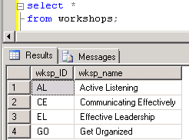
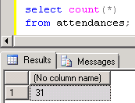
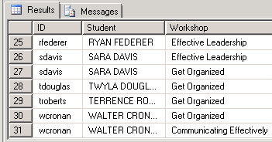
Revised S-T database: Look at the data
Before tackling a DIVISION problem, take a look at the data in the new tables.
/* Show the workshops */
select *
from workshops;
/* Show how many records are in the attendance table. */
select count(*)
from attendances;
/* Show which workshops each student has attended.
List a student even if he/she hasn't attended a workshop. */
select stdid as "ID",
stdfname + ' ' + stdlname as "Student",
wksp_name as "Workshop"
from students left join attendances
on stdid = attnd_stdid
join workshops
on attnd_wksp_ID = wksp
order by stdid;

Slide 7
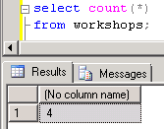
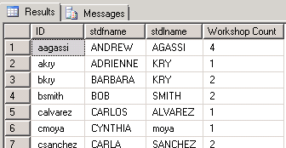
DIVISION problem – Part 1 & 2
Which students have attended all the team skills building workshops?
1st: Count how many workshops there are.
select count(*)
from workshops;
2nd: List students and the # of attendance records each one has.
select stdid as "ID", stdfname, stdlname,
count(*) as "Workshop Count"
from students left join attendances
on stdid = attnd_stdid
group by stdid, stdfname, stdlname;

Slide 8
DIVISION problem – Part 3
Which students have attended all the team skills building workshops?
3rd: Use the workshop counting query (part 1) as a subquery in the HAVING clause of the students’ attendence counting query (part 2).
/* To solve the DIVISION problem, list only students
who have attended as many workshops as the # of workshops
there are. */
select stdid as "ID", stdfname, stdlname,
count(*) as "Workshop Count"
from students left join attendances
on stdid = attnd_stdid
group by stdid, stdfname, stdlname
having count(*) =
(select count(*)
from workshops
);

Slide 9
What was covered …
Division-type problems
No DIVISION operator
Work-around for answering a “division” question.

Slide 10
Resources
http://enterprise.waltoncollege.uark.edu/mec.asp
Microsoft Faculty Connection—Faculty Resource Center http://www.facultyresourcecenter.com/
Microsoft Transact-SQL Reference
http://msdn.microsoft.com/en-us/library/aa299742(v=SQL.80).aspx
AdventureWorks Sample Database
http://msdn.microsoft.com/en-us/library/ms124659%28v=sql.100%29.aspx

