Slide 1
Data Mining Concepts
IBM SPSS
Introduction to Directed Data Mining: Neural Networks

Slide 2
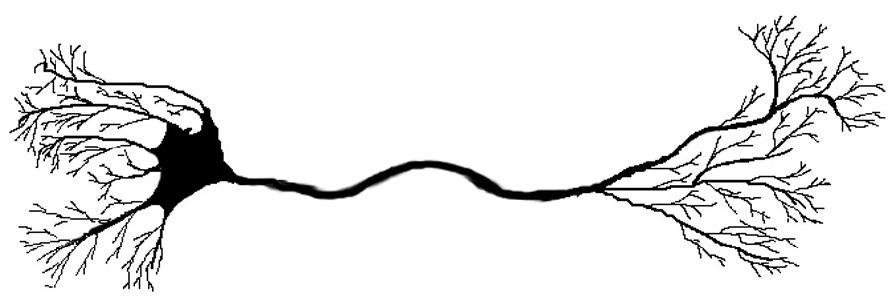
Neural Networks
  Complex learning systems recognized in animal brains
  Single neuron has simple structure
  Interconnected sets of neurons perform complex learning tasks
  Human brain has 10¹⁵ synaptic connections
  Artificial Neural Networks attempt to replicate non-linear learning found in nature—(artificial usually dropped)
Dendrites
Axon
Cell Body
Adapted from Larose

Slide 3
Neural Networks (cont)
  Terms
    Layers
      Input, hidden, output
    Feed forward
    Fully connected
    Back propagation
    Learning rate
    Momentum
    Optimization / sub optimization

Slide 4
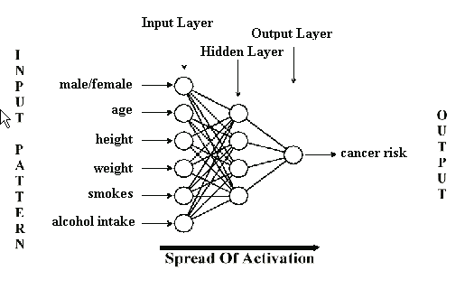
Neural Networks (cont)
  Structure of a neural network
Adapted from Barry & Linoff

Slide 5
Neural Networks (Cont)
  Inputs uses weights and a combination function to obtain a value for each neuron in the hidden layer
  Then a non-linear response is generated from each neuron in the hidden layer to the output
  Activation Function
  After initial pass, accuracy evaluated and back propagation through the network changing weights for next pass
  Repeated until apparent answers (delta) are small—beware, this could be sub optimal solution
Input Layer
Hidden Layer
Output Layer
Combination Function
Transform (Usually a Sigmoid)
Adapted from Larose

Slide 6
Neural Networks (Cont)
  Inputs uses weights and a combination function to obtain a value for each neuron in the hidden layer
  Then a non-linear response is generated from each neuron in the hidden layer to the output
  Activation Function
  After initial pass, accuracy evaluated and back propagation through the network changing weights for next pass
  Repeated until apparent answers (delta) are small—beware, this could be sub optimal solution
Input Layer
Hidden Layer
Output Layer
Combination Function
Transform (Usually a Sigmoid)
Adapted from Larose

Slide 7
Neural Networks (Cont)
Neural network algorithms require inputs to be within a small numeric range. This is easy to do for numeric variables using the min-max range approach as follows (values between 0 and 1)
Other methods can be applied
Neural Networks, as with Logistic Regression, do not handle missing values whereas Decision Trees do. Many data mining software packages automatically patches up for missing values but I recommend the modeler know the software is handling the missing values
Adapted from Larose

Slide 8
Neural Networks (Cont)
Categorical
  Indicator Variables (sometimes referred to as 1 of n) used when number of category values small
  Categorical variable with k classes translated to k – 1 indicator variables
  For example, Gender attribute values are “Male”, “Female”, and “Unknown”
  Classes k = 3
  Create k – 1 = 2 indicator variables named Male_I and Female_I
  Male records have values Male_I = 1, Female_I = 0
  Female records have values Male_I = 0, Female_I = 1
  Unknown records have values Male_I = 0, Female_I = 0
Adapted from Larose

Slide 9
Neural Networks (Cont)
Categorical
  Be very careful when working with categorical variables in neural networks when mapping the variables to numbers. The mapping introduces an ordering of the variables, which the neural network takes into account. 1 of n solves this problem but is cumbersome for a large number of categories.
  Codes for marital status (“single,” “divorced,” “married,” “widowed,” and “unknown”) could be coded
    Single 0
    Divorced .2
    Married .4
    Separated .6
    Widowed .8
    Unknown 1.0
    Note the implied ordering
Adapted from Barry & Linoff

Slide 10
Neural Networks (Cont)
Data Mining Software
  Note that most modern data mining software takes care of these issues for you. But you need to be aware that it is happening and what default setting are being used.
  For example, the following was taken from the PASW Modeler 13 Help topics describing binary set encoding—an advanced topic
  Use binary set encoding. If this option is selected, a compressed binary encoding scheme for set fields is used. This option allows you to more easily build neural net models using set fields with large numbers of values as inputs. However, if you use this option, you may need to increase the complexity of the network architecture (by adding more hidden units or more hidden layers) to allow the network to properly use the compressed information in binary encoded set fields. Note: The simplemax and softmax scoring methods, SQL generation, and export to PMML are not supported for models that use binary set encoding

Slide 11
A Numeric Example
Input Layer
Hidden Layer
Output Layer
W_{0A}
Node 1
W_{1A}
x₁
W_{1B}
Node A
W_{AZ}
Node 2
W_{2A}
Node Z
x₂
W_{2B}
Node B
W_{3A}
W_{BZ}
x₃
Node 3
W_{0Z}
W_{3B}
W_{0B}
x₀
  Feed forward restricts network flow to single direction
  Fully connected
  Flow does not loop or cycle
  Network composed of two or more layers
Adapted from Larose

Slide 12
Numeric Example (Cont)
  Most networks have input, hidden & output layers
  Network may contain more than one hidden layer
  Network is completely connected
  Each node in given layer, connected to every node in next layer
  Every connection has weight (W_{ij}) associated with it
  Weight values randomly assigned 0 to 1 by algorithm
  Number of input nodes dependent on number of predictors
  Number of hidden and output nodes configurable
  How many nodes in hidden layer?
  Large number of nodes increases complexity of model
  Detailed patterns uncovered in data
  Leads to overfitting, at expense of generalizability
  Reduce number of hidden nodes when overfitting occurs
  Increase number of hidden nodes when training accuracy unacceptably low
Adapted from Larose

Slide 13
Numeric Example (Cont)
Combination function produces linear combination of node inputs and connection weights to single scalar value – consider the following weights
Combination function to get hidden layer node values
  Net_{A} = .5(1) + .6(.4) + .8(.2) + .6(.7) = 1.32
  Net_{B} = .7(1) + .9(.4) + .8(.2) + .4(.7) = 1.50
x₀ = 1.0 | W_{0A} = 0.5 | W_{0B} = 0.7 | W_{0Z} = 0.5
x₁ = 0.4 | W_{1A} = 0.6 | W_{1B} = 0.9 | W_{AZ} = 0.9
x₂ = 0.2 | W_{2A} = 0.8 | W_{2B} = 0.8 | W_{BZ} = 0.9
x₃ = 0.7 | W_{3A} = 0.6 | W_{3B} = 0.4
Adapted from Larose

Slide 14
Numeric Example (Cont)
Transformation function is typically the sigmoid function as shown below:
The transformed values for nodes A & B would then be:
Adapted from Larose

Slide 15
Numeric Example (Cont)
Node z combines the output of the two hidden nodes A & B as follows:
  Net_{z} = .5(1) + .9(.7892) + .9(.8716) = 1.9461
The net_{z} value is then put into the sigmoid function
Adapted from Larose

Slide 16
Numeric Example (Cont)
Assume these values used to calculate the output of .8750 is compared to the actual value of a record value of .8
The actual – predicted for all the records on a pass provides a means of measuring accuracy (usually the sum of squared errors). The idea is to minimize this error measurement.
Then the back propagation changes the weights based on the constant weight (initially .5) for node z
  Error at node z, .8750(1-.8750)(.8-.8750) = -.0082
  Calc change weight transmitting 1 unit and learning rate of .1
  .1(-.0082)(1) = -.00082
  Calculate new weights
    .5 - .00082) = .49918
The back propagation continues back through the network adjusting the weights
Adapted from Larose

Slide 17
Learning rate and Momentum
The learning rate, eta, determines the magnitude of changes to the weights
Momentum, alpha, is analogous to the mass of a rolling object as shown below. The mass of the smaller object may not have enough momentum to roll over the top to find the true optimum.
SSE
SSE
I
A
B
C
w
I
A
B
C
w
Small Momentum
Large Momentum
Adapted from Larose

Slide 18
Lessons Learned
Versatile data mining tool
Proven
Based on biological models of how the brain works
Feed-forward is most common type
Back propagation for training sets has been replaced with other methods, notable conjugate gradient
Drawbacks
  Work best with only a few input variables and it does not help on selecting the input variables
  No guarantee that weights are optimal—build several and take the best one
  Biggest problem is that it does not explain what it is doing—no rules

