Slide 1
Data Mining Concepts
Introduction: The essential background

Slide 2
Modules in this Series
The modules in this series are targeted to support using the IBM SPSS Modeler 14.2 using data from DB2 tables on a z10 at the University of Arkansas
This module is the introduction to data mining
The series of modules includes both directed and undirected data mining modules.

Slide 3
Data Mining
What is data mining?
“…the process of discovering meaningful new correlations, patterns, and trends by sifting through large amounts of data…” (Gartner Group)
“…the analysis of observational data sets to find unsuspected relationships and to summarize data in novel ways…” (Hand et al.)
“…is an interdisciplinary field bringing together techniques from machine learning, pattern recognition, statistics, databases, and visualization…” (Cabana et al.)
… is the exploration and analysis of large quantities of data in order to discover previously unknown meaningful and actionable patterns and rules (adapted form Berry and Linoff)
Berry & Linoff (Data Miners) -- http://www.data-miners.com/

Slide 4
Why Data Mining in a customer centric organization?
Data mining can assist in the firm’s ability to form learning relationships with its customers
Factors other than data mining required to turn a product-oriented organization into a customer-centric one
To form a learning relationship with customers, a firm must
Notice what its customers are doing – accomplished via transaction processing system
Remember what it and its customers have done over time – accomplished via data warehouses
Learn from what was remembered – data mining
Act on what is has learned – implementation
Berry & Linoff (Data Miners) -- http://www.data-miners.com/

Slide 5
Why Data Mining Now?
Data are being produced
Data are being stored in data warehouses
Computing power if more affordable
Competitive pressures are enormous
Availability of easy to use data mining software

Slide 6
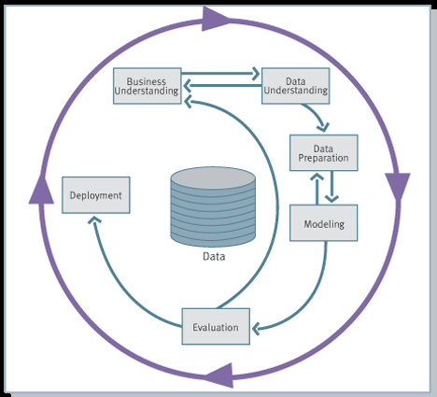
A CRISP Data Mining Methodology?
Cross Industry Standard Process - DM
http://www.crisp-dm.org

Slide 7
Cross Industry Standard Process - DM
Iterative CRISP-DM process shown in outer circle
Most significant dependencies between phases shown
Next phase depends on results from preceding phase
Returning to earlier phase possible before moving forward

Slide 8
CRISP-DM (cont)
(1) Business Understanding Phase
Define business requirements and objectives
Translate objectives into data mining problem definition
Prepare initial strategy to meet objectives
(2) Data Understanding Phase
Collect data
Assess data quality
Perform exploratory data analysis (EDA)
(3) Data Preparation Phase
Cleanse, prepare, and transform data set
Prepares for modeling in subsequent phases
Select cases and variables appropriate for analysis

Slide 9
CRISP-DM (cont)
(4) Modeling Phase
Select and apply one or more modeling techniques
Calibrate model settings to optimize results
If necessary, additional data preparation may be required
(5) Evaluation Phase
Evaluate one or more models for effectiveness
Determine whether defined objectives achieved
Make decision regarding data mining results before deploying to field
(6) Deployment Phase
Make use of models created
Simple deployment: generate report
Complex deployment: implement additional data mining effort in another department
In business, customer often carries out deployment based on model

Slide 10
Important Note
The Need for Human Direction
Don’t be misled into believing that software can just automatically wonder around in the data and produce significant results. Automation is no substitute for human input. Humans need to be involved in every phase of the DM process.
George Grinstein, U. of Mass. at Lowell puts it into perspective
Imagine a black box capable of answering any question it is asked. Any question. Will this eliminate our need for human participation as may suggest? Quite the opposite. The fundamental problem still comes down to a human interface issue. How do I phrase the question correctly? How do I set the parameters to get the solution that is applicable in the particular case I am interested in? How do I get the results in reasonable time and in a form that I can understand? Note that all the questions connect the discovery process to me, for my human consumption.

Slide 11
Four Fallacies of Data Mining (Louie Nautilus Systems, Inc.)
Fallacy 1
Set of tools can be turned loose on data repositories
Finds answers to all business problems
Reality 1
No automatic data mining tools solve problems
Rather, data mining is process (CRISP-DM)
Integrates into overall business objectives
Fallacy 2
Data mining process is autonomous
Requires little oversight
Reality 2
Requires significant intervention during every phase
After model deployment, new models require updates
Continuous evaluative measures monitored by analysts

Slide 12
Four Fallacies of Data Mining (Louie Nautilus Systems, Inc.)
Fallacy 3
Data mining quickly pays for itself
Reality 3
Return rates vary
Depending on startup, personnel, data preparation costs, etc.
Fallacy 4
Data mining software easy to use
Reality 4
Ease of use varies across projects
Analysts must combine subject matter knowledge with specific problem domain

Slide 13
Data Mining Tasks
Supervised
Directed
Description
Estimation
Classification
Prediction
Clustering
Affinity Analysis
Difference; target variable—numeric or categorical
Difference between prediction and (classification and estimation) is future
Unsupervised
Undirected

Slide 14
Matching Data Mining Tasks to Data Mining Algorithms
Estimation
Multiple Linear Regression, Neural Networks
Classification
Decision Trees, Logistic Regression, Neural Networks, k-Nearest Neighbor
Prediction
Estimation & Classification for future values
Clustering
k-means, Kohonen Self Organizing Maps
Affinity Analysis
Association Analysis, sometimes referred to as Market Basket Analysis

