Slide 1
Data Mining Concepts
IBM SPSS
Introduction to Undirected Data Mining: Association Analysis

Slide 2
Association Analysis
Also referred to as
Affinity Analysis
Market Basket Analysis
For MBA, basically means what is being purchased together
Association rules represent patterns without a specific target; thus undirected or unsupervised data mining
Fits in the Exploratory category of data mining

Slide 3
Association Rules
Other potential uses
Items purchases on credit card give insight to next produce or service purchased
Help determine bundles for telcoms
Help bankers determine identify customers for other services
Unusual combinations of things like insurance claims may need further investigation
Medical histories may give indications of complications or helpful combinations for patients

Slide 4
Defining MBA
MBA data
Customers
Purchases (baskets or item sets)
Items
Figure 9-3 set of tables
Purchase (Order) is the fundamental data structure
Individual items are line items
Product –descriptive info
Customer info can be helpful

Slide 5
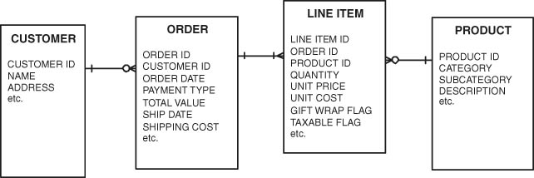
Levels of Data
Adapted from Barry & Linoff

Slide 6
MBA
The three levels of data are important for MBA. They can be used to answer a number of questions
Average number of baskets/customer/time unit
Average unique items per customer
Average number of items per basket
For a given product, what is the proportion of customers who have ever purchased the product?
For a given product, what is the average number of baskets per customer that include the item
For a given product, what is the average quantity purchased in an order when the product is purchased?

Slide 7
Item Popularity
Most common item in one-item baskets
Most common item in multi-item baskets
Most common items among repeat customers
Change in buying patterns of item over time
Buying pattern for an item by region
Time and geography are two of the most important attributes of MBA data

Slide 8
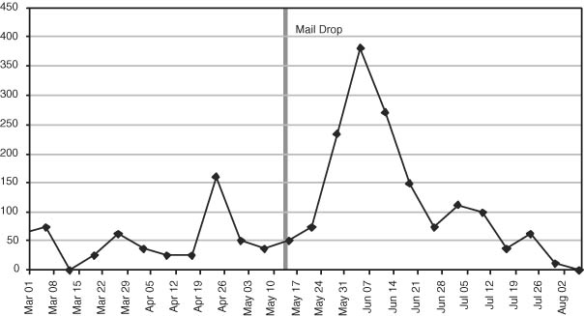
Tracking Market Interventions
Adapted from Barry & Linoff

Slide 9
Association Rules
Actionable Rules
Wal-Mart customers who purchase Barbie dolls have a 60 percent likelihood of also purchasing one of three types of candy bars
Trivial Rules
Customers who purchase maintenance agreements are very likely to purchase a large appliance
Inexplicable Rules
When a new hardware store opens, one of the most commonly sold items is toilet cleaners
Adapted from Barry & Linoff

Slide 10
What exactly is an Association Rule?
Of the form:
IF antecedent THEN consequent
If (orange juice, milk) Then (bread, bacon)
Rules include measure of support and confidence

Slide 11
How good is an Association Rule?
Transactions can be converted to Co-occurrence matrices
Co-occurrence tables highlight simple patterns
Confidence and support can be directly determined from a co-occurrence table
Or by counting via SQL, etc.
DM software makes the presentation easy

Slide 12
Co-Occoncurrence Table
Customer Items
1 Orange juice, soda
2 Milk, orange juice, window cleaner
3 Orange juice, detergent
4 Orange juice, detergent, soda
5 Window cleaner, milk
 | OJ | WC | Milk | Soda | Det
OJ
WC | -
Milk | - | -
Soda | - | - | -
Det | - | - | - | -

Slide 13
Co-Occoncurrence Table
Customer Items
1 Orange juice, soda
2 Milk, orange juice, window cleaner
3 Orange juice, detergent
4 Orange juice, detergent, soda
5 Window cleaner, milk
 | OJ | WC | Milk | Soda | Det
OJ | 4 | 1 | 1 | 2 | 2
WC | - | 2 | 2 | 0 | 0
Milk | - | - | 2 | 0 | 0
Soda | - | - | - | 2 | 1
Det | - | - | - | - | 2

Slide 14
Confidence, Support and Lift
Support for the rule
# records with both antecedent and consequent
Total # records
Confidence for the rule
# records with both antecedent and consequent
# records of the antecedent
Expected Confidence
# records of the consequent
Total # records
Lift
Confidence / Expected Confidence

Slide 15
Confidence and Support
Rule: If soda then orange juice
From the co-occurrence table, soda and orange juice occur together 2 times (out of 5 total transactions)
Thus, support for the rule is 2/5 or 40%
Confidence for the rule:
Soda occurs 2 times; so confidence of orange juice given soda would be 2/2 or 100%
Lift for the rule: Confidence / Expected Confidence
confidence = 100%; expected confidence=80%
lift = 1.0/.8 = 1.25
Rule: If orange juice then soda
support for the rule is the same—40%
orange juice occurs 4 times; so confidence of soda given orange juice is 2/4 or 50%
lift = .5/.8

Slide 16
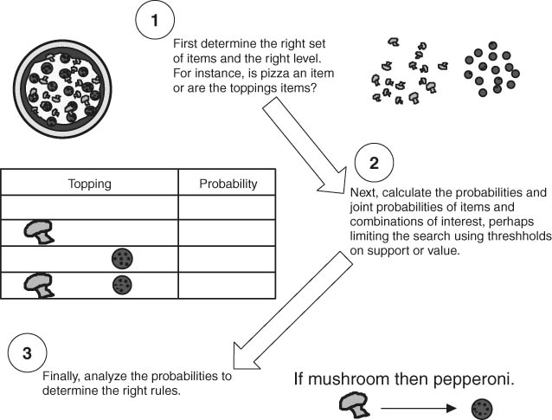
Building Association Rules
Adapted from Barry & Linoff

Slide 17
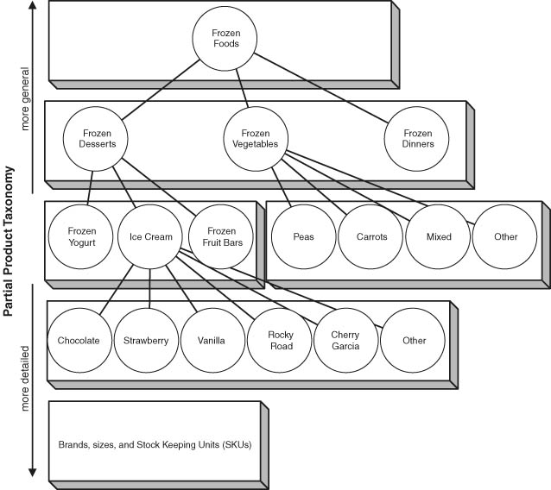
Product Hierarchies

Slide 18
Lessons Learned
MBA is complex and no one technique is powerful enough to provide all the answers.
Three levels—Order (basket), line items and customer
MBA can answer a number of questions
Association rules most common technique for MBA
Generate rules--support, confidence and lift

