Slide 1
Data Mining Concepts
IBM
Introduction to Directed Data Mining: Decision Trees

Slide 2
Decision Trees
A decision tree is a structure that can be used to divide a large collection of records into successively smaller sets of records by applying a sequence of simple decisions rules.
          —Berry and Linoff.
It consists of a set of rules for dividing a large heterogeneous population into smaller and smaller homogeneous groups based on a target variable.
A decision tree is a tree-structured plan of a set of attributes to test in order to predict the output.
                —Andrew Moore.
Target variable is usually categorical.

Slide 3
Uses of Decision Trees
Decision trees are popular for both classification and prediction (Supervised/Directed).
Attractive largely due to the fact that decision trees represent rules—expressed in both English and SQL.
Can also be used for data exploration—thus a powerful first step in model building.

Slide 4
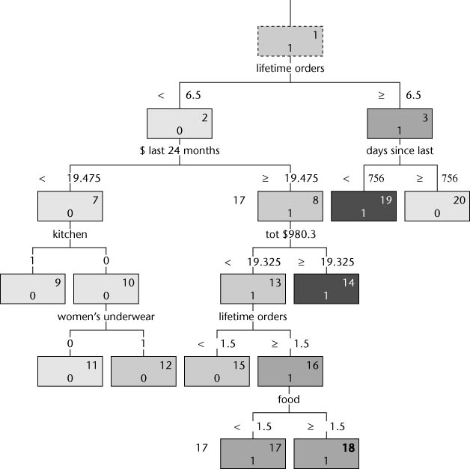
Example Decision Tree
Note this is a binary tree—likely to respond or not.
Leaf nodes with 1 are likely to respond.
There are rules for getting from the root node to a leaf node.
Adapted from Berry and Linoff

Slide 5
Scoring
Binary classifications throw away useful information.
Thus, use of scores and probabilities is essential.

Slide 6
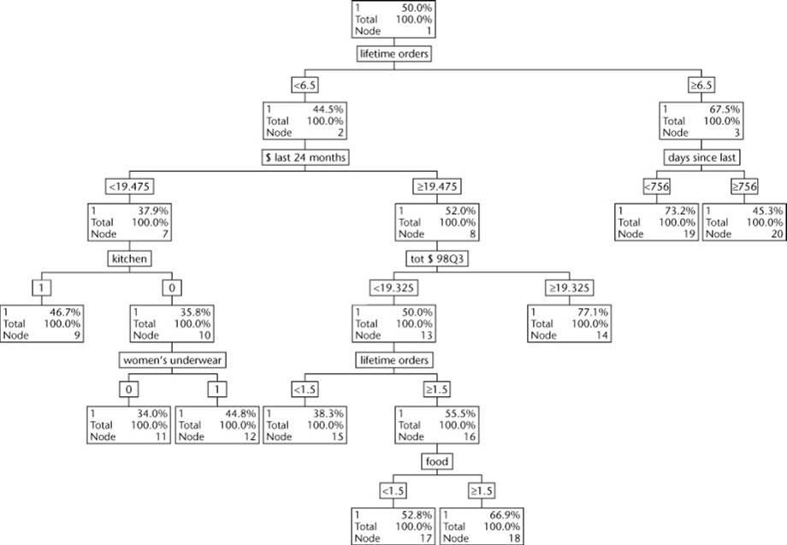
Decision Tree with Proportions
Adapted from Berry and Linoff

Slide 7
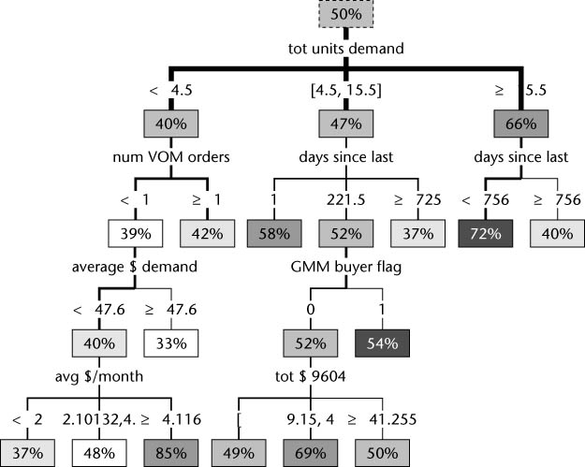
Some DM tools produce trees with more than 2 splits
Adapted from Berry and Linoff

Slide 8
Estimation
Although decision trees can be used to estimate continuous values, there are better ways to do it. So, there are currently no plans to use decision trees for estimation in our discussions.
Multiple Linear Regression and Neural Networks will be used for estimation.

Slide 9
Finding the Splits
A decision tree is built by splitting records at each node based on a single input field—thus there has to be a way to identify the input field that makes the best split in terms of the target variable.
Measure to evaluate the split is purity (Gini, Entropy, Information Gain, Chi-square for categorical target variables and variance reduction and F test for continuous target variables)
Tree building algorithms are exhaustive—try each variable to determine best one on which to split (increase in purity)—not recursive because it repeats itself on the children.

Slide 10
Splitting on a Numeric Variable
Binary split on a numeric input considers each value of the input variable.
Takes the form of X<N (N is a constant).
Because numeric inputs are only used to compare their values at the split points, decision trees are not sensitive to outliers or skewed distributions.

Slide 11
Splitting on a Categorical Variable
The simplest way is to split on each class (level) of the variable.
However, this often yields poor results because high branching factors quickly reduce the population of training records available for lower nodes.
An approach around this is to group the classes that, when taken individually, predict similar outcomes.

Slide 12
Splitting on Missing Values
This can be done by considering null as a possible value with its own branch.
Preferable to throwing out the record or imputing a value.
Null has been shown to have predictive value in a number of data mining projects.

Slide 13
Full Trees
Single value fields are eliminated—it cannot be split.
Full tree when it is not possible to do any more splits or to a predetermined depth.
Note—full trees may not be best at classifying a set of new records.

Slide 14
Building Decision Trees
Key points in building a decision tree
  Purity→ the idea is to split attributes in such a way as move from heterogeneous to homogenous based on target variable
  Splitting algorithm (criterion)
    Repeat for each node. At a node, all attributes analyzed to determine the best variable on which to split (How to measure?)
    There are a number of algorithms and various implementations of the algorithms.
  Stopping
    When a node is pure →leaf
    No more splits are possible.
    User defined parameters such as maximum depth or minimum number in a node.

Slide 15
Splitting Rules
Measure to evaluate the split is purity.
  Gini
    CART
  Entropy reduction or information gain
    C5.0
  Chi-square
    CHAID
  Chi-Square and Variance Reduction
    QUEST
    -------------------------------------------------
  F-test
  Variance reduction

Slide 16
Pruning
A bushy tree may not be the best predictor and a deep tree has complex rules.
Pruning is used to cut back on the tree.
  Depending on the pruning algorithm,
    Pruning may happen as the tree is being constructed.
    Pruning may be done after the tree is completed.
Stability-Based Pruning
  Automatic stability-pruning is not yet available.

Slide 17
Example
Evaluate which split is better—the left or the right? The root node has 10 red and 10 blue cases for the target variable.

Slide 18
Gini--
Left Split
Left Split
Left Split
Gini— sum of the squares of the proportion of the classes
Gini -- ranges from 0 (no two items alike) to 1 (all items alike)
For the root node, .5² + .5² = .5
Left node: .1² + .9² = .82 Right Node: .1² + .9² = .82
Multiple by proportion in node and add
½(.82) + ½(.82) = .82 – The Gini value for this split
Right Split
What is the Gini value?

Slide 19
Entropy Reduction—Information Gain
Left Split
-1*(P(black)log₂P(black) + P(red) log₂P(red)
Root node: -1*(.5)log₂(.5) + (.5) log₂(.5) = +1
Left node: -1*(.1)log₂(.1) + (.9) log₂(.9) = .47
Right node: -1*(.9)log₂(.9) + (.1) log₂(.1) = .47
Multiple by the proportion of records in the node and add
½(.47) +1/2(.47) = .47
Entropy reduction is 1-.47 = .53
-1*(P(black)log₂P(black) + P(red) log₂P(red)
Root node: -1*(.5)log₂(.5) + (.5) log₂(.5) = +1
Left node: -1*(.1)log₂(.1) + (.9) log₂(.9) = .47
Right node: -1*(.9)log₂(.9) + (.1) log₂(.1) = .47
Multiple by the proportion of records in the node and add
½(.47) +1/2(.47) = .47
Entropy reduction is 1-.47 = .53
Right Split—what is the Entropy Reduction value?
Right Split
What is the Entropy Reduction value?

Slide 20
Another Example
Using Gini as the splitting criterion, which split should be taken?
10 Red, 10 Blue
Left Split
Right Split

Slide 21
Example - Entropy
Evaluate which split is better—the left or the right? The root node has 10 red and 10 blue cases for the target variable.

Slide 22
Reduction in Variance - F Test
When target variable is numeric, then a good split would be one that reduces variance of the target variable.
F Test – A large F test means that the proposed split has successfully split the population into subpopulations with significantly different distributions.

Slide 23
Pruning the tree
As previously indicated, full trees may not be the best predictors using new data sets.
Thus, a number of tree pruning algorithms have been developed.
CART—Classification and Regression Trees
C5.0
Stability-Based Pruning
  Automatic stability-pruning is not yet available.

Slide 24
Extracting Rules from Trees
Fewer leafs is better for generating rules.
Easy to develop English rules.
Easy to develop SQL rules that can be used on a database of new records that need classifying.
Rules can be explored by domain experts to see if rules are usable or perhaps a rule is simply echoing a procedural policy.

Slide 25
Using More than One Field on a Split
Most algorithms consider only a single variable to perform each split.
This can lead to more nodes than necessary.
Algorithms exist to consider multiple fields in combination to form a split.

Slide 26
Decision Trees in Practice
Data exploration tool.
Predict future states of important variables in an industrial process.
To form directed clusters of customers for a recommendation system.

Slide 27
Using the Software
Rule Induction (Decision Trees)
  IBM SPSS Modeler 14.2 will be used to illustrate data mining.
  The example will compare decision trees to other classification algorithms
27

Slide 28
Conclusion
Decision Trees are the single most popular data mining tool.
  Easy to understand
  Easy to implement
  Easy to use
  Computationally cheap
It is possible to get into trouble with overfitting.
Mostly, decision trees predict a categorical output from categorical or numeric input variables.
Note: Overfitting is when the model fits noise (i.e. pays attention to parts of the data that are irrelevant)—Another way of saying this is it memorizes the data and may not generalize.
28

