Slide 1
Data Mining Concepts
IBM
Introduction to Directed Data Mining: K-Nearest Neighbor

Slide 2
Nearest Neighbor Techniques
Based on Similarity
  Memory-based reasoning
    Based on analogous situations in the past
  Collaborative filtering
    Not just familiarities but preferences
Two key concepts
  Similarity (distance function)
  Combine information from neighbors to infer something about the target (combination function)

Slide 3
Memory-based reasoning
Typical uses
  Fraud detection
  Customer response prediction
  Medical treatments
  Classifying responses (free-text)
Strength is using data “as is”

Slide 4
Memory-based Reasoning
Two key concepts
  Similarity (distance function)
  Combine information from neighbors to infer something about the target (combination function)
Strengths
  Ability to use data “as is”
    Includes complex data types
  Ability to adapt
Strengths come at a cost—computer resource hog

Slide 5
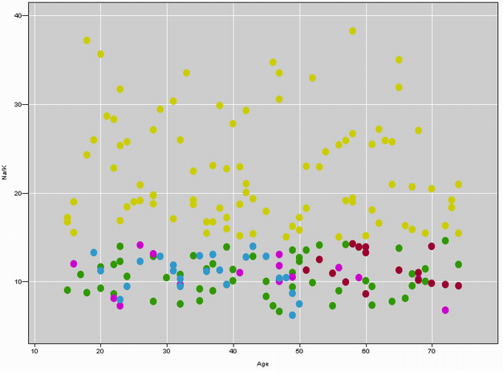
Example
  This scatter plot of Na/K against Age shows the records in the training set that patients 1, 2, and 3 are most similar to
  A “drug” overlay is shown where Light points = drug Y, Medium points = drug A or X, and Dark points = drug B or C
Patient 1
Patient 2
Patient 3
Adapted from Larose

Slide 6
Example (cont)
  Which drug should Patient 1 be prescribed?
  Since Patient 1’s profile places them in the scatter plot near patients prescribed drug Y, we classify Patient 1 as drug Y
  All points near Patient 1 are prescribed drug Y, making this a straightforward classification
Example: Patient 2
  Next we classify a new patient who is 17-years-old with a Na/K ratio = 12.5. A close-up shows the neighborhood of training points in close proximity to Patient 2
C
Patient2
A
B
Adapted from Larose

Slide 7
Example (cont)
  However, with k = 3, voting determines that two of the three closet points to Patient 2 are Medium
  Therefore, Patient 2 is classified as drug A or X
  Note that the classification of Patient 2 differed based on the value chosen for k
Example: Patient 3
  Patient 3 is 47-years-old and has a Na/K ratio of 13.5. A close-up shows Patient 3 in the center, with the closest 3 training data points
Patient3
Adapted from Larose

Slide 8
Normalize Values
Age range 10-60; mean=45; std = 15
Patient | Age | Age_{mmx} | Age_{norm} | Gender
A | 50 | (50-10)/50 = .8 | (50-45)/15 = .33 | Male
B | 20 | (50-20)/50 = .6 | (20-45)/15= -1.67 | Male
C | 50 | (50-10)/50 = .8 | (50-45)/15=.33 | Female
Adapted from Larose

Slide 9
Compare Patients (un weighted)
Variables – Gender and Age – raw, mmx, norm
Compare A to B
  Raw data: sqrt((50-20)² +0²) = 30
  Mmx: sqrt((.8-.2)² +0²) = .6
Compare A to C
  Raw data: sqrt((50-50)² +1²) = 1
  Mmx: sqrt((.8-.8)² +0²) = 1
Note that using raw numbers, A is closer to C (30 versus 1) whereas using min-max, A is closer to B (.6 versus 1)
Try using normalized values
Adapted from Larose

Slide 10
Estimate Rents Example (from Barry and Linoff)
Objective-estimate cost of renting an apartment in the target town by combing data on rents from similar towns (nearest neighbor—not geographical)
Identifies neighbors based on distance function and then uses a combining function to predict the target variable

Slide 11
Estimate Rents Example (cont)
Predict rents for Tuxedo, NY
Nearest neighbor based on population and median home value
Methodology
  Find closest neighbor and then next closest neighbor
  Must determine how many neighbors to include – two for this example
Determine combining function

Slide 12
Estimate Rents Example (cont)
Combining function (North Salem and Shelter Island)
  Median incomes similar but distributions different—see table 8.1
    Shelter Island—34.6% between 500-750
    North Salem – 30.9% between 1000-1500
    Shelter Island—median is $804>ceiling of most common range
    North Salem—median is $1150 < floor of most common range
  Possibilities
    Median income
    Average of most common rents (midpoints)
      Average of 1000 and 1250 to get 1125 as prediction for Tuxedo
  Actual Tuxedo rents has plurality of values between 1000 and 1500 and median rent is $907

Slide 13
Challenges of MBR
Selecting an appropriate set of training records—balanced set
Selecting the most efficient way to represent the training records
Selecting the distance function, the combination function, and the number of neighbors

Slide 14
Performance Issues
Generally each case being scored needs to be compared against every case in the database—thus could be time consuming to score a large number of records
Reduce the number of records

Slide 15
Case Study: Classifying News Stories
(Barry and Linoff)
Table 8.2 provides classification codes
Editors—experts do the codes
  Select the training set
  Determine the distance function
  Selecting nearest neighbors
  Determining the combining function

Slide 16
Metrics
Recall
  Ratio of correct codes assigned by MBR to total number of correct codes
Precision
  Ratio of correct codes assigned by MBR to total number of codes assigned by MBR

Slide 17
Evaluation of Case Study
Experts – 88% codes assigned were correct; 17% of codes assigned were incorrect
MBR -- 80% codes assigned were correct; 28% of codes were incorrect
  Note—editor assignment included expert, intermediate and novice editors—MBR did as well as the intermediate editors

Slide 18
Building the Distance Function
Numeric Data
  Absolute value of the diff: |A – B|
  Square of the difference: (A-B)²
  Normalized absolute value: |A – B| / (maximum difference)
  Absolute value difference of standardized values:
|A-B| / (standard deviation)

Slide 19
Building the Distance Function (cont)
Categorical data – gender example
  D_{gender}(F,F) = 1
  D_{gender}(F,M) = 0
  D_{gender}(M,F) = 0
  D_{gender}(M,M)= 1

Slide 20
Overall Analysis
Combine the distance functions
  Manhattan or summation
    d_{sum}(A,B) = d_{gender}(A,B) + d_{age}(A,B) + d_{salary}(A,B)
  Normalized summation
    d_{norm}(A,B) = d_{sum}(A,B) /max(d_{sum})
  Euclidean distance
    d_{Eucllid}(A,B) = sqrt(d_{gender}(A,B)² + d_{age}(A,B) ² + d_{salary}(A,B)²)
Table 8.9 illustrates using these functions
  New rec—table 8.10 & table 8.11 shows nearest neighbors
  Note—2nd nearest neighbor using summation is farthest using Euclidian
  Euclidian tends to favor fields where neighbors are relatively close—thus punishes record 3 because genders are different

Slide 21
Distance Functions for Other Data Types
Use higher order digits of zip code for geographic applications
However, use latitude and longitude if geography if really important
Many times geography is not important

Slide 22
Combing Function
Ask the neighbors--democracy
  Classification, members of the class casts vote for its class
Weighted voting—not all are equal
  Weight inversely proportion to distance

Slide 23
Collaborative Filtering
Recommendation from a trusted friend lead to action that otherwise would not have been taken
Starts with a history of people’s preferences
Distance function based on overlap of preferences
Votes are weighted by distances
Also referred to as “social information filtering”

Slide 24
Collaborative Filtering (cont)
An attempt to automate “word-of-mouth”
Who liked it is important
Challenge of building profiles
  Often far more items to be rated than any one person is likely to have experienced or willing to rate
    Maybe have persons rank list of top 20 items
See Figure 8.7 (Barry and Linoff) for prediction example

Slide 25
Lessons Learned
Power DM technique that can be used to solve a wide variety of DM problems
  Selecting the right training set is critical
  Nearest neighbor technique
    Distance function
    Combining function
      A large difference in any one field may be enough to make two records far apart using the Euclidian method
    How many neighbors to use—try two, three, four

