Slide 1
Advanced SQL
Microsoft Enterprise Consortium
Greenhouse Database – Introduction
Saving output in SQL Server Management Studio
Microsoft Enterprise Consortium: http://enterprise.waltoncollege.uark.edu
Microsoft Faculty Connection/Faculty Resource Center http://www.facultyresourcecenter.com

Slide 2
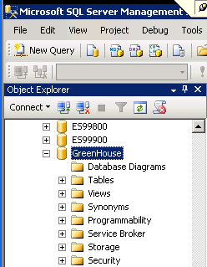
What you’ll need …
Log in to MEC for this lesson and into MSSMS (Microsoft SQL Server Management Studio).
Be sure to select your account ID under Database in the Object Explorer pane, similar to the example shown here.
Select the Greenhouse database.
(Note: The database name might change over time. Look for MEC_greenhouse or UARK_greenhouse.)

Slide 3
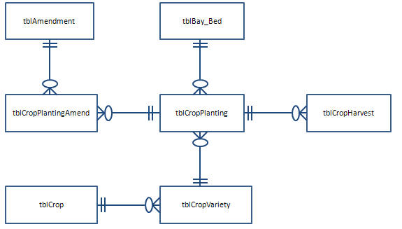
Greenhouse Database
Below is the greenhouse data model.
Amend_Code = AmendCode
bay_bed
CropPlantingID
CropPlantingID
CropVarID
Crop

Slide 4
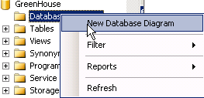
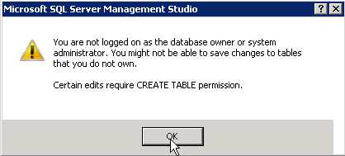
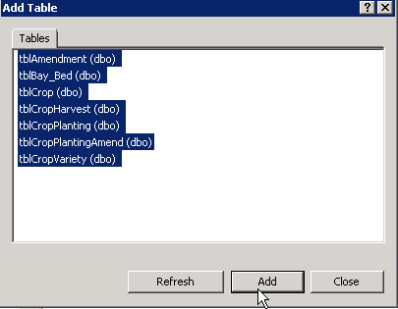
Greenhouse – SSMS Diagram
SQL Server Management Studio – Diagram
Copy to Clipboard and paste in to a Word file.

Slide 5
Greenhouse Database - How many rows in a table?
/* Get a count of the records in each table. */
select count(*) as "tblCrop Rows"
from tblCrop;
select count(*) as "tblCropVariety Rows"
from tblCropVariety;
select count(*) as "tblBay_Bed Rows"
from tblBay_Bed;
select count(*) as "tblCropPlanting Rows"
from tblCropPlanting;
select count(*) as "tblAmendment Rows"
from tblAmendment;
select count(*) as "tblCropPlantingAmend Rows"
from tblCropPlantingAmend;
select count(*) as "tblCropHarvest Rows"
from tblCropHarvest;

Slide 6
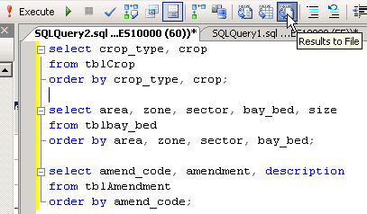
Greenhouse Database - List contents of small tables.
/* List contents of smaller tables. Save output to a file. */

Slide 7
Greenhouse Database – Crops are planted and harvested.
Area, Zone, Sector, Bay-Bed
Area = “Greenhouse”
Zone = “North Seed”
Zone = “South Seed”
Sector = “A”
Bay=“01”
Bay=“02”
A1
A1
A2
A2
A3
A3
Sector = “B”
Bay=“01”
B1
B2
B3

Slide 8
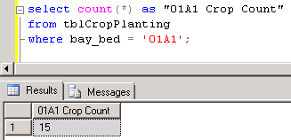
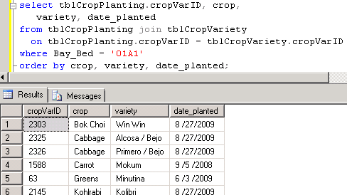
Greenhouse Database - View some crop planting data.
/* Example SQL: Show how many crops have been planted in bay-bed 01A1. */
select count(*) as "01A1 Crop Count"
from tblCropPlanting
where bay_bed = '01A1';
/* Show which crops have been planted in bay-bed 01A1. */
select tblCropPlanting.cropVarID, crop, variety, date_planted
from tblCropPlanting join tblCropVariety
on tblCropPlanting.cropVarID = tblCropVariety.cropVarID
where bay_bed = '01A1'
order by crop, variety, date_planted;

Slide 9
What was covered …
An overview of the greenhouse database.
How to save SQL output to a file in SQL Server Management Studio.

Slide 10
Resources
http://enterprise.waltoncollege.uark.edu/mec.asp
Microsoft Faculty Connection—Faculty Resource Center http://www.facultyresourcecenter.com/
Microsoft Transact-SQL Reference
http://msdn.microsoft.com/en-us/library/aa299742(v=SQL.80).aspx
AdventureWorks Sample Database
http://msdn.microsoft.com/en-us/library/ms124659%28v=sql.100%29.aspx

