Slide 1
Advanced SQL
Microsoft Enterprise Consortium
Equi-Join
One-sided Outer Join
Full Outer Joiin
Microsoft Enterprise Consortium: http://enterprise.waltoncollege.uark.edu
Microsoft Faculty Connection/Faculty Resource Center http://www.facultyresourcecenter.com

Slide 2
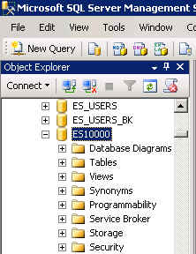
What you’ll need …
Log in to MEC for this lesson and into MSSMS (Microsoft SQL Server Management Studio).
  Be sure to select your account ID under Database in the Object Explorer pane, similar to the example shown here.
You should be very comfortable with the SQL commands covered in the SQL Fundamental series.

Slide 3
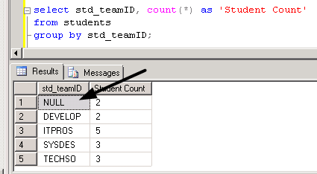
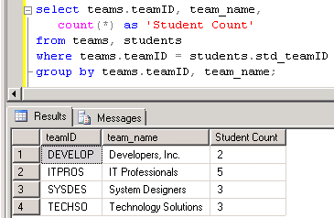
Equi-Join
Equi-join: When you join two tables in a query, by default, you only get output for data that has related data in both tables. This is called an “equi-join.”
We’ve seen an example of this in the Student-Team database. The output on the left is based on 1 table. The one on the right uses 2 tables.

Slide 4
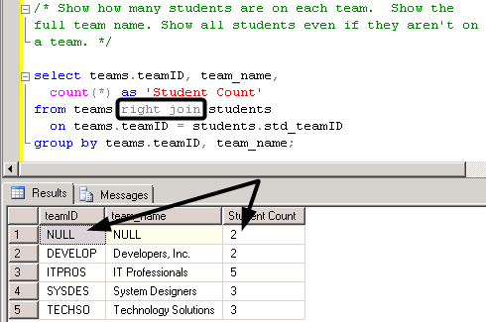
Equi-Join and One-Sided Join
One-sided join: A one-sided join includes all the data on the “one side” and any related data from the other table.
The output on the left uses an equi-join. Add either “right” or “left” to specify from which table you want all data.

Slide 5
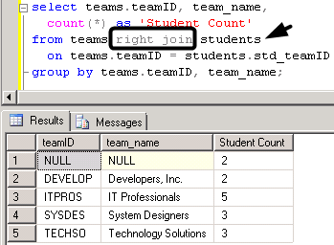
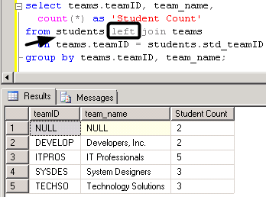
One-Sided Join: Left or Right?
The choice of “left” or “right” is based on which table you want all the data from and the order it is listed in the FROM clause.
Left and right have been used below and the output is the same because the order the tables are listed was switched.

Slide 6
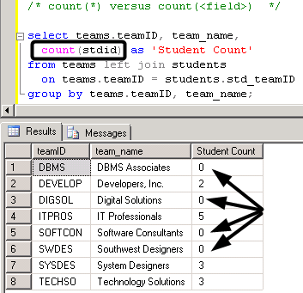
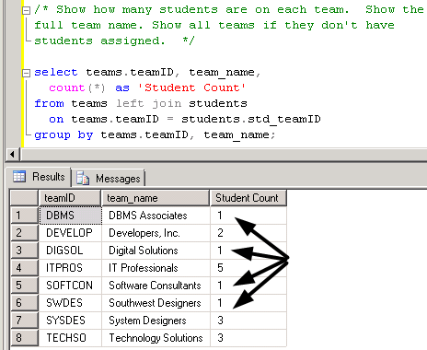
One-Sided Join: Show all teams
Let’s do a one-sided outer join that shows ALL teams and the # of students on each team.
The output on the left demonstrates that sometimes it is important to count a field, not count(*).

Slide 7
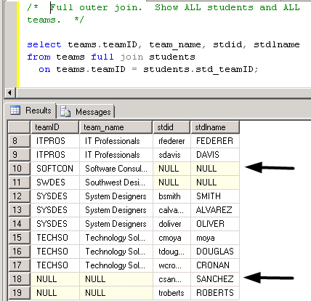
Full outer join
A FULL outer join shows all data from both tables.
/* Full outer join. Show ALL students and ALL teams. */
select teams.teamID, team_name, stdid, stdlname
from teams full join students
on teams.teamID = students.std_teamID;

Slide 8
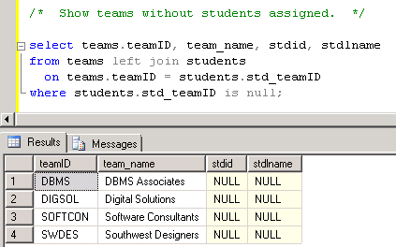
One-Sided JOIN and NULL
If we ask the question “Which teams don’t have students assigned?”, we use a one-sided join and the IS NULL criterion.
/* Show teams without students assigned. */
select teams.teamID, team_name, stdid, stdlname
from teams left join students
on teams.teamID = students.std_teamID
where students.std_teamID is null;

Slide 9
What was covered …
Equi-join
One-sided outer join
  Left
  Right
Full outer join
One-sided outer join with IS NULL

Slide 10
Resources
http://enterprise.waltoncollege.uark.edu/mec.asp
Microsoft Faculty Connection—Faculty Resource Center http://www.facultyresourcecenter.com/
Microsoft Transact-SQL Reference
http://msdn.microsoft.com/en-us/library/aa299742(v=SQL.80).aspx
AdventureWorks Sample Database
http://msdn.microsoft.com/en-us/library/ms124659%28v=sql.100%29.aspx

