Slide 1
Advanced SQL
Microsoft Enterprise Consortium
In-Line Subquery
Microsoft Enterprise Consortium: http://enterprise.waltoncollege.uark.edu
Microsoft Faculty Connection/Faculty Resource Center http://www.facultyresourcecenter.com

Slide 2
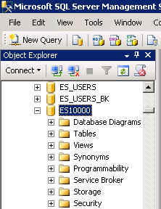
What you’ll need …
Log in to MEC for this lesson and into MSSMS (Microsoft SQL Server Management Studio).
Be sure to select your account ID under Database in the Object Explorer pane, similar to the example shown here.
You should know the SQL covered in the SQL Fundamental series.
If there is something besides the topics for this lesson that you’re not familiar with in this presentation, please review earlier lessons in the Advanced SQL presentations.

Slide 3
In-line subquery
An in-line subquery is in the FROM clause of the outer query. Think of it has a regular but temporary table that is assigned a name through a table alias and must be joined with at least one other table, if more than one table is used.
The use of subqueries is sometimes necessary but, even if the answer can be found without a subquery, it is often beneficial to use subqueries to decompose a problem statement.

Slide 4
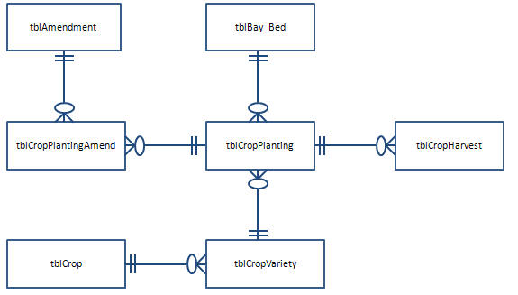
In-line subquery example
For this example, we’ll use the greenhouse database and create 3 temporary tables by using 3 subqueries.
List the crop planting ID and amendment, if the soil was amended with sulphur, potting mix, or mulch.
Count the # of harvests for each crop planting ID.
Be sure to include the field(s) needed to join with other tables.
List crop planting ID, crop, variety, and bay-bed.

Slide 5
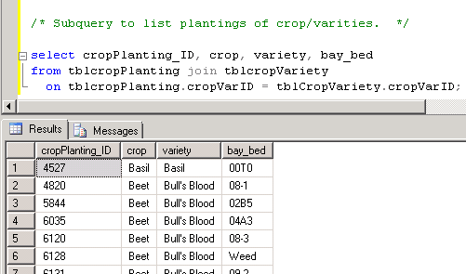
In-line example – 1st subquery
/* Subquery to list plantings of crop/varities. */
select cropPlanting_ID, crop, variety, bay_bed
from tblcropPlanting join tblcropVariety
on tblcropPlanting.cropVarID = tblCropVariety.cropVarID;

Slide 6
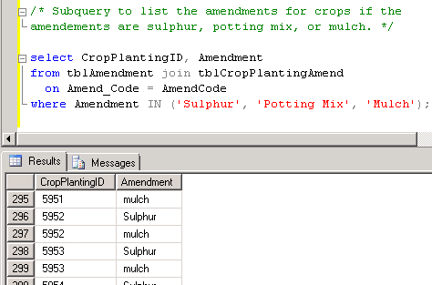
In-line example – 2nd subquery
/* Subquery to list the amendments for crops if the amendements are sulphur, potting mix, or mulch. */
select CropPlantingID, Amendment
from tblAmendment join tblCropPlantingAmend
on Amend_Code = AmendCode
where Amendment IN ('Sulphur', 'Potting Mix', 'Mulch');

Slide 7
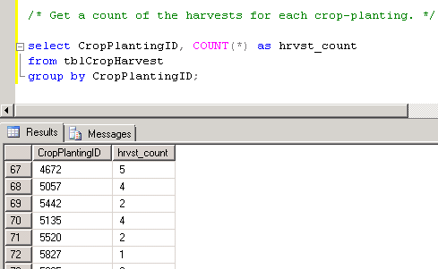
In-line example – 3rd subquery
/* Get a count of the harvests for each crop-planting. */
select CropPlantingID, COUNT(*) as hrvst_count
from tblCropHarvest
group by CropPlantingID;

Slide 8
In-line example – Complete query
/* In-line query using 3 subqueries in the FROM clause. This query uses table aliases. Note that the column aliases in the subquery are used just like "regular" columns in the outer query SELECT clause. */
select Crp.cropPlanting_ID, crop, variety, hrvst_count, BB
from
(select cropPlanting_ID, crop, variety, bay_bed as "BB"
from tblcropPlanting join tblcropVariety
on tblcropPlanting.cropVarID = tblCropVariety.cropVarID) Crp,
(select CropPlantingID, Amendment
from tblAmendment join tblCropPlantingAmend
on Amend_Code = AmendCode
where Amendment IN ('Sulphur', 'Potting Mix', 'Mulch')) Amd,
(select CropPlantingID, COUNT(*) as hrvst_count
from tblCropHarvest
group by CropPlantingID) Hrv
where amd.CropPlantingID = Crp.CropPlanting_ID
and Crp.CropPlanting_ID = hrv.CropPlantingID
order by hrvst_count desc;

Slide 9
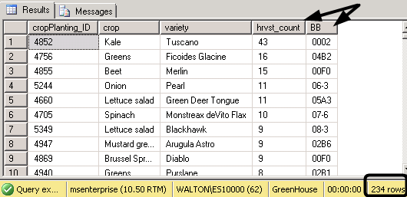
In-line example – Query output
/* In-line query using 3 subqueries in the FROM clause. This query uses table aliases. Note that the column aliases in the subquery are used just like "regular" columns in the outer query SELECT clause. */
OUTPUT:

Slide 10
What was covered …
In-line subquery
Use in decomposing a problem and writing queries for each subquery. This can also help in debugging or troubleshooting a query.

Slide 11
Resources
http://enterprise.waltoncollege.uark.edu/mec.asp
Microsoft Faculty Connection—Faculty Resource Center http://www.facultyresourcecenter.com/
Microsoft Transact-SQL Reference
http://msdn.microsoft.com/en-us/library/aa299742(v=SQL.80).aspx
AdventureWorks Sample Database
http://msdn.microsoft.com/en-us/library/ms124659%28v=sql.100%29.aspx

