Slide 1
Advanced SQL
Microsoft Enterprise Consortium
Nested aggregate queries
Microsoft Enterprise Consortium: http://enterprise.waltoncollege.uark.edu
Microsoft Faculty Connection/Faculty Resource Center http://www.facultyresourcecenter.com

Slide 2
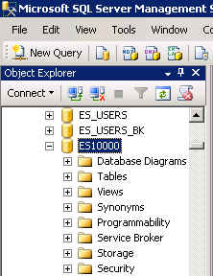
What you’ll need …
Log in to MEC for this lesson and into MSSMS (Microsoft SQL Server Management Studio).
Be sure to select your account ID under Database in the Object Explorer pane, similar to the example shown here.
You should know the SQL covered in the SQL Fundamental series.
If there is something besides the topics for this lesson that you’re not familiar with in this presentation about nested aggregate queries, please review earlier lessons in the Advanced SQL presentations.

Slide 3
Nested Aggregate queries
Sometimes it is necessary to embed one aggregate query inside another aggregate query, a.k.a. nested aggregate queries.
As with other types of subqueries, the aggregate subquery decomposes the problem statement and creates a solution for part of the problem statement.

Slide 4
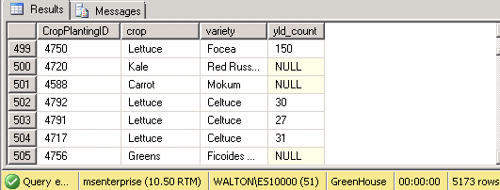
Nested Aggregate – 1st: detailed data
Using the greenhouse database, we will list crop-planting ID, crop, variety, and the yield count.
NOTE: The way harvest data is recorded varies. Some harvests are weighed, others are counted.
/* 1st: List detailed data about crop plantings and the harvest yield count. */
select CropPlantingID, crop, variety,
cast(Yield_Count as decimal) as yld_count
from tblcropVariety CV, tblcropPlanting CP, tblCropHarvest CH
where CV.CropVarID = CP.CropVarID
and CP.CropPlanting_ID = CH.CropPlantingID;
Though not required, table aliases have been used here —defined in the FROM clause and used in the WHERE clause.

Slide 5
Comment about the CAST() function
In the query we just created the CAST() function is used to convert data stored as text to numeric data.
The data types for columns in the greenhouse database may be revised in the future and you may not need to use the CAST() function to convert numbers stored as text to numeric values that can be calculated.
select CropPlantingID, crop, variety,
cast(Yield_Count as decimal) as yld_count
from tblcropVariety CV, tblcropPlanting CP, tblCropHarvest CH
where CV.CropVarID = CP.CropVarID
and CP.CropPlanting_ID = CH.CropPlantingID;

Slide 6
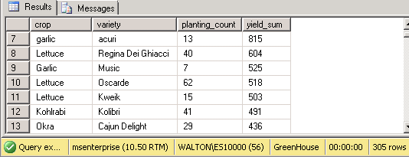
2nd: Aggregate data
Using the previous query in the FROM clause, we now use the count and sum aggregate functions to count the number of crop plantings and sum the yield count.
Note the table alias for the subquery.
select crop, variety,
count(cropPlantingID) as planting_count,
sum(yld_count) as yield_sum
from
(select CropPlantingID,crop, Variety,
cast(Yield_Count as decimal) as yld_count
from tblcropVariety CV, tblcropPlanting CP, tblCropHarvest CH
where CV.CropVarID = CP.CropVarID
and CP.CropPlanting_ID = ch.CropPlantingID) CVPH
group by crop, variety
order by yield_sum desc;

Slide 7
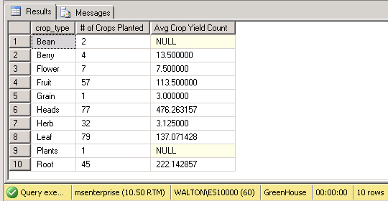
3rd: Aggregate data
Using the previous query in the FROM clause, we now the count the number of crops (not plantings of each crop) and average the yield count.
select crop_type,
count(*) as "# of Crops Planted",
avg(yield_sum) as "Avg Crop Yield Count"
from tblCrop,
(select crop, variety,
count(cropPlantingID) as planting_count,
sum(yld_count) as yield_sum
from
(select CropPlantingID,crop, Variety,
cast(Yield_Count as decimal) as yld_count
from tblcropVariety CV, tblcropPlanting CP, tblCropHarvest CH
where CV.CropVarID = CP.CropVarID
and CP.CropPlanting_ID = ch.CropPlantingID) cvph
group by crop, variety) SubQ
where tblCrop.Crop = SubQ.Crop
group by crop_type
order by crop_type;

Slide 8
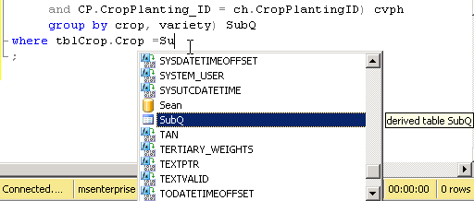
3rd: Aggregate data: Output
Output:
The IntelliSense feature immediately recognizes the use of a temporary (derived) table, i.e. the subquery table alias.

Slide 9
What was covered …
Nested aggregate queries
When do you need a nested aggregate?
Whenever you find yourself trying to do a function within a function, such as an average of a sum, you probably need a nested aggregate query.

Slide 10
Resources
http://enterprise.waltoncollege.uark.edu/mec.asp
Microsoft Faculty Connection—Faculty Resource Center http://www.facultyresourcecenter.com/
Microsoft Transact-SQL Reference
http://msdn.microsoft.com/en-us/library/aa299742(v=SQL.80).aspx
AdventureWorks Sample Database
http://msdn.microsoft.com/en-us/library/ms124659%28v=sql.100%29.aspx

