Slide 1
Database Fundamentals
Introduction: A little history and some terms
Microsoft Enterprise Consortium: http://enterprise.waltoncollege.uark.edu
Microsoft Faculty Connection/Faculty Resource Center http://www.facultyresourcecenter.com

Slide 2
Databases
A database is a collection of data. How that data is organized determines what type of database it is.
Over the history of computers there have been different types of databases—hierarchical and network, for example—but over the past 25 years the relational database has been the most prevalent.

Slide 3
Relational Databases
E. F. Codd, a researcher at I.B.M., published a paper at the beginning of the 1970s in which he proposed the terms and principles of relational databases. These principles are based on relational algebra.
Peter Chen, a professor in computer science, wrote a paper in 1976 that presented the concepts and symbols for the entity relationship model. This modeling approach has been widely used to depict the data in a relational database.

Slide 4
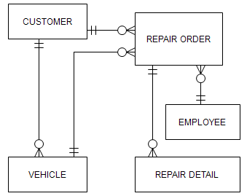
Database – An example
This diagram is an example of an entity relationship diagram (ERD).
This diagram is for the data used in an auto repair business.
This diagram depicts how the relational database is structured.

Slide 5
Databases – Why bother?
Databases are important because almost everyone—businesses, government agencies, schools, etc.—need to keep track of data over time.
Whether it is a business that wants to keep a record of its customers and its inventory or a non-profit agency that wants to keep track of donors and donations, storing and retrieving that information efficiently requires a database.
Information and data: A distinction is usually made between these two terms. Information is data organized in a way that is useful to someone—for example, a list of phone numbers and email addresses for employees in the marketing department sorted by last name. All the details about employees—first name, last name, phone number, pay rate, social security number, department, etc.—are the data stored in the database.

Slide 6
Database Management System (DBMS)
A DBMS is software that provides tools for building and managing a database.
Examples of relational DBMS software are:
  Microsoft Access
  SQL Server
  Oracle
  DB2
  MySQL

Slide 7
A brief introduction …
This presentation gave a short overview of relational databases.
Subsequent presentations will provide more detailed coverage.

Slide 8
Resources
Inside Relational Databases with Examples in ACCESS, Mark Whitehorn & Bill Marklyn, Springer Science-Business Media, 2007.
  This is not a database textbook but it is a good overview of relational databases written in a non-technical manner. The examples presented may be shown in Access but the concepts apply to any relational database. The authors even have a chapter on Codd’s rules for relational databases and, again, these are presented in the most non-technical way possible.
Microsoft Enterprise Consortium: http://enterprise.waltoncollege.uark.edu/mec.asp
  The consortium provides teaching material and large databases donated by some major corporations.
Microsoft Faculty Connection—Faculty Resource Center http://www.facultyresourcecenter.com/

