Slide 1
SQL Fundamentals
Microsoft Enterprise Consortium
Using two or more tables in a query
Microsoft Enterprise Consortium: http://enterprise.waltoncollege.uark.edu
Microsoft Faculty Connection/Faculty Resource Center http://www.facultyresourcecenter.com

Slide 2
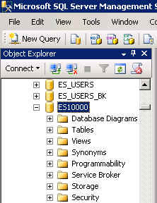
What you’ll need …
Log in to MEC for this lesson and into MSSMS (Microsoft SQL Server Management Studio).
  Be sure to select your account ID under Database in the Object Explorer pane, similar to the example shown here.
If there is something besides the topics for this lesson that you’re not familiar with in this presentation, please review earlier lessons in this SQL Fundamental series.

Slide 3
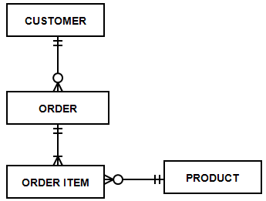
Using more than one table in a query
A relational database has many tables. Usually, you will want to combine information from two or more tables in a query.
For example, if you create a query to list sales orders for today, you may want to include customer information and product information along with the sales order data itself.
Based on this example data model, 4 tables would be used in the query to list sales orders for today if query includes customer names and product names.

Slide 4
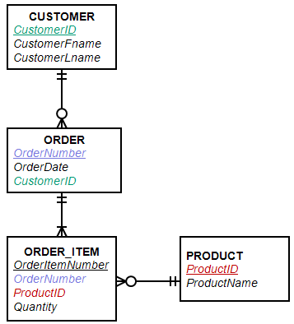
Joining tables in a query
Tables are joined or connected in a query based on a column they have in common.
For example, the CUSTOMER table is joined with the ORDER table through the CustomerID column each table has.
Order is joined to Order_Item through OrderNumber.
Order_Item is joined to Product through ProductID.
Customer.CustomerID = Order.CustomerID
Order.OrderNumber = Order_Item.OrderNumber
Order_Item.ProductID = Product.ProductID

Slide 5
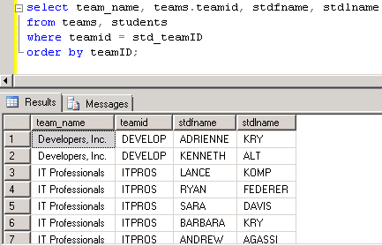
Using 2 tables in a query
The 2 tables must be joined in the query on column they have in common.
Show team names and students on each team.
/* Show the full team name and students on each team. Sort by team. */
select team_name, teams.teamid, stdfname, stdlname
from team, students
where teams.teamid = students.std_teamID
order by teamID;
When you display a column name that appears in more than one table, you may need to add the table name to the column name in the SELECT clause.
You have to do this if the column names are identical in each table. If you don’t put the table name first, you’ll get an error that the column is ambiguously defined.

Slide 6
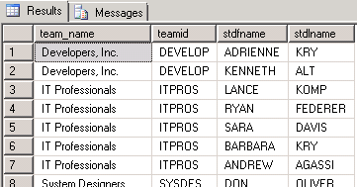
Two way to join tables: WHERE clause and JOIN operator.
There are 2 ways to join tables in a query.
WHERE Clause
select team_name, teams.teamID, stdfname, stdlname
from team, students
WHERE teams.teamid = students.std_teamID
order by teamID;
JOIN Operator in FROM clause
select team_name, teams.teamID,
stdfname, stdlname
from teams INNER JOIN students
ON teamID = std_teamID
order by teamID;

Slide 7
Which to use? WHERE clause or JOIN operator?
In many situations you can decide which method of joining tables you want to use.
There are a few situations in which the method of joining tables is not just a matter of choice. (The Advanced SQL series presents some examples of this.)

Slide 8
Using more than 2 tables in a query.
Take a look at using 3 tables in a query. We’ll try both methods to join the tables.
Show students and their evaluations as evaluatee.
Use the JOIN operator in the FROM clause.
INNER JOIN … INNER is optional and often omitted.
/* Show team name, teamd ID, student ID and name, semester,
year and evaluation ID for each student who was evaluated (evaluatee).
Sort by team name and student ID. */
/* Join with the JOIN operator in the FROM clause. */
select team_name, teams.teamID, stdid, stdfname, stdlname,
evalsemester, evalyear, eval_ID
from teams join students
on teams.teamID = students.std_teamid
join evaluations
on students.stdid = evaluations.evaluateeID
order by teamID, stdid;

Slide 9
Each JOIN has a temporary data set
Each JOIN creates a temporary data set and this data set is what is joined with the next JOIN operator.
/* Show team name, teamd ID, student ID and name, semester,
year and evaluation ID for each student who was evaluated (evaluatee). */
select team_name, teams.teamID, stdid, stdfname, stdlname,
evalsemester, evalyear, eval_ID
from teams join students
on teams.teamID = students.std_teamid
join evaluations
on students.stdid = evaluations.evaluateeID
order by teamID, stdid;
Team
Students
Team-Students
Team-students
Evaluations
Team-Students-Evaluations

Slide 10
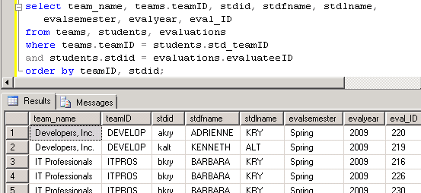
Joining 3 tables in the WHERE clause
Show students and their evaluations as evaluatee.
/* Join in the WHERE clause */
select team_name, teams.teamID, stdid, stdfname, stdlname,
evalsemester, evalyear, eval_ID
from teams, students, evaluations
where teams.teamID = students.std_teamID
and students.stdid = evaluations.evaluateeID
order by teamID, stdid;

Slide 11
What was covered …
How to use more than one table in a query.
Joining tables
  WHERE clause
  JOIN operator in the FROM clause

Slide 12
Resources
http://enterprise.waltoncollege.uark.edu/mec.asp
Microsoft Faculty Connection—Faculty Resource Center http://www.facultyresourcecenter.com/
Microsoft Transact-SQL Reference
http://msdn.microsoft.com/en-us/library/aa299742(v=SQL.80).aspx
AdventureWorks Sample Database
http://msdn.microsoft.com/en-us/library/ms124659%28v=sql.100%29.aspx

