Slide 1
SQL Fundamentals
Microsoft Enterprise Consortium
Aggregate data and the HAVING clause
Microsoft Enterprise Consortium: http://enterprise.waltoncollege.uark.edu
Microsoft Faculty Connection/Faculty Resource Center http://www.facultyresourcecenter.com

Slide 2
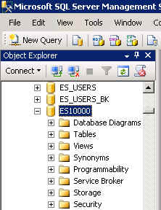
What you’ll need …
Log in to MEC for this lesson and into MSSMS (Microsoft SQL Server Management Studio).
  Be sure to select your account ID under Database in the Object Explorer pane, similar to the example shown here.
If there is something besides the topics for this lesson that you’re not familiar with in this presentation, please review earlier lessons in this SQL Fundamental series.

Slide 3
GROUP BY – aggregating data
Sometimes when we aggregate data, we also want to filter the output based on the aggregated values.
Before filtering, a school might want a list of how many students are in each course in the fall and spring semesters. The grouping shown here is based on the year, then by semester, then by course.
Year | Semester | Course | Student Count
2010 | Fall | ENG301 | 46
 | Fall | MAT301 | 35
 | Spring | ENG301 | 51

Slide 4
GROUP BY and HAVING
What if the list should only show classes with more than 40 students? If that’s the case, the aggregated data we saw on the previous slide would filter out one row.
Year | Semester | Course | Student Count
2010 | Fall | ENG301 | 46
 | Fall | MAT301 | 35
 | Spring | ENG301 | 51
Year | Semester | Course | Student Count
2010 | Fall | ENG301 | 46
 | Spring | ENG301 | 51

Slide 5
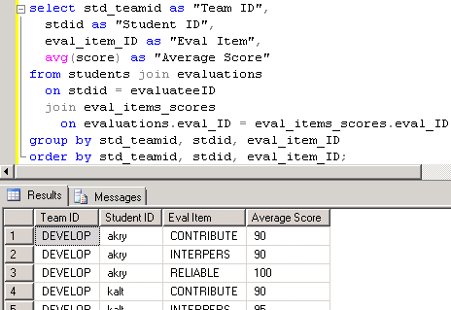
GROUP BY clause
First, let’s look at the aggregate query: Show the evaluation scores for each student in each team.
select std_teamid as "Team ID", stdid as "Student ID", eval_item_ID as "Eval Item", avg(score) as "Average Score”
from students join evaluations
on stdid = evaluateeID join eval_items_scores
on evaluations.eval_ID = eval_items_scores.eval_ID
group by std_teamid,
stdid, eval_item_ID
order by std_teamid,
stdid, eval_item_ID;

Slide 6
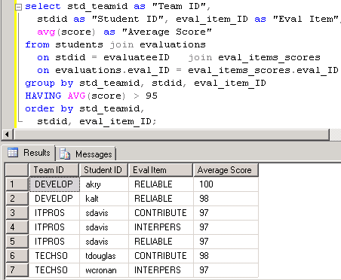
GROUP BY with a HAVING clause
Next, let’s add a filter criterion in the HAVING clause. Show the evaluation scores for each student in each team if their average is above 95.
select std_teamid as "Team ID", stdid as "Student ID", eval_item_ID as "Eval Item", avg(score) as "Average Score”
from students join evaluations
on stdid = evaluateeID
join eval_items_scores
on evaluations.eval_ID =
eval_items_scores.eval_ID
group by std_teamid,
stdid, eval_item_ID
HAVING avg(score) > 95
order by std_teamid,
stdid, eval_item_ID;

Slide 7
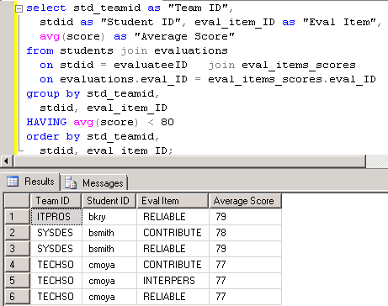
Another HAVING clause example
Next, let’s add a filter criterion in the HAVING clause. Show the evaluation scores for each student in each team if their average is below 80.
select std_teamid as "Team ID", stdid as "Student ID", eval_item_ID as "Eval Item", avg(score) as "Average Score”
from students join evaluations
on stdid = evaluateeID
join eval_items_scores
on evaluations.eval_ID =
eval_items_scores.eval_ID
group by std_teamid,
stdid, eval_item_ID
HAVING avg(score) < 80
order by std_teamid,
stdid, eval_item_ID;

Slide 8
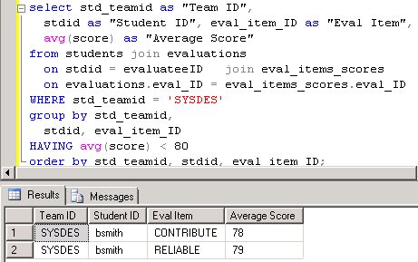
WHERE and HAVING clauses
We can filter individual rows in the WHERE clause and the aggregate values in the HAVING clause.
select std_teamid as "Team ID", stdid as "Student ID", eval_item_ID as "Eval Item", avg(score) as "Average Score”
from students join evaluations
on stdid = evaluateeID
join eval_items_scores
on evaluations.eval_ID =
eval_items_scores.eval_ID
WHERE std_teamid = 'SYSDES'
group by std_teamid,
stdid, eval_item_ID
HAVING avg(score) < 80
order by std_teamid,
stdid, eval_item_ID;

Slide 9
What was covered …
HAVING clause for aggregate values
  Filter output based on aggregate value criteria.
HAVING versus WHERE criteria
  Aggregate versus detail (row by row) criteria

Slide 10
Resources
http://enterprise.waltoncollege.uark.edu/mec.asp
Microsoft Faculty Connection—Faculty Resource Center http://www.facultyresourcecenter.com/
Microsoft Transact-SQL Reference
http://msdn.microsoft.com/en-us/library/aa299742(v=SQL.80).aspx
AdventureWorks Sample Database
http://msdn.microsoft.com/en-us/library/ms124659%28v=sql.100%29.aspx

