Slide 1
SQL Fundamentals
Microsoft Enterprise Consortium
Aggregating data
AVG(), SUM(), MIN(), MAX(), COUNT()
Microsoft Enterprise Consortium: http://enterprise.waltoncollege.uark.edu
Microsoft Faculty Connection/Faculty Resource Center http://www.facultyresourcecenter.com

Slide 2
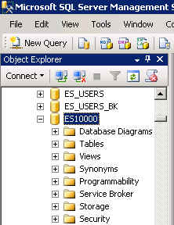
What you’ll need …
Log in to MEC for this lesson and into MSSMS (Microsoft SQL Server Management Studio).
  Be sure to select your account ID under Database in the Object Explorer pane, similar to the example shown here.
If there is something besides the topics for this lesson that you’re not familiar with in this presentation, please review earlier lessons in this SQL Fundamental series.

Slide 3
Aggregates
We often want to group data, also known as aggregating data.
For example, a school might want a list of how many students are in each course in the fall and spring semesters. The grouping would be based on the current year, then by semester, then by course.
Year | Semester | Course | Student Count
2010 | Fall | ENG301 | 46
 | Fall | MAT301 | 35
 | Spring | ENG301 | 51

Slide 4
Aggregates
Another example of aggregating data would be to list the current semester’s courses, the majors, and the number of students in each major. (You would filter the data for the current year and semester in the WHERE clause.)
Course | Major | Student Count
ENG301 | HIST | 17
 | EDUC | 19
 | BUS | 10
MAT301 | MATH | 15
 | BUS | 8
 | EEG | 12

Slide 5
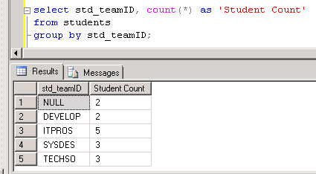
GROUP BY clause
The GROUP BY clause determines how data is grouped or aggregated. This comes after the WHERE clause, if one is used.
Aggregate functions—such as count, average, sum—are in the SELECT clause.
/* Show how many students are on each team. */
select std_teamID, count(*) as 'Student Count'
from students
group by std_teamID;

Slide 6
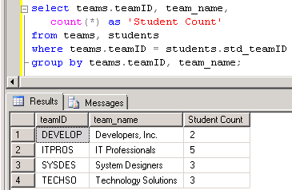
Grouping with more fields in the SELECT clause and GROUP BY clause.
Fields in the GROUP BY clause:
  The GROUP BY clause needs to include any fields in the SELECT clause that are not aggregate functions.
/* Show how many students are on each team. Show the full team name. */
select teams.teamID, team_name, count(*) as 'Student Count'
from teams, students
where teams.teamID = students.std_teamID
group by teams.teamID, team_name;

Slide 7
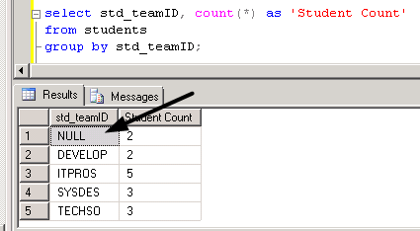
Just a comment for now …
Did you notice in the past two queries that one showed “null” for students without a team but the other query only shows students on teams?
When you join two tables, by default, you only get output for data that is found in both tables. The students without a team “disappear” because there’s no team ID value to link the student to the TEAMS table.

Slide 8
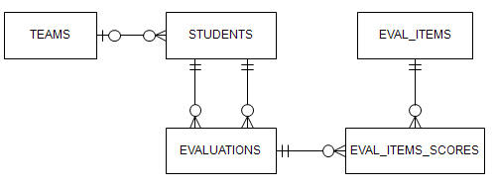
Using other aggregate functions
To see some of the other aggregate functions, let’s look at a student’s evaluation scores—average, maximum and minimum.
First, let’s review the data model to see what tables we will use. We’ll use 3 tables but only display information from 2.
Stdid = evaluateeID
evaluations.Eval_ID = eval_items_scores.Eval_ID

Slide 9
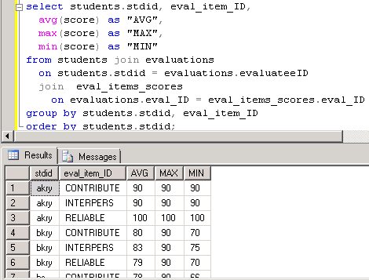
Aggregate functions: average, maximum, minimum
To see some of the other aggregate functions, let’s look at a student’s evaluation scores—average, maximum and minimum.
Used column aliases for clearer output.
Two JOINs joined the 3 tables.
GROUP BY has each column in the SELECT clause that isn’t an aggregate function.

Slide 10
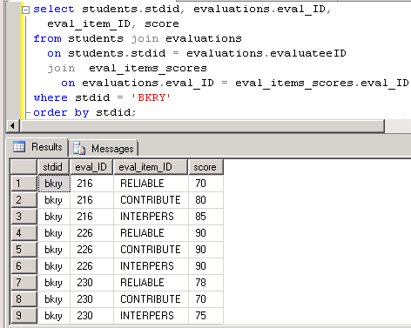
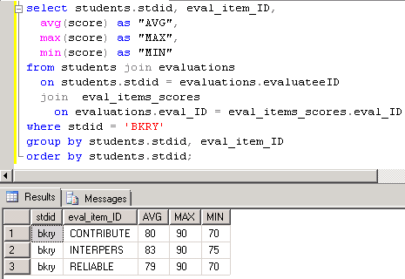
Compare detailed data versus aggregate data for a student.
Contribution:
80 + 90 + 70 = 240
240/3 = 80

Slide 11
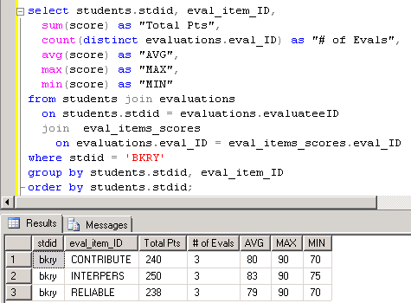
A few more aggregate functions.
sum(<field>)
count(distinct <field>)

Slide 12
What was covered …
How to group data using the GROUP BY clause.
Some aggregates functions
  COUNT() and COUNT(distinct)
  SUM()
  AVG()
  MIN()
  MAX()

Slide 13
Resources
http://enterprise.waltoncollege.uark.edu/mec.asp
Microsoft Faculty Connection—Faculty Resource Center http://www.facultyresourcecenter.com/
Microsoft Transact-SQL Reference
http://msdn.microsoft.com/en-us/library/aa299742(v=SQL.80).aspx
AdventureWorks Sample Database
http://msdn.microsoft.com/en-us/library/ms124659%28v=sql.100%29.aspx

