Slide 1
SQL Fundamentals
Microsoft Enterprise Consortium
Self-joins,
2 joins between 2 tables,
and table aliases
Microsoft Enterprise Consortium: http://enterprise.waltoncollege.uark.edu
Microsoft Faculty Connection/Faculty Resource Center http://www.facultyresourcecenter.com

Slide 2
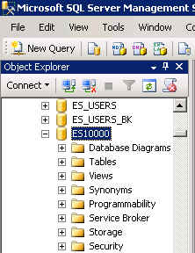
What you’ll need …
Log in to MEC for this lesson and into MSSMS (Microsoft SQL Server Management Studio).
  Be sure to select your account ID under Database in the Object Explorer pane, similar to the example shown here.
If there is something besides the self-join and table alias topics that you’re not familiar with in this presentation, please review earlier lessons in this SQL Fundamental series.

Slide 3

Self-joins
A unary relationship occurs when an entity (table) is related to itself. This is not that unusual in a database, by the way.
For this presentation we’ll use the Student-Teams database and we’ll also use a simple one-table example created just for this lesson.
EMPLOYEE: The ERD shown here shows that the employee table has a one-to-many relationship with itself.

Slide 4
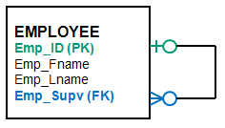
EMPLOYEE – A unary relationship
Why is the employee related to itself?
  An employee may report to another employee (supervisor).
  An employee may supervise zero to many employee (subordinates).
In the EMPLOYEE table example, emp_ID is the primary key.
Emp_Supv is the foreign key (this is the supervisor’s employee ID).
SELF-JOIN: If we want a list of employees and the names of their supervisors, we’ll have to JOIN the EMPLOYEE table to itself to get this list.

Slide 5
EMPLOYEE – Create table & insert data
To prepare for the self-join, create the employee table and insert data. (The SQL script is provided to instructors.)
Insert data.
CREATE TABLE dbo.employee(
emp_ID varchar(4) NOT NULL,
emp_Fname varchar(10) NULL,
emp_Lname varchar(10) NULL,
emp_Supv varchar(4) NULL,
CONSTRAINT PK_employee PRIMARY KEY(emp_ID) ,
CONSTRAINT FK_supervisor FOREIGN KEY(emp_Supv) REFERENCES employee(emp_ID));
insert into employee
(emp_id, emp_fname, emp_lname, emp_supv)
values ('1050', 'Carlo', 'Mora', NULL);
insert into employee
(emp_id, emp_fname, emp_lname, emp_supv)
values ('1062', 'Robert', 'Block', 1050);
insert into employee
(emp_id, emp_fname, emp_lname, emp_supv)
values ('1063', 'Teresa', 'Roberts', 1062);
insert into employee
(emp_id, emp_fname, emp_lname, emp_supv)
values ('1077', 'Carla', 'Stevens', 1050);
insert into employee
(emp_id, emp_fname, emp_lname, emp_supv)
values ('1080', 'Wilma', 'Washington', 1050);
insert into employee
(emp_id, emp_fname, emp_lname, emp_supv)
values ('1081', 'Rory', 'Block', 1062);

Slide 6
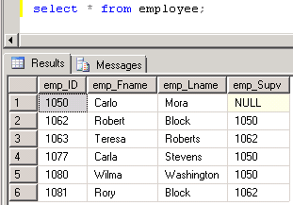
EMPLOYEE data
If you look at the employee data, you can figure out that Robert Block’s supervisor is Carlo Mora.
Carla Stevens and Wilma Washington also report to Carlo Mora.
Select * from employee;
How can we get the list of employees and their supervisors?

Slide 7
Using EMPLOYEE twice in a query.
We will use the EMPLOYEE table twice in the query. In order to do this we have to rename the table—give it an alias.
When we list the table in the FROM clause the table name is immediately followed by the table alias.
We’ll use sub (subordinate) and supv (supervisor).
select ...
from employee sub, employee supv
Where ...
You should decide on the aliases before typing the SELECT clause because you’ll use them in the SELECT clause.
select sub.emp_id as "Sub ID",
sub.emp_fname + ' ' + sub.emp_lname as "Subordinate",
supv.emp_id as "Supv ID",
supv.emp_fname + ' ' + supv.emp_lname as "Supervisor"
from employee sub, employee supv
where sub.emp_supv = supv.emp_id;

Slide 8
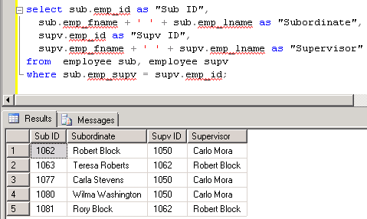
Self-join output: List of employees and their supervisors.
select sub.emp_id as "Sub ID",
sub.emp_fname + ' ' + sub.emp_lname as "Subordinate",
supv.emp_id as "Supv ID",
supv.emp_fname + ' ' + supv.emp_lname as "Supervisor"
from employee sub, employee supv
where sub.emp_supv = supv.emp_id;

Slide 9
Another need for table aliases:
Two joins between two tables
The Student-Teams database has two tables with two relationships.
To get the names of evaluatees and evaluators, we’ll need to use the STUDENTS table twice—one for each relationship to EVALUATIONS.
TEAMS
STUDENTS
EVAL_ITEMS
Evaluatee
Evaluator
EVALUATIONS
EVAL_ITEMS_SCORES

Slide 10
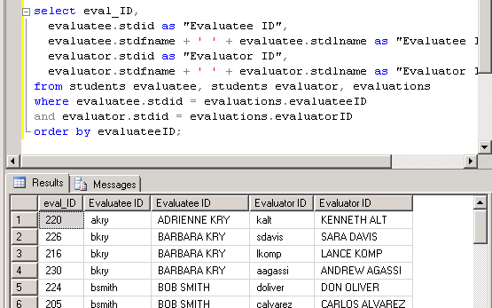
Another need for table aliases:
Two joins between two tables
/* List evaluatees and evaluators. Show the evaluation ID, student IDs and full names. */
We’ll use EVALUATEE and EVALUATOR as the table aliases for the STUDENTS table.
select eval_ID,
evaluatee.stdid as "Evaluatee ID",
evaluatee.stdfname + ' '
+ evaluatee.stdlname as "Evaluatee ID",
evaluator.stdid as "Evaluator ID",
evaluator.stdfname + ' '
+ evaluator.stdlname as "Evaluator ID"
from students evaluatee, students evaluator,
evaluations
where evaluatee.stdid = evaluations.evaluateeID
and evaluator.stdid = evaluations.evaluatorID
order by evaluateeID;
STUDENTS
Evaluatee
Evaluator
EVALUATIONS

Slide 11
What was covered …
Unary relationship
Self-join in a query
Table aliases
Joining the same two tables twice in a query

Slide 12
Resources
http://enterprise.waltoncollege.uark.edu/mec.asp
Microsoft Faculty Connection—Faculty Resource Center http://www.facultyresourcecenter.com/
Microsoft Transact-SQL Reference
http://msdn.microsoft.com/en-us/library/aa299742(v=SQL.80).aspx
AdventureWorks Sample Database
http://msdn.microsoft.com/en-us/library/ms124659%28v=sql.100%29.aspx

