Slide 1
SQL Fundamentals
Microsoft Enterprise Consortium
Set Operators: UNION,
INTERSECT,
EXCEPT
Microsoft Enterprise Consortium: http://enterprise.waltoncollege.uark.edu
Microsoft Faculty Connection/Faculty Resource Center http://www.facultyresourcecenter.com

Slide 2
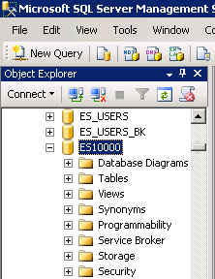
What you’ll need …
Log in to MEC for this lesson and into MSSMS (Microsoft SQL Server Management Studio).
Be sure to select your account ID under Database in the Object Explorer pane, similar to the example shown here.
If there is something besides the topics for this preentation that you’re not familiar with, please review earlier lessons in this SQL Fundamental series.

Slide 3
SET OPERATORS
There are 3 set operator commands:
UNION
INTERSECT
EXCEPT
UNION combines two or more data sets.
A
B
A and B
+
=

Slide 4
Set Operators: UNION
UNION: If the data sets overlap (have common data), the duplicates are removed.
UNION compatible rule: This rule applies to all 3 set operators.
The # of columns must be the same in both data sets.
The column data types must be in the same sequence and compatible. Example: Column 2 in both data sets must be have the same data type.
A
+
A and B
=
B

Slide 5
Set Operators: INTERSECT
INTERSECT: If the data sets overlap, only the overlap is in the result.
A
+
=
B

Slide 6
Set Operators: EXCEPT
EXCEPT: If the data sets overlap, only the portion not in common with the second data set is in the result.
A
+
=
B

Slide 7
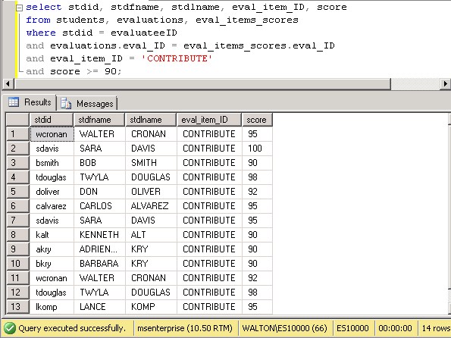
UNION example – p1
List students who got 90 or higher on their CONTRIBUTE evaluation item (they were evaluatees).
select stdid, stdfname, stdlname, eval_item_ID, score
from students, evaluations, eval_items_scores
where stdid = evaluateeID
and evaluations.eval_ID = eval_items_scores.eval_ID
and eval_item_ID = 'CONTRIBUTE'
and score >= 90;
The output has 14 rows.

Slide 8
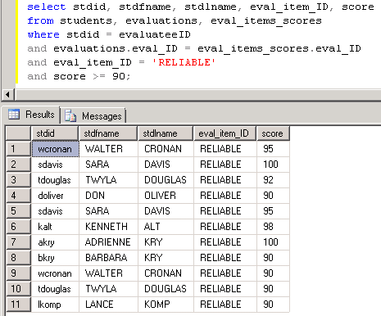
UNION example – p2
List students who got 90 or higher on their RELIABLE evaluation item (they were evaluatees).
select stdid, stdfname, stdlname, eval_item_ID, score
from students, evaluations, eval_items_scores
where stdid = evaluateeID
and evaluations.eval_ID = eval_items_scores.eval_ID
and eval_item_ID = 'RELIABLE'
and score >= 90;
The output has 11 rows.

Slide 9
UNION example – p3
UNION the lists to combine the output.
select stdid, stdfname, stdlname, eval_item_ID, score
from students, evaluations, eval_items_scores
where stdid = evaluateeID
and evaluations.eval_ID = eval_items_scores.eval_ID
and eval_item_ID = 'CONTRIBUTE'
and score >= 90
UNION
select stdid, stdfname, stdlname, eval_item_ID, score
from students, evaluations, eval_items_scores
where stdid = evaluateeID
and evaluations.eval_ID = eval_items_scores.eval_ID
and eval_item_ID = 'RELIABLE'
and score >= 90;

Slide 10
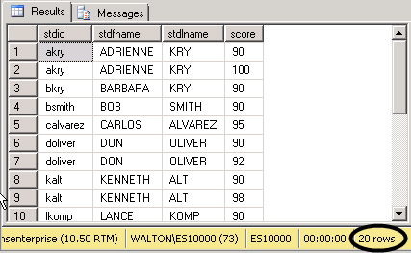
UNION example – p4
Remove the evaluation item ID column. This will reduce the list because some students were listed twice—once for CONTRIBUTE and once for RELIABLE.
The output drops to 20 rows.
select stdid, stdfname, stdlname, eval_item_ID, score
from students, evaluations, eval_items_scores
where stdid = evaluateeID
and evaluations.eval_ID = eval_items_scores.eval_ID
and eval_item_ID = 'CONTRIBUTE'
and score >= 90
UNION
select stdid, stdfname, stdlname, eval_item_ID, score
from students, evaluations, eval_items_scores
where stdid = evaluateeID
and evaluations.eval_ID = eval_items_scores.eval_ID
and eval_item_ID = 'RELIABLE'
and score >= 90;

Slide 11
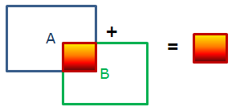
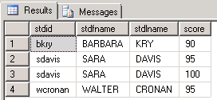
INTERSECT example
Change UNION to INTERSECT. Now, we see which students got 90 or higher in both CONTRIBUTE and RELIABLE>
select stdid, stdfname, stdlname, score
from students, evaluations, eval_items_scores
where stdid = evaluateeID
and evaluations.eval_ID = eval_items_scores.eval_ID
and eval_item_ID = 'CONTRIBUTE'
and score >= 90
INTERSECT
select stdid, stdfname, stdlname, score
from students, evaluations, eval_items_scores
where stdid = evaluateeID
and evaluations.eval_ID = eval_items_scores.eval_ID
and eval_item_ID = 'RELIABLE'
and score >= 90;

Slide 12
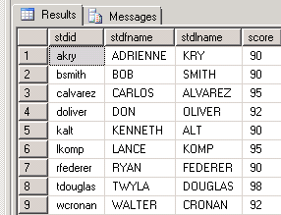
EXCEPT example
Now, use EXCEPT. We see which students got 90 or higher for CONTRIBUTE but didn’t for RELIABLE.
select stdid, stdfname, stdlname, score
from students, evaluations, eval_items_scores
where stdid = evaluateeID
and evaluations.eval_ID = eval_items_scores.eval_ID
and eval_item_ID = 'CONTRIBUTE'
and score >= 90
EXCEPT
select stdid, stdfname, stdlname, score
from students, evaluations, eval_items_scores
where stdid = evaluateeID
and evaluations.eval_ID = eval_items_scores.eval_ID
and eval_item_ID = 'RELIABLE'
and score >= 90;

Slide 13
What was covered …
Set Operators
UNION
INTERSECT
EXCEPT
UNION compatible rule

Slide 14
Resources
http://enterprise.waltoncollege.uark.edu/mec.asp
Microsoft Faculty Connection—Faculty Resource Center http://www.facultyresourcecenter.com/
Microsoft Transact-SQL Reference
http://msdn.microsoft.com/en-us/library/aa299742(v=SQL.80).aspx
AdventureWorks Sample Database
http://msdn.microsoft.com/en-us/library/ms124659%28v=sql.100%29.aspx

