Slide 1
SQL Fundamentals
Microsoft Enterprise Consortium
Create Student-Team Database
Microsoft Enterprise Consortium: http://enterprise.waltoncollege.uark.edu
Microsoft Faculty Connection/Faculty Resource Center http://www.facultyresourcecenter.com

Slide 2
What you’ll need …
For this and other SQL lessons, you need a user account from the Microsoft Enterprise Consortium. Get this account from your instructor.
Log in to your account for this lesson.
If you have not already done so, you need to create the Student-Team database and populate it with data (enter data in the tables).
Get the scripts (files with SQL commands) from your instructor.
The next few slides describe the steps you need to take to build this database.

Slide 3
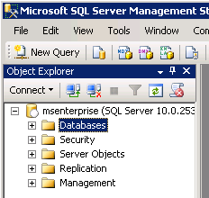
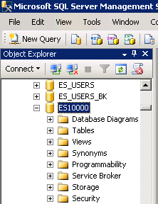
Object Explorer in MSSMS
In the Object Explorer select and expand the Database section.
Locate your account ID in the list NOT the account shown here.

Slide 4
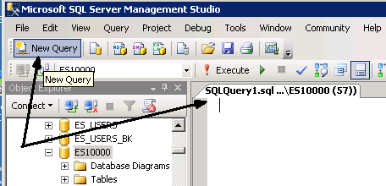
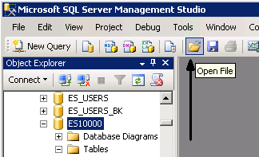
SQL pane
Either click New Query to open an SQL pane and paste in the contents of the “create” script OR …
Open the CREATE script file, which opens the SQL pane with the file contents.

Slide 5
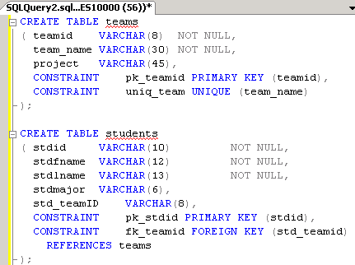
CREATE – Build tables & relationships.
The CREATE script contains several comments. You should read these to learn more about the Student-Teams database and the SQL commands this script.
The commands in this file show:
How to create a table by defining the columns it will contain.
How to define a primary key field.
How to define a foreign key field (a relationship).

Slide 6
Relationships and the CREATE TABLE sequence.
A data model shows the sequence in which tables are created in the database.
In a one-to-many relationship, the table on the “one” side is created first so that it already exists when the foreign key constraint is created in the “many” table.
The CREATE TABLE statements in the script are listed in the correct order. Execute these SQL commands.
Click
TEAMS
STUDENTS
EVAL_ITEMS
TEAMS is created before STUDENTS.
STUDENTS is created before EVALUATIONS.
EVAL_ITEMS and EVALUATIONS are created before EVAL_ITEMS_SCORES.
EVALUATIONS
EVAL_ITEMS_SCORES

Slide 7
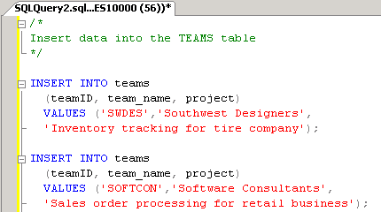
INSERT INTO – Populate the tables.
The INSERT INTO script has SQL commands to insert data into the tables in the Student-Team database.
First, you specify the table name after INSERT INTO.
Next, you list in parentheses the column names in the order in which the data is listed.
Each column name is separated by a comma.
Last, after VALUES the data values are listed in parentheses.
Each value separated by a comma.

Slide 8
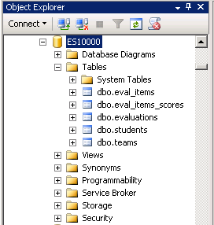
Student-Teams Database
Now you have the Student-Teams database in your MEC account. You can see the list of tables in the Object Explorer pane.
NOTE 1: Need to drop these tables? A script for deleting these tables is available. Also, MSSMS can generate these commands for you if you right-click a table then select SCRIPT TABLE AS ... DROP TO ....
NOTE 2: There are graphical tools that allow you to create tables and populate them without writing the SQL yourself. However, the purpose of these lessons is to learn SQL so we won’t use these tools right now.

Slide 9
What was covered …
How to create the Student-Teams database in your MEC account.
DDL
CREATE TABLE (Build tables and relationships)
DML
INSERT INTO (Populate tables with data)

Slide 10
Resources
http://enterprise.waltoncollege.uark.edu/mec.asp
Microsoft Faculty Connection—Faculty Resource Center http://www.facultyresourcecenter.com/
Microsoft Transact-SQL Reference
http://msdn.microsoft.com/en-us/library/aa299742(v=SQL.80).aspx

