Slide 1
SQL Fundamentals
Microsoft Enterprise Consortium
SELECT … FROM …
Microsoft Enterprise Consortium: http://enterprise.waltoncollege.uark.edu
Microsoft Faculty Connection/Faculty Resource Center http://www.facultyresourcecenter.com

Slide 2
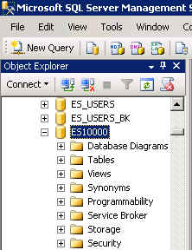
What you’ll need …
For this and other SQL lessons, you need a user account from the Microsoft Enterprise Consortium. Get this account from your instructor.
Log in to MEC for this lesson and into MSSMS (Microsoft SQL Server Management Studio).
Be sure to select your account ID under Database in the Object Explorer pane, similar to the example shown here.

Slide 3
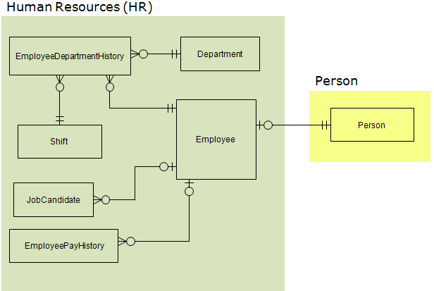
AdventureWorks
Microsoft provides an example database called AdventureWorks (AW). For the time being, only a subset of tables from this database will be used.
Shown here is the data model for the HR portion of the AW database. An additional table is included from the PERSON section of the database.

Slide 4
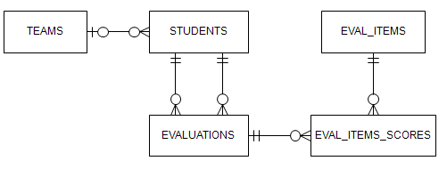
Student-Teams
This database keeps information about students, the teams they are assigned to and the peer evaluations students complete for their teammates at the end of a project.

Slide 5
SELECT … FROM
The SELECT statement has several components but let’s start with only the FROM clause.
A simple SELECT statement has the following format …
SELECT <column1>, <column2>, …
FROM <tablename>;
The angle brackets indicate words that change depending on what data we want to see.
Recommendation: Keep all the SQL commands you write for a lesson in a text file using Notepad. Do the same for SQL you write or assignments.

Slide 6
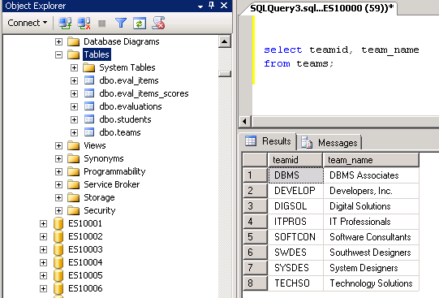
Query the Student-Team database
Open a Query pane (New Query).
Type the SQL in Notepad then copy/paste into the query pane. Add a comment.
Let’s start off by seeing what teams there are.
Enter two columns (teamID and team_name) in the SELECT clause.
List the table name in the FROM clause.
Execute the query.
/* Show teams */
select teamid, team_name
from teams;

Slide 7
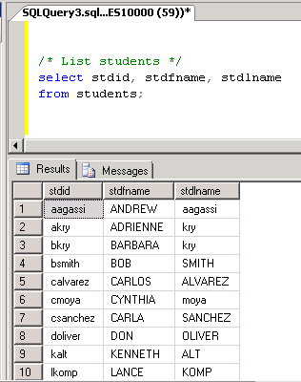
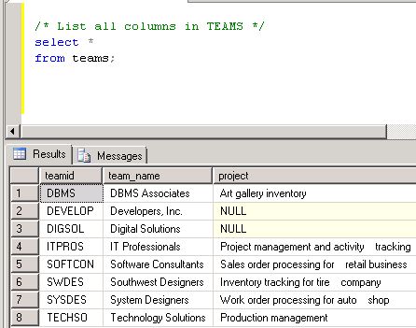
Query students & teams
Query the STUDENTS table and show the ID and full name of each student.
/* List students */
select stdid, stdfname, stdlname
from students;
Query the TEAMS table and show all columns.
The asterisk is a “wild card” that means to show all columns without listing them by name.
/* List all columns in TEAMS */
select *
from teams;

Slide 8
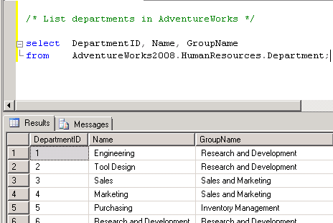
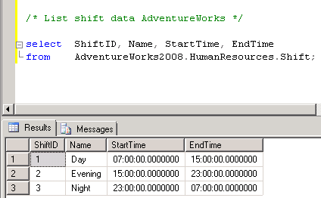
Query tables in AdventureWorks (AW)
The AdventureWorks database is not in your account. To query tables in other accounts, you need to add more information to the table name in the FROM clause.
In SQL below we specify the database or account name and the schema
databasename.schema.tablename
/* List departments in AdventureWorks */
Select DepartmentID, Name, GroupName
From AdventureWorks2008.HumanResources.Department;
Show information about shifts.
/* List shift data AdventureWorks */
Select ShiftID, Name, StartTime, EndTime
From AdventureWorks2008.HumanResources.Shift;

Slide 9
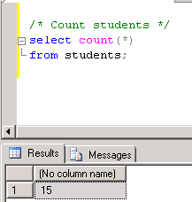
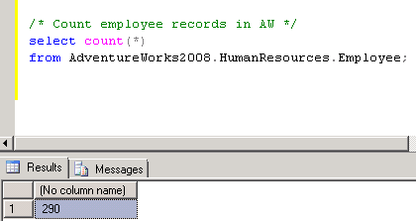
Count rows in a table
How many students are there?
/* Count students */
select count(*)
from students;
How many records are there in AW’s EMPLOYEE table?
/* Count employee records in AW */
select count(*)
from AdventureWorks2008.HumanResources.Employee;

Slide 10
What was covered …
SELECT … FROM …
SELECT * FROM …
SELECT Count(*) FROM …
<databasename>.<schema>.<tablename>
Databasename = database or account name
Schema = container of database objects

Slide 11
Resources
http://enterprise.waltoncollege.uark.edu/mec.asp
Microsoft Faculty Connection—Faculty Resource Center http://www.facultyresourcecenter.com/
Microsoft Transact-SQL Reference
http://msdn.microsoft.com/en-us/library/aa299742(v=SQL.80).aspx
AdventureWorks Sample Database
http://msdn.microsoft.com/en-us/library/ms124659%28v=sql.100%29.aspx

