Slide 1
SQL Fundamentals
Microsoft Enterprise Consortium
SQL Server Management Studio - Overview
Microsoft Enterprise Consortium: http://enterprise.waltoncollege.uark.edu
Microsoft Faculty Connection/Faculty Resource Center http://www.facultyresourcecenter.com

Slide 2
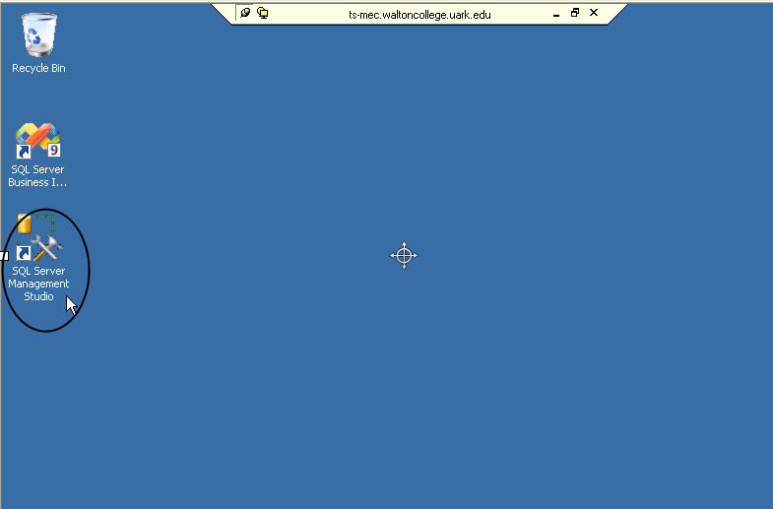
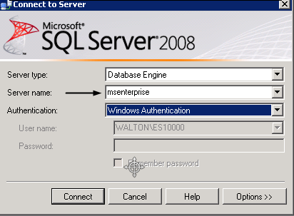
What you’ll need …
For this and other SQL lessons, you need a user account from the Microsoft Enterprise Consortium. Get this account from your instructor.
Log in to your account for this lesson, if you want to practice what is shown here.

Slide 3
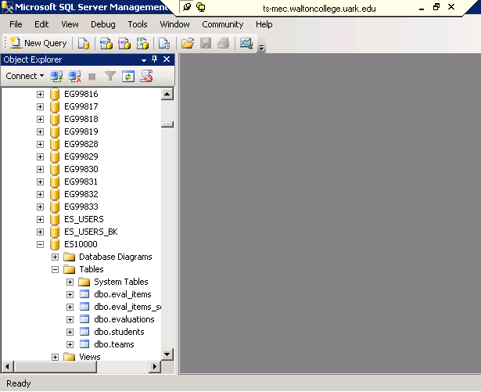
Object Navigator Pane
The Object Navigator provides a hierarchical view of databases maintained by a SQL Server installation.
Username (database name)
Schema name
Object name

Slide 4
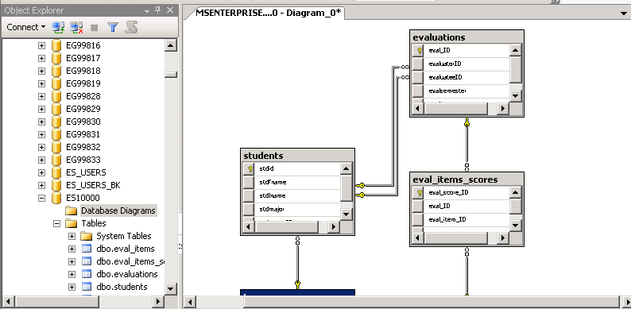
Database Diagram
An easy way to see how a list of tables comprise a database is to create a diagram.
This diagram shows the relationships between table.
For a database with a lot of table, such as AdventureWorks2008, you can select a subset of tables for a diagram.

Slide 5
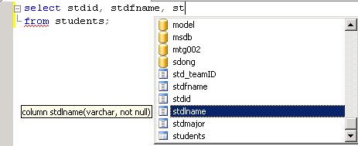
Query Editor Window
IntelliSense features helps you enter SQL code.
Suggestion: When writing SQL commands, enter the table(s) first to help IntelliSense feature help you.

Slide 6
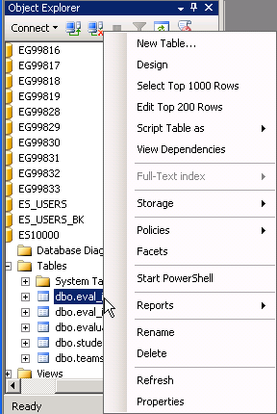
Object Navigator Context menu
The context-sensitive menu (right-click) gives you several options when working with objects such as tables.
Top 1000
Top 200
and more …

Slide 7
What was covered …
Microsoft’s SQL Server Management Studio.
Object Navigator pane
Database Diagram
Query Editor Window
Context-sensitive menu

Slide 8
Resources
http://enterprise.waltoncollege.uark.edu/mec.asp
Microsoft Faculty Connection—Faculty Resource Center http://www.facultyresourcecenter.com/
Microsoft Transact-SQL Reference
http://msdn.microsoft.com/en-us/library/aa299742(v=SQL.80).aspx
AdventureWorks Sample Database
http://msdn.microsoft.com/en-us/library/ms124659%28v=sql.100%29.aspx

