Slide 1
SQL Fundamentals
Microsoft Enterprise Consortium
SELECT … FROM … WHERE
Microsoft Enterprise Consortium: http://enterprise.waltoncollege.uark.edu
Microsoft Faculty Connection/Faculty Resource Center http://www.facultyresourcecenter.com

Slide 2
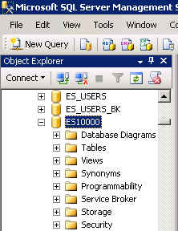
What you’ll need …
Log in to MEC for this lesson and into MSSMS (Microsoft SQL Server Management Studio).
Be sure to select your account ID under Database in the Object Explorer pane, similar to the example shown here.

Slide 3
SELECT … FROM … WHERE
Adding the WHERE clause to the SELECT statement allows you to filter output based on a criterion.
Syntax:
SELECT <column1>, <column2>, …
FROM <tablename>
WHERE <column> = <criterion>;
The syntax shown here checks whether data in a column equals the criterion. Of course, other evaluations can be used.

Slide 4
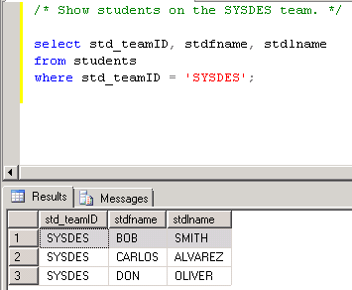
Query the Student-Team database
Open a Query pane (New Query).
Find out which students are on the Systems Designers (SYSDES) team.
/* Show students on the SYSDES team. */
select std_teamID, stdfname, stdlname
from students
where std_teamID = 'SYSDES';

Slide 5
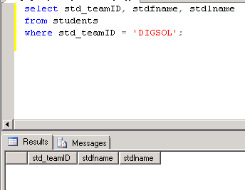
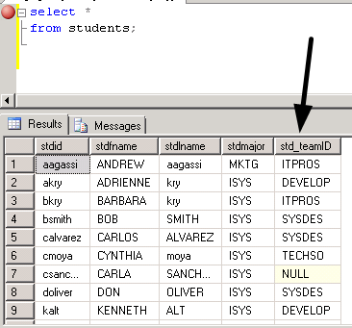
Find students on another team.
Which students are on the Digital Solutions team?
/* Show students on the DIGSOL team. */
select std_teamID, stdfname, stdlname
from students
where std_teamID = 'DIGSOL';
/* Show all student data.
Show that no one is on the DIGSOL team.*/
select *
from students;

Slide 6
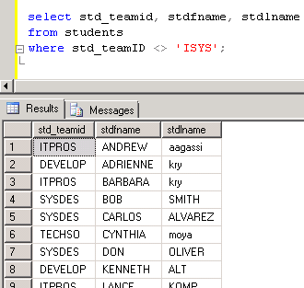
Filter students by major
Which students are majoring NOT in IS?
Use “not equal” for the evaluation.
/* Show students not majoring in information systems. */
select std_teamid, stdfname, stdlname
from students
where std_teamID <> 'ISYS';

Slide 7
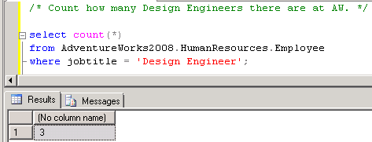
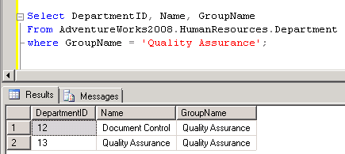
Query the AW database
Count how many AW employees are Design Engineers.
/* Count how many Design Engineers there
are at AW. */
select count(*)
from AdventureWorks2008.HumanResources.Employee
where jobtitle = 'Design Engineer';
Which departments are in the Quality Assurance group?
Select DepartmentID, Name, GroupName
From AdventureWorks2008.HumanResources.Department
where GroupName = 'Quality Assurance';

Slide 8
What was covered …
SELECT … FROM … WHERE
Using the WHERE clause to filter output.
Sometimes no output is the correct output.
Combine the count(*) function with a filter in the WHERE clause.

Slide 9
Resources
http://enterprise.waltoncollege.uark.edu/mec.asp
Microsoft Faculty Connection—Faculty Resource Center http://www.facultyresourcecenter.com/
Microsoft Transact-SQL Reference
http://msdn.microsoft.com/en-us/library/aa299742(v=SQL.80).aspx
AdventureWorks Sample Database
http://msdn.microsoft.com/en-us/library/ms124659%28v=sql.100%29.aspx

