Slide 1
SQL Fundamentals
Microsoft Enterprise Consortium
Logical operators in the WHERE clause
Microsoft Enterprise Consortium: http://enterprise.waltoncollege.uark.edu
Microsoft Faculty Connection/Faculty Resource Center http://www.facultyresourcecenter.com

Slide 2
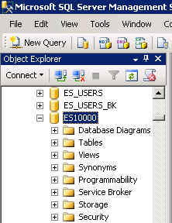
What you need …
Log in to MEC for this lesson and into MSSMS (Microsoft SQL Server Management Studio).
Be sure to select your account ID under Database in the Object Explorer pane, similar to the example shown here.
You need to be familiar with some of the concepts presented in earlier lessons in this SQL Fundamentals series.

Slide 3
Logical Operators: AND
The WHERE clause in the SELECT statement allows you to filter output based on a single criterion or several criteria.
To use more than one criterion in the WHERE clause you need to learn about logical operators.
AND
The AND operator specifies that two conditions be met.
For example: List employees in marketing who were hired before 2005.
Department = ‘marketing’
AND Hire date < 01/01/2005

Slide 4
Logical Operators: OR
OR
The OR operator specifies that at least one condition be met, though both may be.
For example: List employees who work in the Southwest or Northwest regional office.
Office location = Southwest
OR office location = Northwest

Slide 5
Logical Operators: Output for AND
Assume you have a SELECT statement with the AND operator in the WHERE clause. When is data displayed?
The table below shows the possible combinations when evaluating two conditions using the AND operator.
Condition 1 AND | Condition 2 | Display Data?
NO | NO | Don’t display.
YES | NO | Don’t display.
NO | YES | Don’t display.
YES | YES | Display.
YES means the condition is met.

Slide 6
Logical Operators: Output for OR
Assume you have a SELECT statement with the OR operator in the WHERE clause. When is data displayed?
The table below shows the possible combinations when evaluating two conditions using the OR operator.
Condition 1 OR | Condition 2 | Display Data?
NO | NO | Don’t display.
YES | NO | Display.
NO | YES | Display.
YES | YES | Display.
YES means the condition is met.

Slide 7
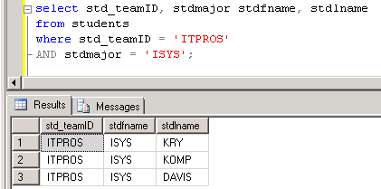
Query S-T database using AND operator
Show students in the ITPROS team with an ISYS major.
/* Show students in the ITPROS team AND with an ISYS major. */
select std_teamID, stdmajor, stdfname, stdlname
from students
where std_teamID = 'ITPROS' AND stdmajor = 'ISYS';

Slide 8
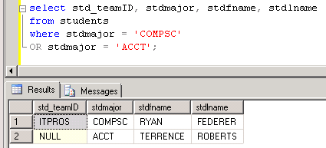
Query S-T database using OR operator
Show students majoring in computer science or accounting.
/* Show students who are majoring computer science (COMPSC) OR accounting (ACCT). */
select std_teamID, stdmajor, stdfname, stdlname
from students
where stdmajor = 'COMPSC' OR stdmajor = 'ACCT';

Slide 9
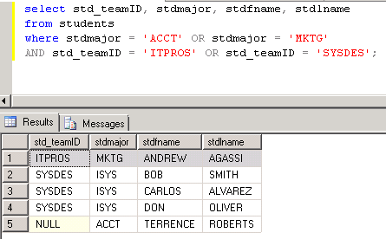
Using operator OR with AND
Show students majoring in accounting or marketing that are in team ITPROS or SYSDES.
/* Show students majoring in accounting OR marketing AND that are in the ITPROS team OR the SYSDES team.*/
select std_teamID, stdmajor, stdfname, stdlname
from students
where stdmajor = 'ACCT' OR stdmajor = 'MKTG'
AND std_teamID = 'ITPROS' OR std_teamID = 'SYSDES';
Is there a problem with this output?

Slide 10
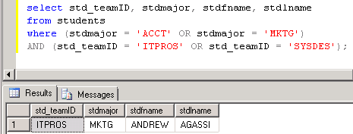
Using operator OR with AND
Show students majoring in accounting or marketing that are in team ITPROS or SYSDES.
/* Show students majoring in accounting OR marketing AND that are in the ITPROS team OR the SYSDES team.*/
select std_teamID, stdmajor, stdfname, stdlname
from students
where (stdmajor = 'ACCT' OR stdmajor = 'MKTG')
AND (std_teamID = 'ITPROS' OR std_teamID = 'SYSDES');

Slide 11
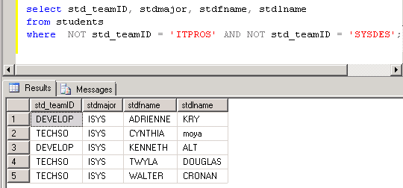
Logical Operators: NOT
You can use NOT to negate an evaluation.
Show students who are NOT in the ITPROS and SYSDES teams.
/* Show students who are NOT in ITPROS and NOT in SYSDES. */
select std_teamID, stdmajor, stdfname, stdlname
from students
where NOT std_teamID = 'ITPROS' AND NOT std_teamID = 'SYSDES';
Can you think of a way to write the SQL without using NOT?

Slide 12
What was covered …
Logical operators in the WHERE clause.
AND
OR
It is best to use parentheses around OR conditions.
NOT

Slide 13
Resources
http://enterprise.waltoncollege.uark.edu/mec.asp
Microsoft Faculty Connection—Faculty Resource Center http://www.facultyresourcecenter.com/
Microsoft Transact-SQL Reference
http://msdn.microsoft.com/en-us/library/aa299742(v=SQL.80).aspx
AdventureWorks Sample Database
http://msdn.microsoft.com/en-us/library/ms124659%28v=sql.100%29.aspx

