Slide 1
SQL Fundamentals
Microsoft Enterprise Consortium
Evaluating an inexact match and a value range
Microsoft Enterprise Consortium: http://enterprise.waltoncollege.uark.edu
Microsoft Faculty Connection/Faculty Resource Center http://www.facultyresourcecenter.com

Slide 2
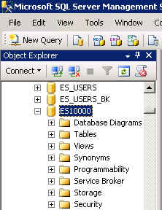
What you need …
Log in to MEC for this lesson and into MSSMS (Microsoft SQL Server Management Studio).
Be sure to select your account ID under Database in the Object Explorer pane, similar to the example shown here.
You need to be familiar with some of the concepts presented in earlier lessons in this SQL Fundamentals series.

Slide 3
Evaluating an inexact match
Sometimes the criterion in the WHERE clause of the SELECT statement is not precise.
For example: List students whose last starts with particular letter.
To evaluate for this we use LIKE instead of =
and we use a “wildcard” symbol to indicate anything else is acceptable. The symbol is the percent sign (%).

Slide 4
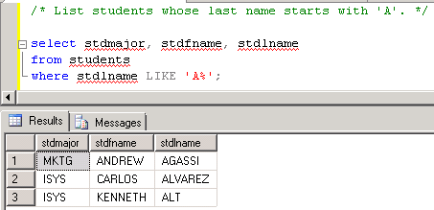
Query the Student-Team database
List students whose last name starts with the letter ‘A’.
/* List students whose last name starts with 'A'. */
select stdmajor, stdfname, stdlname
from students
where stdlname LIKE 'A%';

Slide 5
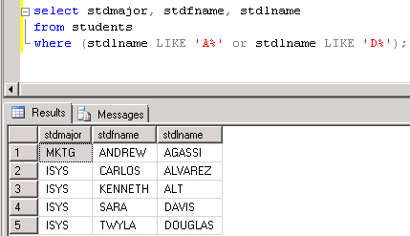
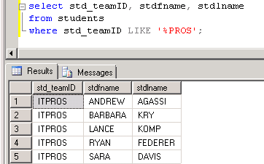
More examples using LIKE
List students whose last name starts with A or D.
/* List students whose last name starts with 'A' or "D'. */
select stdmajor, stdfname, stdlname
from students
where (stdlname LIKE 'A%' or
stdlname LIKE 'D%');
List students whose team name ends with PROS.
/* List students whose team ends with 'PROS'. */
select std_teamID, stdfname, stdlname
from students
where std_teamID LIKE '%PROS';

Slide 6
Evaluating a range of values
Sometimes the criterion in the WHERE clause of the SELECT statement is for a range of values.
For example: List employees with a salary between $25,000 and $45,000.
BETWEEN <starting value> AND <ending value>
The starting and ending values are included.

Slide 7
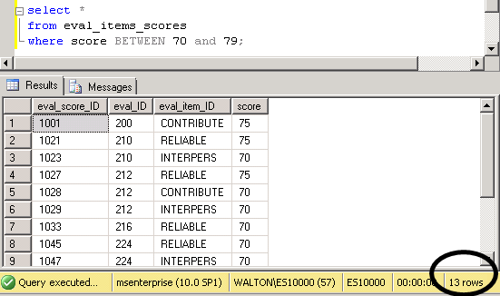
Example using a range of values
List evaluation item scores between 70 and 79.
select *
from eval_items_scores
where score BETWEEN 70 AND 79;

Slide 8
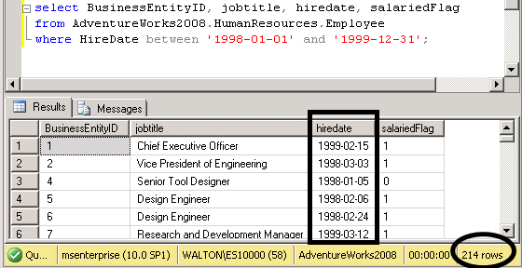
Evaluate a range of dates
In AW, list employees hired between 1998 and 1999.
/* List employees hired between 1998 and 1999. */
select BusinessEntityID, jobtitle, hiredate, salariedFlag
from AdventureWorks2008.HumanResources.Employee
where HireDate between '1998-01-01' and '1999-12-31';

Slide 9
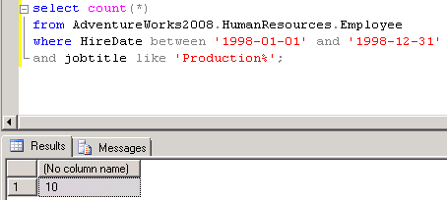
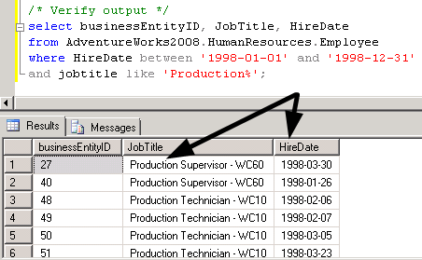
Evaluate a range of dates and other criteria
In AW, count how many people were hired in 1998 and work in production (job title starts with ‘Production’).
/* Count how many people were hired in 1998 who work in production
(job title starts with 'Production'). */
select count(*)
from AdventureWorks2008.HumanResources.Employee
where HireDate between '1998-01-01' and '1998-12-31'
and jobtitle like 'Production%';

Slide 10
What was covered …
Evaluating inexact matches in the WHERE clause using LIKE and %
Evaluating a range of values with BETWEEN … AND.

Slide 11
Resources
http://enterprise.waltoncollege.uark.edu/mec.asp
Microsoft Faculty Connection—Faculty Resource Center http://www.facultyresourcecenter.com/
Microsoft Transact-SQL Reference
http://msdn.microsoft.com/en-us/library/aa299742(v=SQL.80).aspx
AdventureWorks Sample Database
http://msdn.microsoft.com/en-us/library/ms124659%28v=sql.100%29.aspx

