Slide 1
SQL Fundamentals
Microsoft Enterprise Consortium
Sorting output (ORDER BY)
Column aliases
Concatenating columns
Calculated columns
Microsoft Enterprise Consortium: http://enterprise.waltoncollege.uark.edu
Microsoft Faculty Connection/Faculty Resource Center http://www.facultyresourcecenter.com

Slide 2
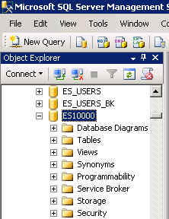
What you’ll need …
Log in to MEC for this lesson and into MSSMS (Microsoft SQL Server Management Studio).
Be sure to select your account ID under Database in the Object Explorer pane, similar to the example shown here.
If there is something besides the topics for this lesson that you’re not familiar with, please review earlier lessons in this SQL Fundamental series.

Slide 3
Sorting output
The more data your query displays the more likely you’ll want to sort the output.
ORDER BY – You add the ORDER BY clause to the SELECT statement to sort output.
SELECT <column1>, <column2>, <column3>
FROM <tablename>
WHERE <column1> = <criterion>
ORDER BY <column1>, <column2>;
The trick is to remember to not use the word SORT but ORDER.

Slide 4
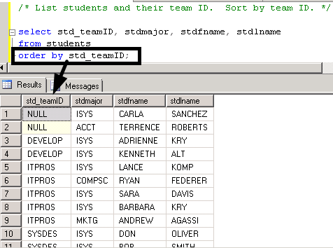
Sort output from the Student-Team database
List students and their team ID. Sort by team ID.
/* List students and their team ID. Sort by team ID. */
select std_teamID, stdmajor, stdfname, stdlname
from students
order by std_teamID;

Slide 5
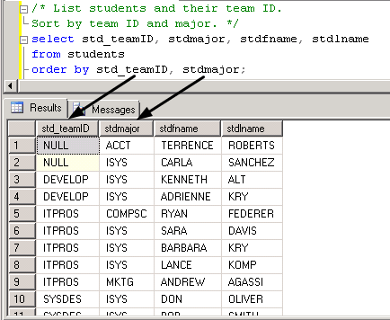
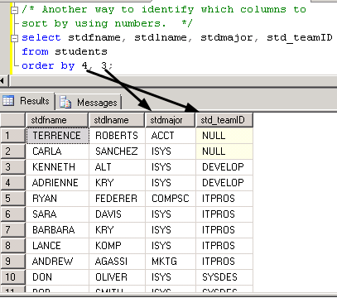
Sort by more than one column.
List students by team and major.
/* List students and their team ID. Sort by team ID and major. */
select std_teamID, stdmajor, stdfname, stdlname
from students
order by std_teamID, stdmajor;
/* Another way to identify which columns to sort by using numbers. */
select stdfname, stdlname, stdmajor, std_teamID
from students
order by 4, 3;

Slide 6
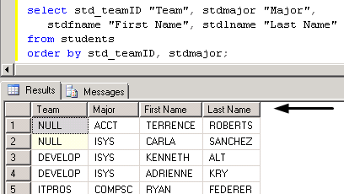
Column aliases improve readability
Columns in the output display can show standard text rather than field names.
/* Use column aliases column headings in output. */
select std_teamID "Team", stdmajor "Major",
stdfname "First Name", stdlname "Last Name"
from students
order by std_teamID, stdmajor;

Slide 7
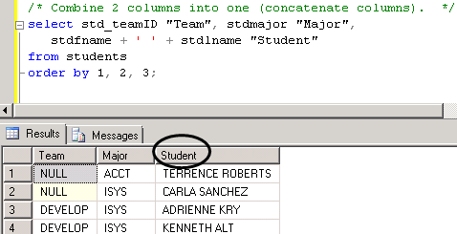
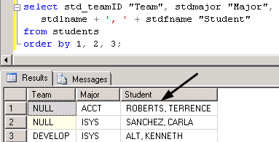
Combine columns into a single output column
Sometimes you can improve output readability by combining columns, also known as concatenated columns.
/* Combine 2 columns into one (concatenate columns). */
select std_teamID "Team", stdmajor "Major",
stdfname + ' ' + stdlname "Student"
from students
order by 1, 2;
select std_teamID "Team", stdmajor "Major",
stdlname + ', ' + stdfname "Student"
from students
order by 1, 2, 3;

Slide 8
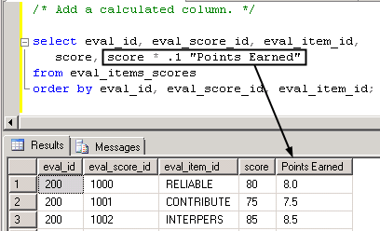
Creating a calculated column
The concatenated column we just created in one example of a calculated column. You can also actually do calculations.
/* Add a calculated column. */
select eval_id, eval_score_id, eval_item_id,
score, score * .1 "Points Earned"
from eval_items_scores
order by eval_id, eval_score_id, eval_item_id;

Slide 9
What was covered …
Sorting query output using ORDER BY.
Using column aliases to make easy-to-read column headings,
Using calculated columns.
Concatenating text columns into a single display column.
Calculating values and displaying them.

Slide 10
Resources
http://enterprise.waltoncollege.uark.edu/mec.asp
Microsoft Faculty Connection—Faculty Resource Center http://www.facultyresourcecenter.com/
Microsoft Transact-SQL Reference
http://msdn.microsoft.com/en-us/library/aa299742(v=SQL.80).aspx
AdventureWorks Sample Database
http://msdn.microsoft.com/en-us/library/ms124659%28v=sql.100%29.aspx

