Slide 1
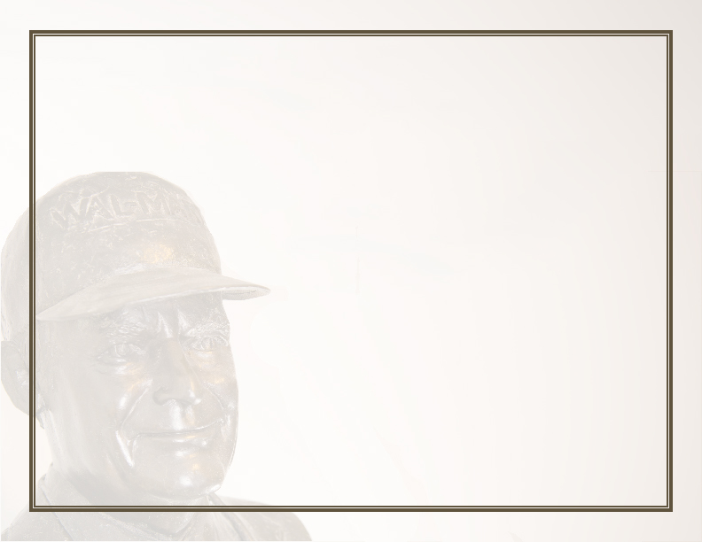



^{WALTON}
^{THIS IS TO CERTIFY THAT}
^{NAME}
HAS SUCCESSFULLY COMPLETED THE HONORS REQUIREMENTS FOR THE SAM M. WALTON COLLEGE OF BUSINESS
^{AND HAS THE HONORS LEVEL OF}
^{HONORS LEVEL}
^{MAJOR}
^{02/02/2025}
^{Brent Williams, Dean}
^{Date}

Slide 2
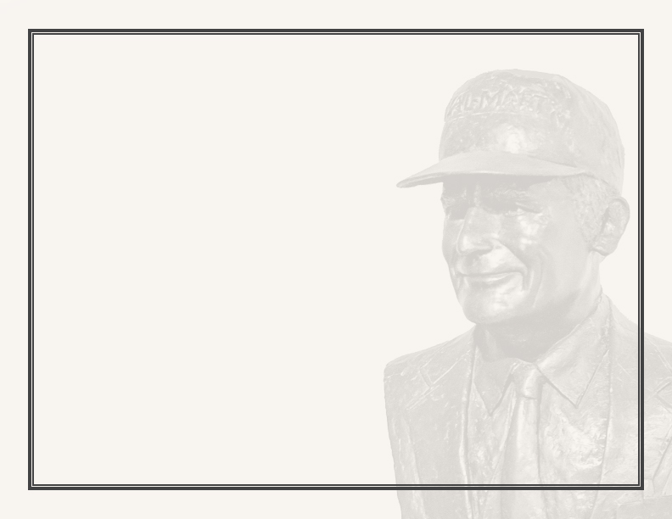

^{THIS IS TO CERTIFY THAT}
^{NAME}
HAS SUCCESSFULLY COMPLETED THE HONORS REQUIREMENTS FOR THE SAM M. WALTON COLLEGE OF BUSINESS
^{AND HAS THE HONORS LEVEL OF}
^{HONORS LEVEL}
^{MAJOR}
^{02/02/2025}
^{Brent Williams, Dean}
^{Date}

Slide 3
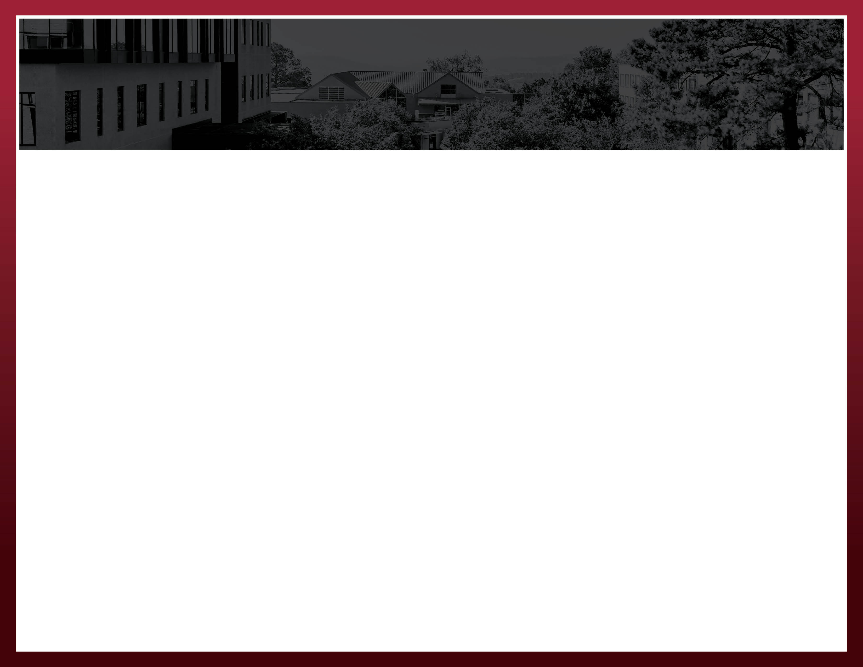

^{THIS IS TO CERTIFY THAT}
^{NAME}
HAS SUCCESSFULLY COMPLETED THE HONORS REQUIREMENTS FOR THE SAM M. WALTON COLLEGE OF BUSINESS
^{AND HAS THE HONORS LEVEL OF}
^{HONORS LEVEL}
^{MAJOR}
^{02/02/2025}
^{Brent Williams, Dean}
^{Date}

